Slide 1
Medical and Legal Perspectives of Medical Causation and Prevailing Factor
By: Dr. Robert Hagan, Neuropax Clinic
Bob Mandava, Hammond & Shinners, Attorneys at Law
Steve McManus, MVP Law

Slide 2
Phases of Medical Causation
Proving medical causation for original accident.
Proving medical causation to treat injuries.
Proving medical causation for award of future medical benefits.

Slide 3
Medical Causation: Injury caused by accident
Accident must be the PREVAILING FACTOR (PF) in causing both the resulting medical condition and disability.
PF: primary factor in relation to any other factor
Employee bears the burden of proof on all essential elements of his WC case.
Employee must establish a causal connection between the accident and injury.

Slide 4
Medical Causation: Injury caused by accident
Injury is deemed to arise out of and in the course of employment only if:
It is reasonably apparent,…, that the accident is the prevailing factor in causing the injury; and
It does not come from a hazard or risk unrelated to the employment to which workers would have been equally exposed outside of and unrelated to the employment in normal non-employment life.

Slide 5
Medical Causation: Injury caused by accident
If medical causation is within understanding of laypersons, expert medical testimony is not needed
If the case is a sophisticated injury requiring surgery or highly scientific techniques for diagnosis, and when there is a serious question of pre-existing disability, proof of medical causation is not within lay understanding.

Slide 6
Prevailing factor: factors to consider.
Mechanism of injury/history of injury.
Type of symptoms.
Onset of symptoms.
Pre-existing conditions/prior medical treatment.
Diagnostic studies.
Physical/clinical exam.
Response to treatment.

Slide 7
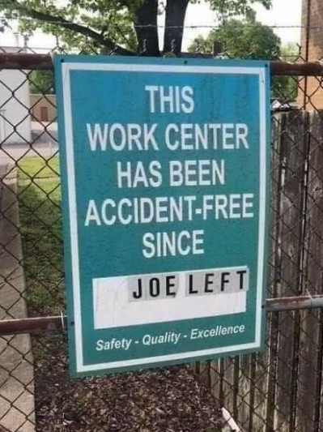
Mechanism of Injury
The mechanism of injury is something that the Court and Commission evaluate on a case-by-case basis.
More acute or forceful injuries are likely to be found compensable for aggravation than less forceful or traumatic accidents.
In Armstrong, the claimant was denied compensation when moving and lifting stacks of cardboard.
In Beatrice, the claimant was a nurse who received compensation after experiencing back pain when pushing a patient’s bed down a hallway.
Both of the above claimants had histories of back pain or injury in the relative areas they aggravated following their work accidents.

Slide 8
Medical Assessment for Causation
Information
History from patient
Exam of patient
Diagnostic tests
Old records
Old tests
Response to treatment
Opinion
Diagnosis
Identify old vs. new
Treatment plan

Slide 9
Prevailing Factor: Meniscal Tear
In Favor of:
Twisting mechanism
Pop/swelling
No/minimal arthritis
MRI positive
Positive physical exam
Against:
Old cartilage problems
Degenerative MRI
No pop/swelling
Pre-injury condition in records and studies.

Slide 10
Prevailing Factor: Upper extremity-repetitive trauma.
In Favor of:
Long-term repetitive work.
Sustained awkward or forceful gripping.
Not in risk factor group.
Positive EMG/NCV.
Against:
Short-term employment.
Negative EMG/NCV.
Risk Factor
Females over age of 50
Other peripheral nerve injury.

Slide 11
Employee Statements
Mechanism of injury—did something significant happen?
Was it:
Unique to the job?
An ordinary activity?
Walking?
Stairs?

Slide 12
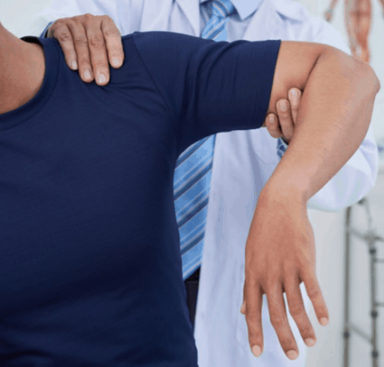
Mechanism of Injury
Knee
Twisting
Sudden deceleration/pop
Shoulder
Impingement
Torque/strains
Falls/fractures

Slide 14
Johnson v. Indiana Western Exp., Inc., 281 S.W.3d 885 (Mo. App. S.D. 2009)
The Claimant’s Argument: | The Employer’s Argument:
He aggravated a prior back condition when he was operating a trailer door that was pulled by a gust of wind. | Though the injury was to the same area of the back, the claimant was asymptomatic until the work injury. There was no difference in the MRI taken prior to the injury and the one taken after the injury.

Slide 15
Johnson v. Indiana Western Exp., Inc., 281 S.W.3d 885 (Mo. App. S.D. 2009)
The court held the new injury was not the prevailing factor and it was not compensable.

Slide 16
Gordon v. City of Ellisville, 268 S.W.3d 454 (Mo. App. E.D. 2008)
The Claimant’s Argument: | The Employer’s Argument:
He injured his right shoulder after having a previous rotator cuff repair. He alleged difficulties in performing activities that he did not have prior to the work injury. | The treating surgeon found that there was extensive damage to the rotator cuff that was not caused by an acute injury.

Slide 17
Gordon v. City of Ellisville, 268 S.W.3d 454 (Mo. App. E.D. 2008)
The court held that as there was no evidence of an acute injury, the work injury was not the prevailing factor and the claim was found to not be compensable.

Slide 18
Payne v. Thompson Sales Co. 322 S.W.3d 590 (Mo. App. S.D. 2010)
The Claimant’s Argument: | The Employer’s Argument:
Claimant alleged injury to his neck when shoveling ice and snow at work. He had prior cervical surgery that included removing a cervical bone. Despite working for six weeks without interruption or restriction, he alleged the work accident aggravated his prior neck condition. | The prior cervical surgery made the claimant’s cervical structure weaker. Claimant also had a history of smoking and degenerative disc disease. Claimant worked for six weeks without complaint before being diagnosed.

Slide 19
Payne v. Thompson Sales Co. 322 S.W.3d 590 (Mo. App. S.D. 2010)
The court held that as the claimant worked for six weeks after the injury with no complaint or restrictions, the injury was not compensable.

Slide 20
Maness v. City of De Soto 421 S.W.3d 532 (Mo. App. E.D. 2014)
The Claimant’s Argument: | The Employer’s Argument:
Claimant injured his neck when moving concrete stones. Claimant’s doctor testified that the work accident was the prevailing factor, as there were significant changes in his cervical spine when comparing an MRI prior to the accident and one taken after the accident. | Claimant had a prior history of motor vehicle accidents and was diagnosed with degenerative disc disease.

Slide 21
Maness v. City of De Soto 421 S.W.3d 532 (Mo. App. E.D. 2014)
The court held that the accident was the prevailing factor, and not merely an aggravation.

Slide 22
Whiteley v. City of Poplar Bluff 350 S.W.3d 70 (Mo. App. S.D. 2011)
The Claimant’s Argument: | The Employer’s Argument:
Claimant alleged an injury to his neck when cleaning his police car. None of the claimant’s prior injuries had been to the cervical spine and his neck had been asymptomatic prior to the work accident. | Claimant had a long history of injuries due to his bull riding career. He had degenerative disc disease in the thoracic spine

Slide 23
Whiteley v. City of Poplar Bluff 350 S.W.3d 70 (Mo. App. S.D. 2011)
The court held that the accident was compensable, as it was the prevailing factor in his condition.

Slide 24
Armstrong v. Tetra Pak, Inc., 391 S.W.3d 466 (Mo. App. S.D. 2012)
The Claimant’s Argument: | The Employer’s Argument:
Claimant alleged injury to his shoulder when he was reaching to move a stack of cardboard. | He had a history of prior injuries to the neck and upper extremities. An MRI found no significant tears but did find arthritis. A doctor opined that the mechanism of injury was could not have created clinical damage.

Slide 25
Armstrong v. Tetra Pak, Inc., 391 S.W.3d 466 (Mo. App. S.D. 2012)
The court held the claim was not compensable, as the MRI showed chronic, long-term, pre-existing issues.

Slide 26
Dierks v. Kraft Foods, 471 S.W.3d 726 (Mo. App. W.D. 2015)
The Claimant’s Argument: | The Employer’s Argument:
Claimant tore her meniscus after tripping over a hose. An MRI revealed the torn meniscus and significant arthritis to both knees. | The Employer argued that the meniscus was caused by the arthritis and that the claim should not be compensable.

Slide 27
Dierks v. Kraft Foods, 471 S.W.3d 726 (Mo. App. W.D. 2015)
The court held that since the claimant was asymptomatic prior to the work injury, the case was compensable.

Slide 28
Moore-Ransdell, 446 S.W.3d 699 (Mo. Ct. App. W.D. - July 29, 2014)
The Claimant’s Argument: | The Employer’s Argument:
Claimant injured her low back when squatting down and twisting to remove a file from a jammed bottom file drawer. The treating physician testified that the lumbar strain was the primary factor of the overall condition and that the workplace incident caused the degeneration of the spine to become symptomatic. | The claimant had prior back injuries.

Slide 29
Moore-Ransdell, 446 S.W.3d 699 (Mo. Ct. App. W.D. - July 29, 2014)
The Court held that the claim was compensable as although she had prior back issues, they were “well” before the injury and the symptoms she had were new as of her first visit with the treating physician.

Slide 30
Tillotson v. St. Joseph Medical Center
Dr. V and Dr. S agree that C suffered a torn lateral meniscus from the incident and had pre-existing degenerative arthritis.
Both agree she needed a total knee replacement to repair the conditions.
Dr. V stated both lateral meniscus and arthritis contributing to her present pain.
Dr. S stated “her pre-existing arthritis” is the major prevailing factor for the need for surgery (total knee).

Slide 31
Tillotson v. St. Joseph Medical Center
At the Court of Appeals:
Reverse and Remand Analysis: (1) Did C suffer accident by injury arising out of and in the course of employment; and (2) The appropriate compensation to be furnished.
Employer admitted accident, therefore, only question is on benefits.
it is immaterial that the treatment may have been required because of 1) complication of pre-existing conditions, or 2) the treatment will benefit the compensable injury and a pre-existing condition.
If accident admitted, C need only prove that the need for treatment and medication flow from the work injury. C need only prove that the treatment will cure and relieve him from the effects of the injury where accident is admitted.

Slide 32
Trends and Factors on Which the Commission and Court Rely
Evidence of Acute Injury
Many of the opinions made mention of whether medical records showed evidence of a new injury, or if medical testing (such as MRIs) looked similar to how they were when the claimants were evaluated for prior injuries.
In Johnson, Armstrong, Gordon, and Wilken, medical records did not show changes significant enough compared to the claimant’s prior injuries to warrant that the accident was the prevailing factor, and the courts held that the claims were not compensable.
In Maness and Holeman, the medical records showed significant changes and evidence of acute injuries, and the courts held that the claims were compensable.

Slide 33
Trends and Factors on Which the Commission and Court Rely
Treating physician testified to acute damage.
In Gordon, as the treating surgeon found that the claimant’s shoulder had been in its present condition prior to the work accident, the claim was not found compensable.
Conversely, in Dierks and Beatrice, the treating physicians testified to acute damage that was not there prior to the work accident and the courts held that the claims were compensable.
This can create a dilemma for the employer on denying claims knowing that the claimant will have surgery with an unauthorized surgeon.

Slide 34
Claimant had Been Asymptomatic or Working Job with No Problems Prior to Accident
The employer may need to investigate by doing hospital/medical clinic skip trace looking for medical records, as well as speak with co-employees regarding claimant's pre-existing condition.
In Whitley, Holeman, and Dierks, the claimants had been working for considerable amounts of time without complaint until after their work accidents, and the claims were deemed compensable.
In Gordon, as the claimant’s rotator cuff had been damaged for years prior to the work accident, the court held the case was non-compensable.

Slide 35
Questions?

