Slide 1
Telemedicine Perspectives:
Staying outside the box

Slide 2
Our panelists:
Kimberly Sumner, ARC Physical Therapy+
Gregg Smith, Conservative Care
Adrien Allen, CorVel
Cheryl Tinsley, Tinsley Risk Solutions, Moderator
Disclaimer: There are many ways to get to a positive outcome. We are not here to suggest you change all your team of providers! We hope to trigger a conversation to create positive outcomes for your organization.

Slide 3
Objectives:
#1 TBA
#2 TBA
#3 – consider the possibilities
#4 – stay outside the box

Slide 4
Perspective: Is Telemedicine New?
Prior to 2017
Nurse call lines
Cell phones with cameras
Popularity post-2020
Don’t close the box!

Slide 5
So Many Options
Format: Each panelist will speak about 8 minutes:
How their company is offering telemedicine
Successes and pitfalls
Other considerations
After each panelist speaks, will have Q&A time for all.

Slide 6
Advocacy 24/7: The Intake Process Re-Defined
Injured
Worker
Nurse
Concierge
Telehealth
Virtual Clinic Services Temporary Rx Card
Physical Therapy Referral Diagnostics Scheduled DME Delivered
Provider channeling App Assistance
4.6/5 Patient Satisfaction
Medical Care
Needed
Ancillary Service Utilization
4.8/5 Patient Satisfaction
PT: 16%
Diagnostics: 35%
DME: 27%
Rx: 45%
Triage Results
Self Care/First Aid
Facility Visit
31% Decrease in avg incurred 26% Decrease in avg days open
63% Decrease in litigation
Minor injuries
Temporary Rx Card
In-network Provider Driving Directions
Treatment Authorization
Report Only
Care^{MC}
FNOL

Slide 7
The successful management of workplace injuries begins with providing
immediate access to the right level of care for injured workers at the right time.
 | Brick & Mortar | Telehealth
Location | Avg Travel Time: 20 Min | At Job Site
Wait Time | 2 hours | 10 minutes
Time Away | 4 hours | 30 minutes
Ancillary Referral Rates
Narcotics Prescribed | 4% | 0%
Medications Prescribed | 59% | 45%
X-rays | 66% | 17%
DME | 67% | 22%
PT | 52% | 35%
Patient Satisfaction
Patient Satisfaction | 3.65 | 4.8
88%
reduction in time away from work
34%
reduction in medical spend
63%
Improvement in patient satisfaction
Notes:
I made the font bigger

Slide 8
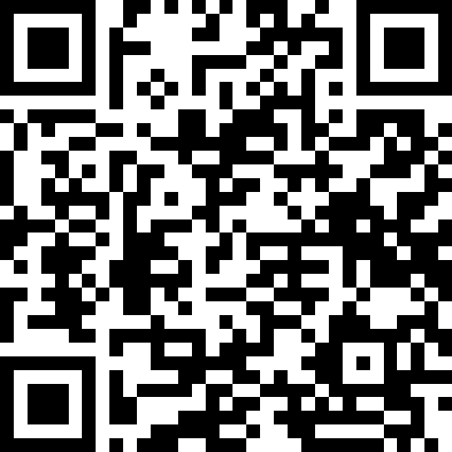
Improved front end processes and care accessibility can dramatically change the trajectory of patient outcomes.
Scan to see CorVel’s virtual care
white paper: An Evolution Underway

Slide 9
Telemedicine for Occupational Injury Treatment
Pros
Convenient for company and employee
Minimize lost production
Cons
Lack of diagnostic testing – X-ray
Post accident drug screens
Quality of the video platform
Reduced ability to evaluate physical cues
Concern that the video is being saved by the company
Non-secure video
Notes:
I have to pull my pants down to show you the large hematoma on my thigh. Who is recording me in my underwear?

Slide 10
Telemedicine for Occupational Injury Treatment
Is telemedicine right for my injury?
Head injury
Eye injury
Possible fracture
Sprains and strains
Minor lacerations
Contusions
1st visit vs. follow up visit

Slide 11
Telemedicine for Occupational Injury Treatment
Do you have the correct equipment for telemedicine?
Computer camera
Speakers
Cell phone
Tablet
Is telemedicine the correct method of injury treatment for this employee?
Notes:
Can you zoom in on an injury
Do you have cell phone reception in the area that you want to do the telemedicine visit
How are you going to hold or position the cell phone or tablet so the provider can see the injured employee
Who has the login information for the computer, cell phone, or tablet
Not all employees are the same
Some employees don’t like telemedicine and they feel like the company is taking the easy way out
Some employees are difficult and looking for any reason possible to cause the company pain

Slide 12
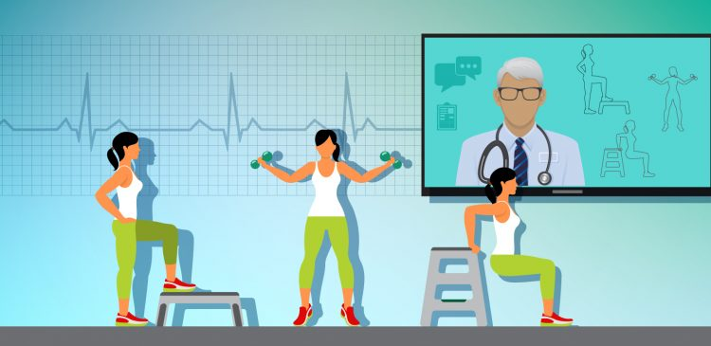
The PT/OT Telehealth Visit
Initial Evaluation
Subjective Exam- Thorough history extremely important
Objective Exam- Creativity Required
Treatment- HEP, education
Follow Up Visits
HEP progression
Recheck functional limitations
and aggravating factors
Progress Notes
R/A measurements from eval
Lift Testing/Job Related Tasks

Slide 13
OPPORTUNITIES
Accessibility
Decreased Mileage costs
Early intervention by work comp specialists
In Lieu of home health

Slide 14
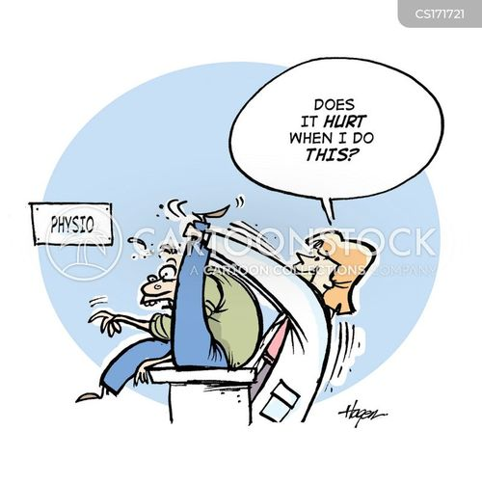
OBSTACLES
Physical limitations
Limited visual assessment
Equipment
Modalities
SOME THERAPY IS BETTER THAN NO THERAPY!!

Slide 15
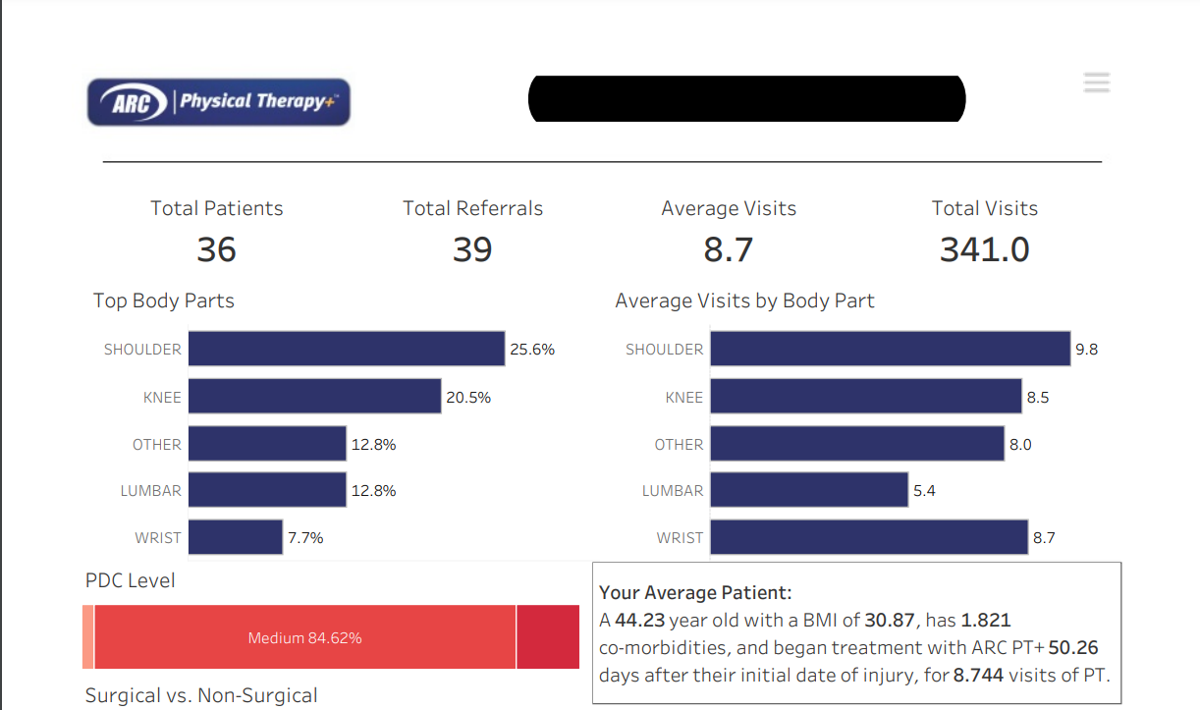
TAKE AWAYS
The sooner intervention (PT/OT) is begun the shorter the claim will be. Telehealth can be a tool to help with this.
Data from a health system ARC PT+ works with:
Average number of days from injury to begin PT/OT= 50 (Average among all employers we work with
is 3 months)
Average number
of visits per case: 8.7

Slide 16
Questions?

Slide 17
What Next?
Talk to vendors in exhibit hall – you have one more break time!
Talk to your team, including your current providers – there are many ways to reach a good outcome
Think outside the box!
Reach out to any of us with questions

Slide 18
Contact Information
Kimberly Sumner
ksumner@arcpt.com
Leslie Borden
lborden@arcpt.com
Gregg Smith
gsmith@ccohusa.com
Lane Sanders
lsanders@ccohusa.com
Adrien Allen
adrien_allen@corvel.com
Lucille DiMaria
Lucille_dimaria@corvel.com
Cheryl Tinsley, ARM, ABC
cheryl@tinsleyrisksolutions.com

