Slide 1
MO DOLIR DWC Fraud and Noncompliance Unit
2023 DWC Conference

Slide 3
The Fraud and Noncompliance Unit (FNU)
The FNU was created by the General Assembly in 1993 to investigate fraud and noncompliance of Chapter 287 RSMo (Workers’ Compensation Law).
The FNU has eight investigators, two supervisors, one support staff, and one manager.
The Unit is based in Jefferson City, with three investigators assigned in Kansas City, two in St. Louis, two in Columbia, one in Cape Girardeau, and another in Springfield.

Slide 4
The FNU Vision Statement
Vision Statement: To promote a safe, supportive, fair, and equitable work environment by preserving the integrity of Missouri’s Workers’ Compensation Law.
We do this through:
INVESTIGATION – investigate all allegations of fraud and failure to comply with the Workers’ Compensation Laws.
PREVENTION – provide education about the Workers’ Compensation Laws and requirements.
SERVICE – Focus on effectively and efficiently serving employers, employees, insurers, and all stake holders impacted by the Workers’ Compensation Laws.

Slide 5
The FNU Contact Information
Our message to employers, employees, insurers and all stakeholders is to contact us early so we can help!
Reporting:
fraudandnoncompliance@labor.mo.gov
1-800-592-6003
PO Box 1009, Jefferson City, MO 65102-1009
General inquiries:
www.labor.mo.gov
573-526-6630
573-526-1441 (FAX)

Slide 6
WHO Can Report to the FNU & 2022 FNU Stats.
ANY PERSON may file a complaint alleging fraud or noncompliance relevant to the Workers’ Compensation Laws.
In 2022, we conducted 389 investigations in 68 Missouri Counties, plus the City of St. Louis.
39% of the cases involved fraud allegations by employees, employers, and healthcare providers.
58% involved allegations of noncompliance (primarily failure to comply with the Workers’ Compensation Law’s requirements, failure to maintain coverage and failure to report an injury).

Slide 7
HOW to Report to the FNU & WHO Reports?
How to report to the FNU?
800#, email, DOLIR website, mail.
Who makes reports to the FNU (2022 Stats)?
Attorneys 7%
Employers 3%
Employees 18%
Insurers 12%
Healthcare 2%
Anonymous 58%
Others? Other state agencies (DES, DOI, etc), FNU inquiries.

Slide 8
The FNU Workflow
When an allegation is received by the FNU…
The manager reviews and forwards to a supervisor for investigator assignment.
The support staff enters the case into the case management system.
The investigator conducts the investigation.
At the conclusion of the investigation the investigator submits report to the supervisor with a recommendation for closure or referral.
The supervisor reviews the recommendation and refers to the manager with their recommendation.

Slide 9
FNU Reports
The manager reviews the case and recommendation, and either closes, or forwards to the Division Director for referral.
The Director reviews the case and may refer to the Division’s General Counsel’s Office or the Missouri Attorney General (pursuant to Chapter 287.128.8 RSMo).
ALL reports and records submitted or obtained by the FNU shall be confidential and not subject to the requirements of Chapter 610 RSMo (Sunshine Law).

Slide 10
What does the FNU Investigate?
Common cases the FNU investigates:
Employers who allegedly fail to insure their liability by not obtaining/ maintaining workers’ compensation insurance.
Failure to report an injury to the Division.
Invalid (fictitious or modified) certificates of insurance.
Fraudulent injury claims, denying prior injuries, false information to employers, insurers, medical providers regarding injuries, claiming a non-work injury as work-related, false statements to an injured worker/employee…all related to acquiring or interfering with a claim or obtaining or denying a benefit.

Slide 11
The Statute of Limitations
The Statute of Limitations (SOL) for prosecution of Workers’ Compensation Law violations (287.128 RSMo) is three years from the date of discovery of the offense by an aggrieved party.
Violations are misdemeanor or felony offenses.
May result in significant fines, imprisonment, or both.
However, many violations result in Deferred Prosecution Agreements (DPA’s).
Workers’ Compensation Law violations are a crime!
The law exists to ensure that Missouri workers receive the benefits they are entitled to, and that businesses operate on a level playing field and are protected from any unfair economic disadvantages, and civil liability.

Slide 12
WHO is Affected by the Workers’ Compensation Law?
Employers and Employees including Injured workers, co-workers, and the family’s of injured workers are subject to the provisions of the law.
There are some exemptions as detailed later in this presentation, such as:
Farm Labor, Domestic Servants (chauffeurs, house keepers, lawn care, etc.), volunteers of tax-exempt organizations, certain religious organizations.

Slide 13
What is “NONCOMPLIANCE”?
Noncompliance
Failure to insure liability pursuant to the Workers’ Compensation Law.
Failing to have workers’ compensation insurance (not insuring ones liability) puts employees at risk of not receiving benefits they are entitled to, subjects employers to civil liability, and can burden taxpayers with associated medical costs.
Employers who do not provide workers’ compensation insurance have an unfair economic advantage over employers who comply.
Failure to file a report of injury with the Division within 30 days.
Failure to abide by an Administrative Ruling or Award.

Slide 14
What is an “EMPLOYER”
The Workers’ Compensation Law defines an EMPLOYER as:
Every person, partnership, corporation, limited liability partnership or company, trustee, receiver, the legal representatives of a deceased employer, and every other person, including any corporation operating railroad and any public service corporation, using the service of another for pay;
The state, county, municipal corporation, township, school or road, drainage, swamp and levee districts, or school boards, board of education, regents, curators, managers or control commission, board or any other political subdivision, corporation, or quasi-corporation, or cities under special charter, or under the commission form of government;

Slide 15
What is an “EMPLOYER” FOR Workers’ Compensation
And…to be subject to Missouri’s Workers’ Compensation Laws they Must have five or more employees.
Unless they are a Construction industry employer (erect, demolish, alter or repair and make improvements). One or more employees (including themselves).
Unless election is made to become subject to the provisions of this chapter as provided in subsection 2 of section 287.090,
Employer’s family members are counted in the determination of the total number of employees.
Part-time employees also count in the determination of the total number of employees.
Any reference to the employer shall also include his or her insurer or group self-insurer.

Slide 16
Exempt Employers and Occupations
Exempt employers:
Farm labor, domestic servants in a private home, including chauffeurs, or occasional labor performed for and related to a private household;
Qualified real estate agents and direct sellers (sec 3508 of Title 26 US Code);
Volunteers of a tax-exempt organization which operates under the standards of Section 501(c)(3) or Section 501(c)(19), where such volunteers are not paid wages, but provide services purely on a charitable and voluntary basis;
Persons providing services as adjudicators, sports officials, or contest workers for interscholastic activities programs or similar amateur youth programs who are not otherwise employed by the sponsoring school, association of schools or nonprofit tax-exempt organization sponsoring the amateur youth programs.

Slide 17
Exempt Employers and Occupations
Exempt employers cont’d:
Person employed as an inmate confined in a state prison, penitentiary or county or municipal jail, or a patient or resident in a state mental health facility, and the labor or services of such inmate, patient, or resident are exclusively on behalf of the state, county or municipality having custody of said inmate, patient, or resident.
Nothing in this subdivision is intended to exempt employment where the inmate, patient or resident was hired by a state, county or municipal government agency after direct competition with persons who are not inmates, patients or residents and the compensation for the position of employment is not contingent upon or affected by the worker's status as an inmate, patient or resident.

Slide 18
Exempt Employers and Occupations
The mandatory coverage sections of this chapter shall not apply to the employment of any member of a family owning a family farm corporation or to the employment of any salaried officer of a family farm corporation organized pursuant to the laws of this state
Such family members and officers may be covered under a policy of workers' compensation insurance if approved by a resolution of their board of directors.
Nothing in this subsection shall be construed to apply to any other type of corporation other than a family farm corporation.
A corporation may withdraw from the provisions of this chapter, when there are no more than two owners of the corporation who are also the only employees of the corporation
By filing a notice of election to be withdrawn with the Division. Takes effect/continues from date of filing.
Withdraw by filing a notice with the Division. Takes effect thirty days after the date of the filing, or at date specified in the notice of withdrawal.

Slide 19
What is an “EMPLOYEE”
The Workers’ Compensation Law defines an employee as a person in the service of an employer…under any contract of hire, express or implied, oral or written, or under any appointment or election.
Some issues that commonly occur with identifying employees are:
Misclassification of employees
Subcontractors vs. employees

Slide 20
Employers & Employees
ALL officers of corporations and ALL members of Limited Liability Companies are considered employees, and count toward the total number of employees of the corporation/LLC.
As previously noted, a corporation may withdraw from the provisions of this chapter, when there are no more than two owners of the corporation who are also the only employees of the corporation.
Sole Proprietors and Partners DO NOT count as employees of their companies.

Slide 21
What is “FRAUD”?
Fraud occurs when someone knowingly makes or causes to be made any false or fraudulent material statement or material representation for the purpose of obtaining or denying any benefit.
Knowingly means intentional statements or actions to obtain or deny a benefit.
Material means any statements, forms, claims, actions intended to obtain or deny a benefit.
Fraud also includes preparing or providing Invalid certificates of insurance as proof of workers’ compensation insurance.

Slide 22
Failure to Report
Chapter 287.380.1 RSMo:
Every Employer or Insurer, whether they accept or reject the provisions of the Missouri’s Workers’ Compensation Law
Shall within 30 days after knowledge of the injury
File with the Division (DWC) a full and complete report of an injury or death to any employee for which the employer would be liable to furnish medical aid, treatment, lost time at work or compensation and furnish supplement reports as required.
Employers shall report all injuries to their insurance carrier, or third-party administrators, within 5 days of the date of the injury or within 5 days of the date on which the injury was reported to the employer by the employee, whichever is later.
The Insurer or third-party administrator SHALL be responsible for filing the Report of Injury to the DWC.

Slide 23
New to Our Unit 2023
Failure to Report Regulatory Plan
In 2023 the Division will initiate a Failure to Report Regulatory Plan.
The FNU will administer this plan with the addition of a Regulatory Auditor supported by a Regulatory Inspector.
Purpose - to ensure that injured workers’ reports of injury are received by the Division within the 30-day statutory requirement.
Goal – to increase injuring reporting compliance and ensure injured workers receive timely workers’ compensation benefits entitled under the Missouri Workers’ Compensation Law.

Slide 24
New to Our Unit 2023
The plan involves monitoring injuring reporting data received by the Division from insurers.
When late reports are identified, the insurer will be notified of their violations and assessed a $500 penalty per occurrence.
Refusal to cooperate may result in referral to the Attorney General’s Office for prosecution, and if found guilty, their ability to do business in Missouri could be impacted.

Slide 25
New to Our Unit 2023
Plan will initiate in 2023 with the notification phase
All insurers and TPA’s (Third Party Administrators) will receive notification of the plan and a list of late reports from the previous quarter.
This notification will provide the statutory requirement for reporting, and detail the need for corrective action to prevent future violations.
It will also explain that in 2024, the Division will begin the penalty phase, where penalties will be assessed for new violations.

Slide 26
New to Our Unit 2023
Religious Exceptions
In May of 2023 the FNU took over administrating the Religious Exceptions program for the Division
What is a Religious Exception
In accordance with Missouri law, an employee may request an exception from the provisions of the workers’ compensation law in respect to certain employees, who are;
Members of a recognized religious sect or division, as defined in 26 U.S.C. 1402 (g), by reason;
They are conscientiously opposed to accepting public or private insurance benefits, including benefits of any insurance system established under the Federal Social Security Act.

Slide 27
New to Our Unit 2023
Eligibility
Commissioner of Social Security must find that:
The religious sect or division has the established benefits or teachings previously mentioned.
The practice for the members of such sect or division to provide for their dependent members, which is reasonable in view of their general level of living.
The religious sect or division thereof has been in existence at all times since December 31, 1950.

Slide 28
New to Our Unit 2023
Those requesting religious exceptions must submit:
Employee’s Application for Religious Exception from the provisions of the Missouri Workers’ Compensation law,” (WC-138)
Employee’s Affidavit and Waiver of Workers’ Compensation Benefits (WC-138-3)
Employer’s Affidavit of Exception from Workers’ Compensation Benefits (WC-138-5)
If the Division grants the religious exception, the employee waives his/her rights to any benefits under the workers’ compensation law.

Slide 29
New to Our Unit 2023
Employer Exemptions
In 2023, the FNU will also take over administering Employer Exemptions program
Employer Exemptions as previously noted:
A corporation may withdraw from the provisions of this chapter, when there are no more than two owners of the corporation who are also the only employees of the corporation
By filing a notice of election to be withdrawn with the Division. Takes effect/continues from date of filing.
Withdraw by filing a notice with the Division. Takes effect thirty days after the date of the filing, or at date specified in the notice of withdrawal.

Slide 30
New Employer?
Re Workers’ Compensation, new employers should consider:
…the type of business.
…how many employees.
…the definition of an employee.
…how, when, and who to report to if an employee is injured.
Most questions can be answered by accessing the Division website: www.labor.mo.gov/dwc

Slide 31
Post the Notice
Employers SHALL post a notice at their place of employment and/or notify each employee:
The employer is operating under the provisions of the Workers’ Compensation Law.
Employees MUST report injuries immediately to their employer within thirty (30) days or they MAY lose their right to compensation.
The Insurer or designated person’s contact information and the DWC 800#.
That fraudulent activity by an employer, employee, or other person is unlawful.

Slide 32
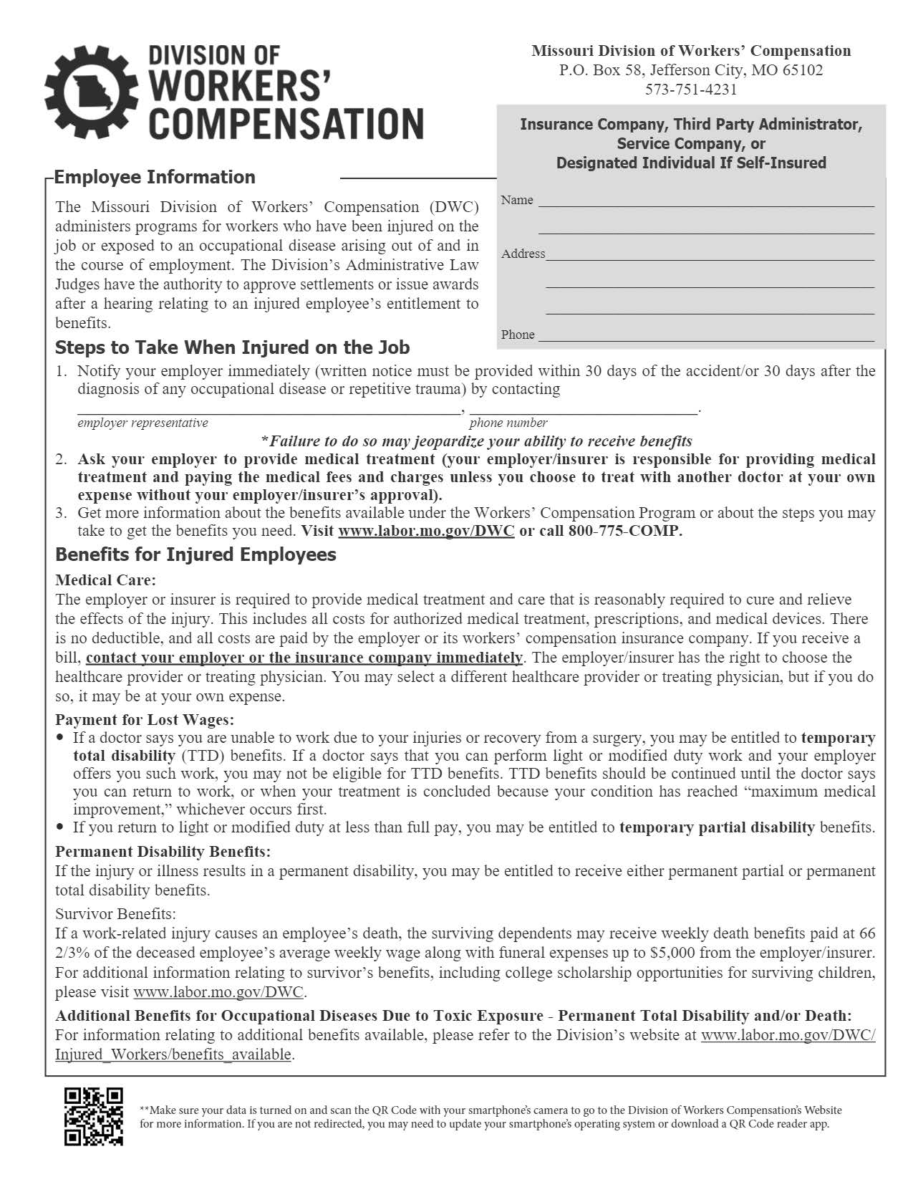
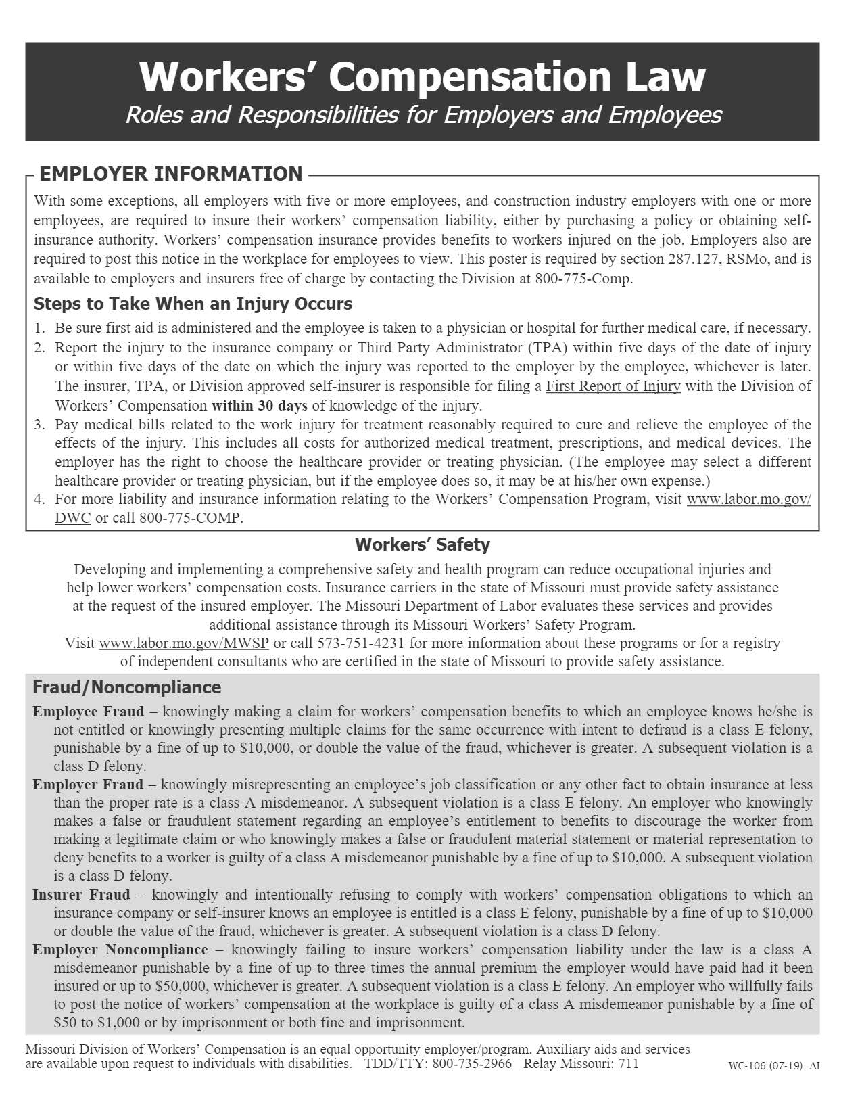

Slide 33
FAQ
I have an injured employee who is collecting TTD (temporary, total disability) and working at another job. Isn’t that fraud?
It depends. Collecting TTD and working at another job is not in and of itself fraud. If the other job requires less stringent physical duties than the restrictions related to the work injury, it is likely the employee is not violating the law. A key element of the law is the representation of a material fact in order to obtain a benefit.
If the employee is asked about working and they deny doing so, that COULD be a violation.

Slide 34
FAQ
I have a video of an injured employee violating a doctor’s restrictions. The video shows the employee building a barn on his property. Has the employee violated the Workers’ Compensation Law?
Maybe. Did anyone ask:
How has your injury affected your ability to perform daily functions?
If there is evidence that a fraudulent statement was made to someone (medical provider, employer, insurer) in a position to determine if a benefit is paid…then probable cause of fraud may exist.

Slide 35
FAQ
I have a business in Missouri AND Kansas. I have three employees in Missouri and five in Kansas, plus some others in both states that are part-time. I don’t have to have workers’ compensation insurance in Missouri because I only have three full-time employees there, right?
No. The law does not state five employees in Missouri. If the sum of all employees for the business is five or more (one or more for construction), then the employer must carry workers’ compensation insurance. The Law views this business as having at least eight employees.
Also, the Law does not differentiate between full-time or part-time employees.

