Slide 1
Before and After:
A 2-Part Method for Improving Safety & Claims Outcomes
Mark Woodward, Sr. Safety and Risk Trainer

Slide 2
BREAKING DOWN YOUR RISK MANAGEMENT PLAN INTO TWO MAIN COMPONENTS
BEFORE
THE INCIDENT
AFTER
THE INCIDENT
1
2
SAFETY & RISK MANAGEMENT
INJURY MANAGEMENT PLAN

Slide 3
When was the last time your written safety expectations were 100% reviewed with employees, and signed?
When was the last safety meeting all your employees attended?
Does anyone perform inspections / observations to verify safety rules are being followed?
When was the last time written corrective action occurred after an unsafe act / behavior / condition?

Slide 4
Each safety rule matters… The only way to make a safety rule effective:
The written rule…
Followed by training & educating that rule…
Followed by auditing to verify / validate the rule is being followed
Followed by a corrective action / incentive

Slide 5
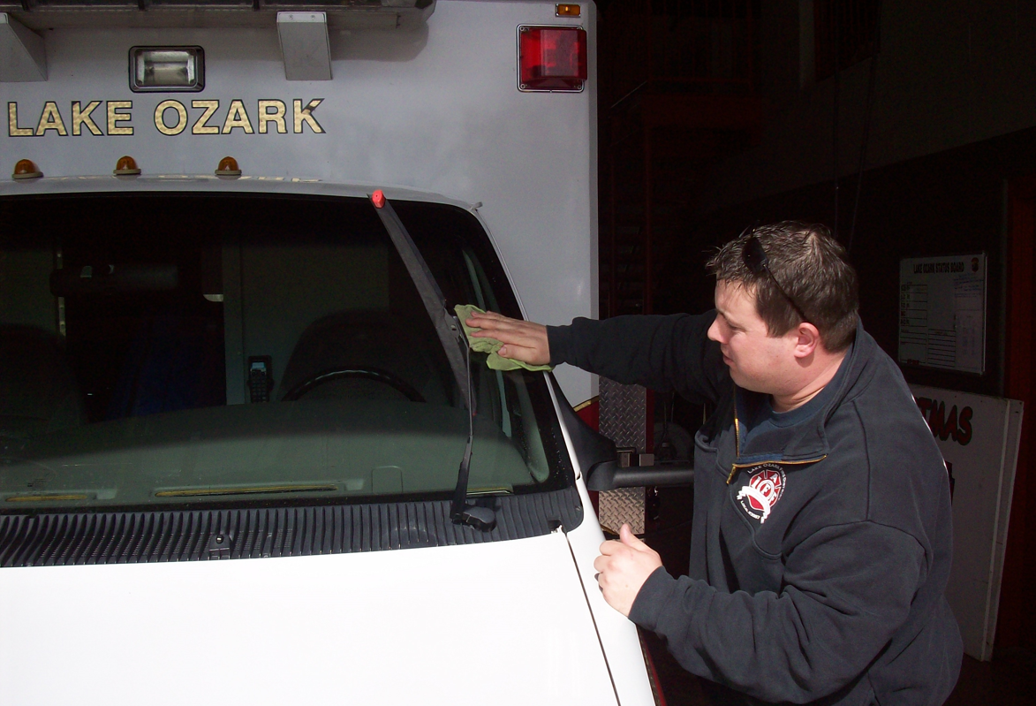
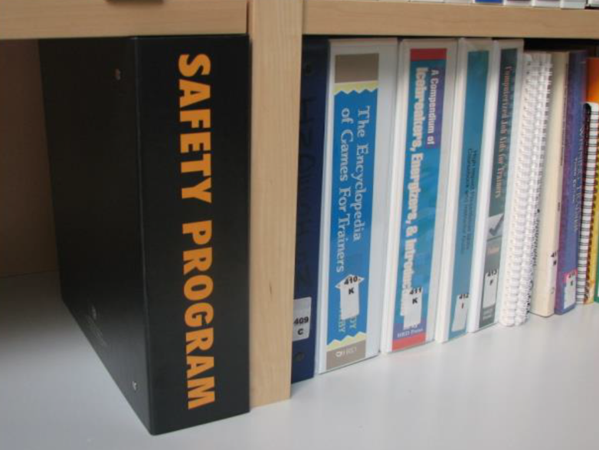
Does your safety program (actually) affect behavior?
Are the rules part of daily work life?

Slide 6
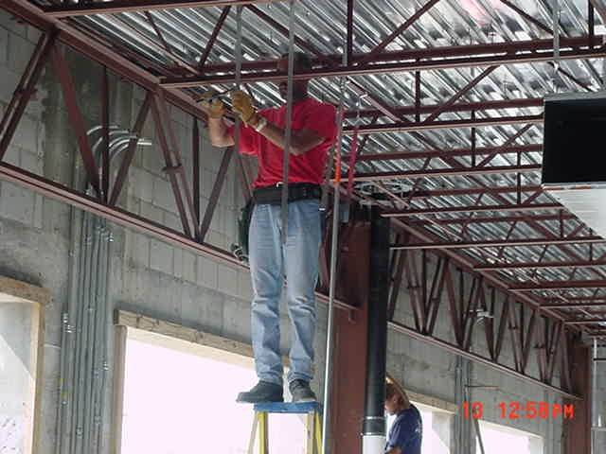
REMEMBER THE HUMAN ELEMENT!
Will this activity cause an “accident”?

Slide 8
Routine and Regular Safety and Workers Compensation Claim Problems
Lack of timely reporting of injuries and incidents
Lack of incident investigation and incident facts
No drug-free workplace program
No written safety rules
No directed medical care
No timely return-to-work program
No proof / documentation of safety enforcement

Slide 9
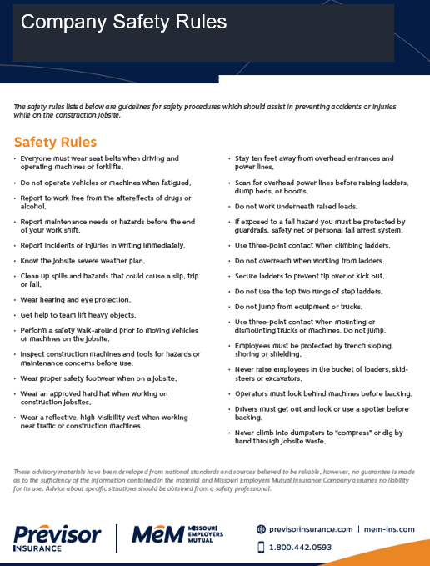
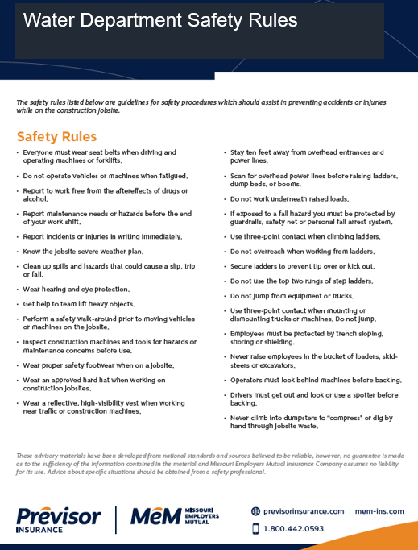
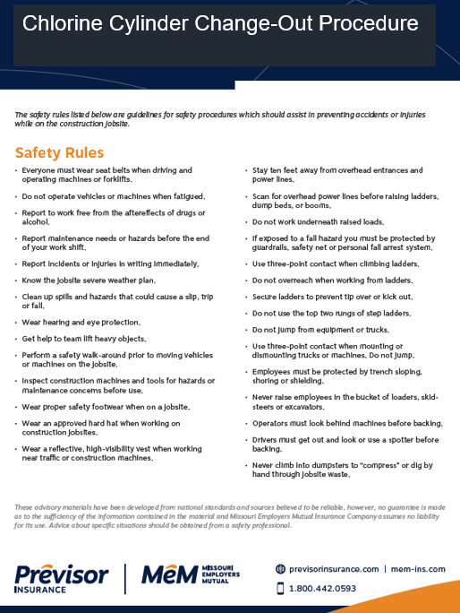
OVERALL COMPANY SAFETY PLAN
SAFETY RULES FOR MAJOR JOBS, TASKS, DUTIES
MACHINE, TOOL OR JOB-SPECIFC RULES

Slide 10
SAFETY MUST-HAVES
ALL Management Must Commit! (Top and Middle Mgmt.)
Understand Your Costs – EMR, Premium, Claims
Develop, Communicate, Enforce Safety Rules
Hold Regular Safety Meetings & Provide Training
Perform Corrective Action & Document
Inspect Jobsites, Tools, Buildings and Vehicles
Enforce a Drug-Free Workplace (NH & PA)
Enforce a Written Seat Belt Policy – All Employees
Enforce Written Distracted Work / Driving Policy
New Hires – Provide Training and Set Expectations
New Hires – Post-Offer Employment Physicals

Slide 11
AFTER: PROPER CLAIMS MGMT.
Have a written injury reporting policy
Direct medical care
Do post-injury drug & alcohol screens within 24 hours
Perform an investigation of all incidents and injuries
Report injuries to the insurance carrier within 24 hours.
Know and utilize carrier cost savings programs
Document when treatment is declined by the employee
Offer light duty to injured employees
Plan for injuries and emergencies at night, or rural locations.
Communicate with your injured employee often.
Communicate with your insurance carrier often.

Slide 12
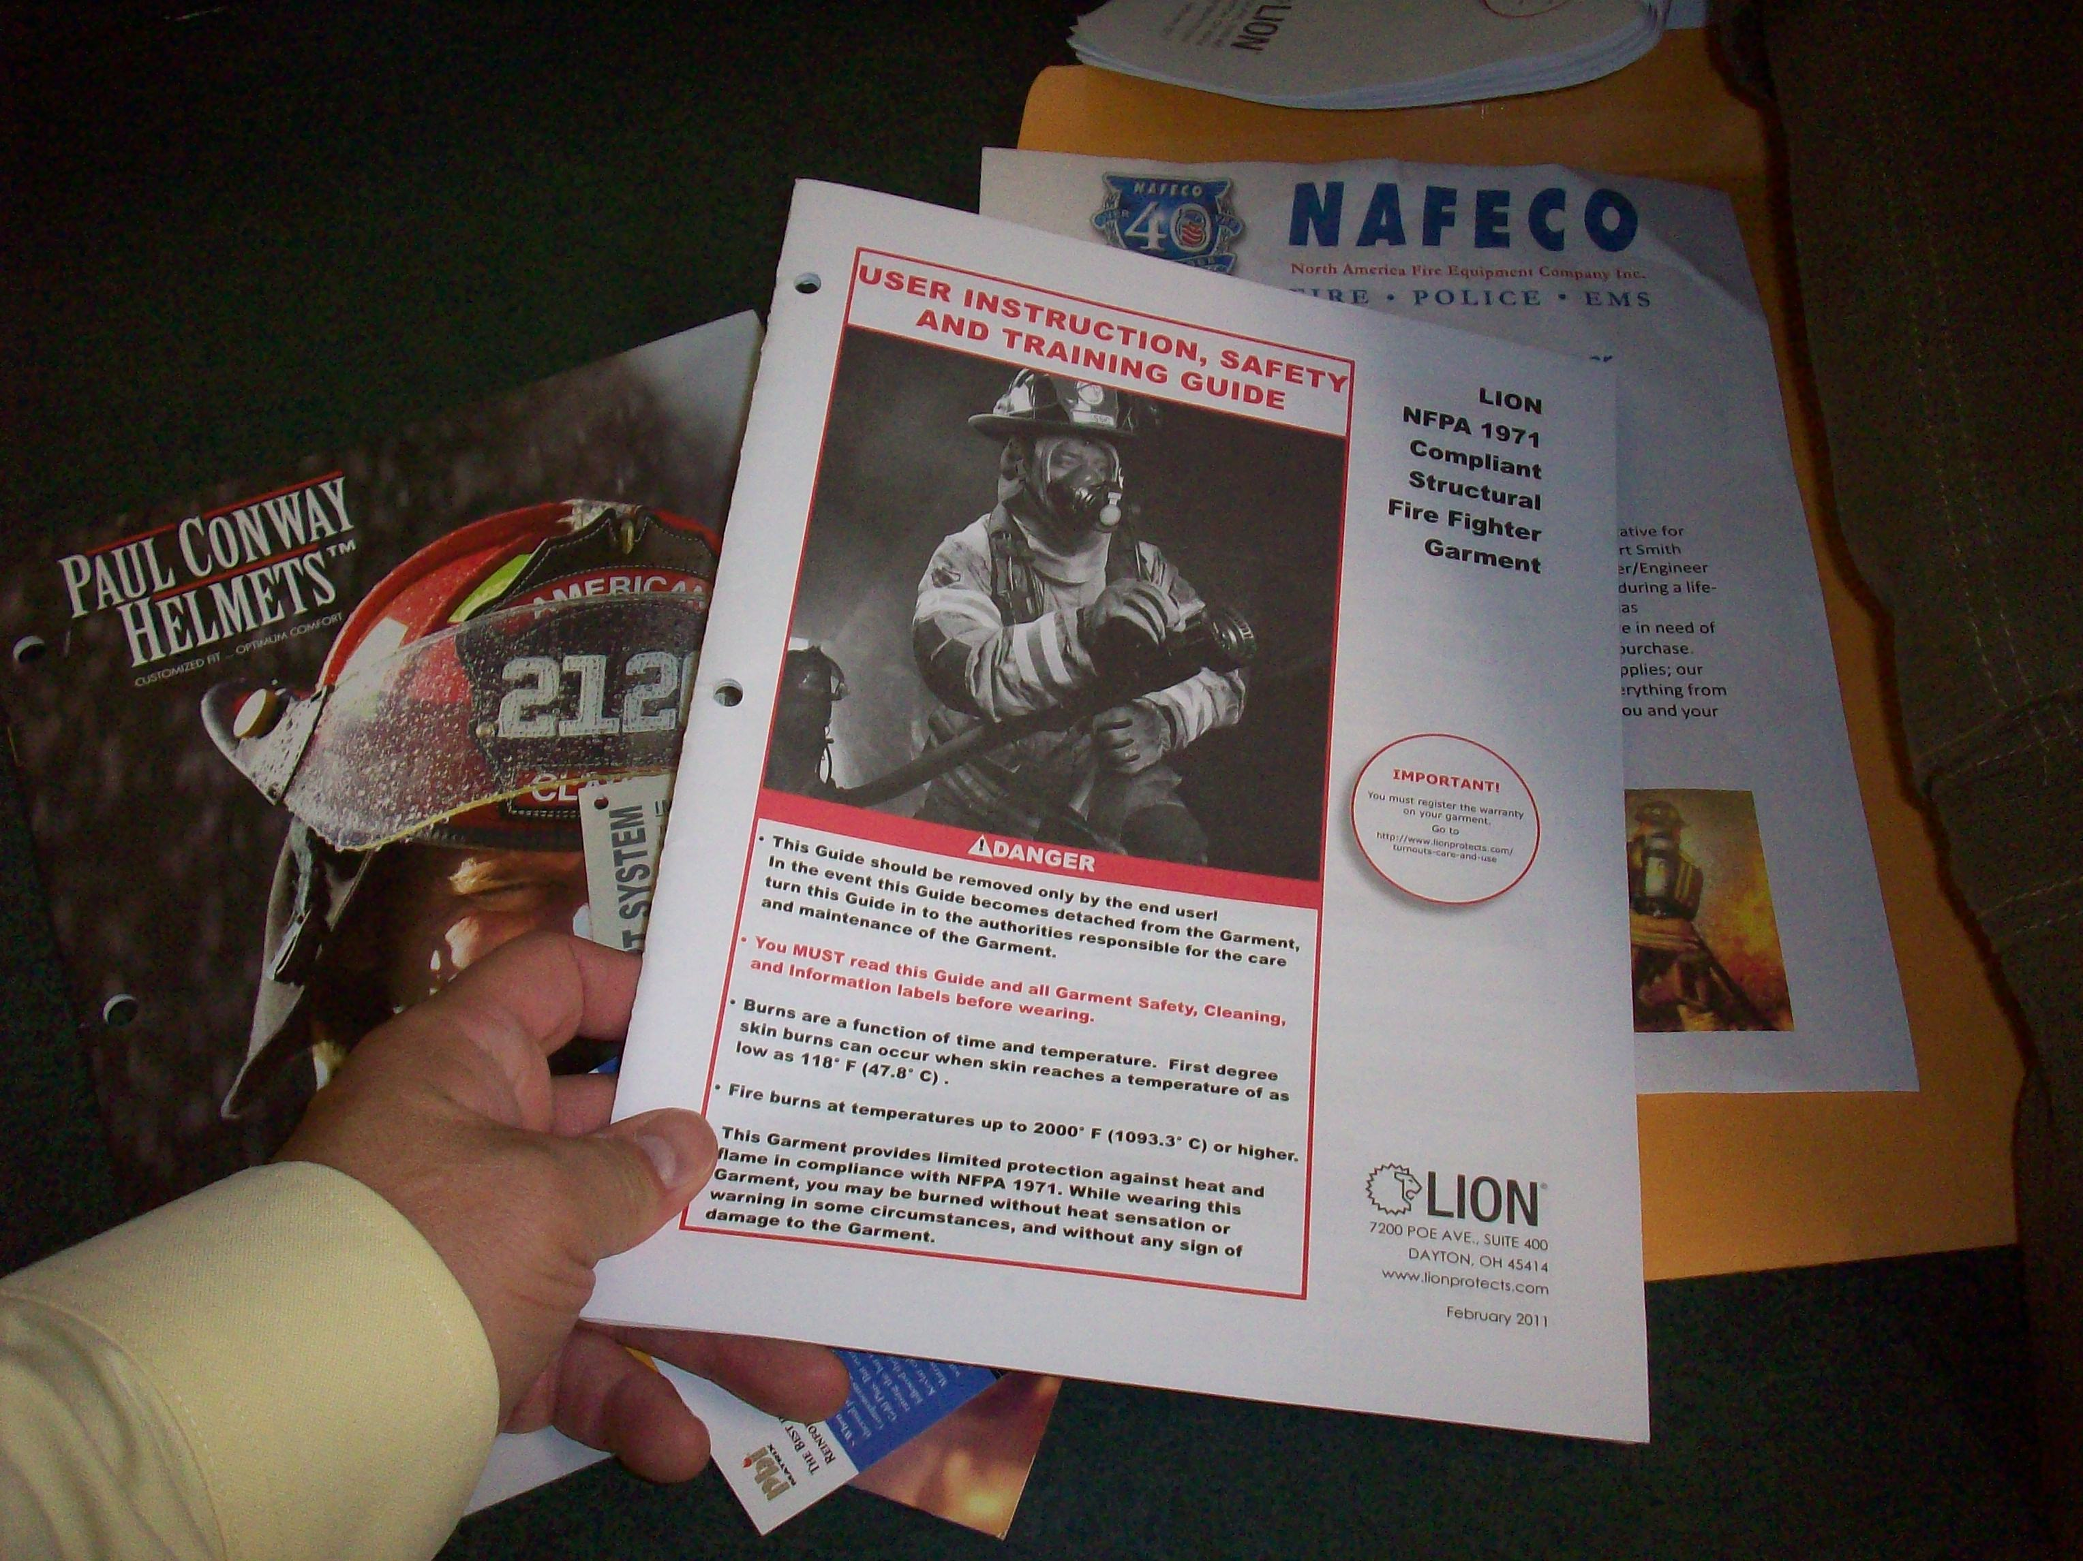
Fact-Based Training
Warning labels and decals
SDS
Owner’s manuals
Instructions
OSHA publications
Your company safety policy
Insurance premiums and costs

Slide 13
The State of Missouri supports safety!
Please Develop Safety Rules
If the employee fails to use safety devices provided by the employer or fails to obey safety rules, compensation is reduced by 25 - 50%.
Section 287.120.5
Initial Employee Orientation Training
Signed Receipt of Employee Manual
Ongoing Safety Training Logs
Enforcement

Slide 14
The State of Missouri supports safety!
Please Develop a Drug & Alcohol Policy
Section 287.120.6
Reduces WC benefits by 50% in instances of positive post-accident drug tests for non-prescribed controlled drugs or the metabolites of such drugs, by presuming that the injury was sustained in conjunction with such drug use.
Denies benefits in cases where it is shown that the drug use was the proximate cause of the injury or when the employee refuses to submit to an employer requested drug test.

Slide 15
29 USC 654 General Duty Clause Did you know OSHA wants employees to follow safety rules?
(a)Each employer
(1)shall furnish to each of his employees employment and a place of employment which are free from recognized hazards that are causing or are likely to cause death or serious physical harm to his employees;
(2)shall comply with occupational safety and health standards promulgated under this chapter.
(b)Each employee shall comply with occupational safety and health standards and all rules, regulations, and orders issued pursuant to this chapter which are applicable to his own actions and conduct.

Slide 17
After the Incident – Controls & Best Practices for Improved Claim Outcomes
Steve Summers, Field Service Manager – Claims

Slide 18
Effective Incident Management
Workers’ Compensation Best Practices & Procedures Meant to Maximize Overall Claim Outcomes:
Improved Medical Treatment/Outcomes
Reduced Medical Costs
Improved eMod
Reduced Insurance Costs
“Other,” Non-Occupational Claim Cost Savings

Slide 19
Effective Incident Management
Incident Management Program
An effective Incident Management Program requires a partnership between all parties:
Employer
Insurance Carrier
Medical Providers
Injured Worker

Slide 20
Effective Incident Management
Incident Management Program
Direct, control and manage both the injury & accident scene as soon as the loss occurs or upon notification.

Slide 21
Effective Incident Management
Incident Management Program
A company-wide plan of action, in place before accidents occur, meant to manage on the job injuries. An effective Injury Management Program should include:
Drug & Safety Policies
Thorough Accident Scene Investigation & Documentation
Pre-planned Direction of Authorized Medical Care
Early Return to Work Program

Slide 22
Effective Incident Management
Incident Management Program
Every Missouri Employee Deserves a Safe, Healthy, Drug-Free & Injury-Free Workplace
Employer Obligation?
Notes:
All should know where to refer Injured Workers for treatment.

Slide 23
Effective Incident Management
Incident Management Program - Drug Free Workplace
Implement a substance abuse policy.
Post-Offer Employment
Random
Probable Cause
Post-Accident (workers’ compensation)

Slide 24
Post-Accident Drug Testing
Section 287.120.6
Reduces wc compensation and death benefit by 50% in instances an employee fails to obey any policy adopted by the employer relating to a drug-free workplace, with a positive post-accident drug test for non-prescribed controlled drugs or the metabolites of such drugs, by presuming that the injury was sustained in conjunction with such drug use.

Slide 25
Post-Accident Drug Testing
Section 287.120.6
Forfeits benefits in cases where it is shown that the drug use was the proximate cause of the injury.
In instances when under Missouri law the drug test constitutes legal intoxication, such as 0.08% BAC
A much higher bar to meet by the Employer

Slide 26
Post-Accident Drug Testing
Section 287.120.6
Forfeits benefits when the employee refuses to submit to an employer requested drug test.
Employer must have a policy that requires or authorizes post-injury testing
Please note, the employer must do the requesting

Slide 27
Post-Accident Drug Testing
SB 66, effective 08/28/2017
Adds the metabolites of non-prescribed controlled drugs (287.120.6). Provides a rebuttable presumption that the injury was sustained in conjunction with drug use if…

Slide 28
Post-Accident Drug Testing
SB 66, effective 08/28/2017
Adds the metabolites of non-prescribed controlled drugs (287.120.6). Provides a rebuttable presumption that the injury was sustained in conjunction with drug use if…
Initial testing was administered within 24 hours of the incident

Slide 29
Post-Accident Drug Testing
SB 66, effective 08/28/2017
Adds the metabolites of non-prescribed controlled drugs (287.120.6). Provides a rebuttable presumption that the injury was sustained in conjunction with drug use if…
Initial testing was administered within 24 hours of the incident
Notice was given to the employee of the test results within 14 calendar days of the insurer receiving actual notice of the results

Slide 30
Post-Accident Drug Testing
SB 66, effective 08/28/2017
Adds the metabolites of non-prescribed controlled drugs (287.120.6). Provides a rebuttable presumption that the injury was sustained in conjunction with drug use if…
Initial testing was administered within 24 hours of the incident
Notice was given to the employee of the test results within 14 calendar days of the insurer receiving actual notice of the results
The employee was given an opportunity to perform a 2nd test of original sample

Slide 31
Post-Accident Drug Testing
SB 66, effective 08/28/2017
Adds the metabolites of non-prescribed controlled drugs (287.120.6). Provides a rebuttable presumption that the injury was sustained in conjunction with drug use if…
Initial testing was administered within 24 hours of the incident
Notice was given to the employee of the test results within 14 calendar days of the insurer receiving actual notice of the results
The employee was given an opportunity to perform a 2nd test of original sample
The initial and any subsequent testing which forms the basis of the presumption was confirmed by mass spectrometry …

Slide 32
Post-Accident Drug Testing
Medicinal Marijuana
No actual prescriptions, only a card that authorizes such use due to a qualifying medical condition
With a positive post-accident drug test and a valid medicinal medical marijuana card is produced, the Employee’s drug usage will not be deemed illicit. And thus, unlikely able to assert the 50% post-accident drug policy violation penalty.
Remains untested, little new Missouri WC case law

Slide 33
Post-Accident Drug Testing
Recreational Marijuana, Amendment 3
Effective 12/08/2022
Allows for the purchase and consumption of recreational marijuana for adults 21 years of age and older
Forbids the sale to minors and driving under the influence
Specifically allows for continued drug-free workplace policies
But does add specific protections for those medicinal marijuana certification holders (prohibiting discrimination or adverse employment action)

Slide 34
Post-Accident Drug Testing
Recreational Marijuana, Amendment 3
Drug policies do not prevent people from using their legally obtained medications - they prevent them from being impermissibly under the influence of them on the job.
An Employer can still bar an employee from possessing, using or being under the influence of marijuana on the place of employment or during hours of employment

Slide 35
Post-Accident Drug Testing
Recreational Marijuana, Amendment 3
A positive test for marijuana might not be sufficient evidence of a drug policy violation or on the job usage necessary to trigger the employer’s disciplinary rights. The employer needs a positive test and some reasonable observations or credible knowledge of on-the-job usage or intoxication to trigger their drug free workplace policy.
Evidence of Impairment

Slide 36
Effective Incident Management
Safety Policies
Safe Workplace, Implement a Safety Policy
If the employee fails to use safety devices provided by the employer or fails to obey safety rules, compensation is reduced by 25 - 50%. Section 287.120.5
Safety violation must be the cause of the injury
Notes:
All should know where to refer Injured Workers for treatment.

Slide 37
Effective Incident Management
Safety Policies
Recent Court of Appeals decisions reinforce the statutory burden of proof on an employer in showing they “…made a reasonable effort to cause its employees to obey the safety rule”
Initial Employee Orientation Training
Signed Receipt of Employee Manual
Ongoing Safety Training Logs
Notes:
All should know where to refer Injured Workers for treatment.

Slide 38
Effective Incident Management
Incident Management Program
Accident Investigation & Documentation
It is vital for an employer to have an internal investigation process in place to collect incident details, in order to prevent future occurrences and provide their insurance carrier with sufficient information to assist in the claim investigation and compensability determination.

Slide 39
Effective Incident Management
Incident Management Program
Accident Investigation & Documentation
Supervisor Investigation Form - Identify causes of accident, identify witnesses, verify facts & employee details, and determine any safety violation. Was the accident preventable? Does the accident description make sense?
Employee Statement - Signed & dated by the employee.
Witness Statements - To confirm accident details.
Corrective Action Form – Document steps taken to prevent future occurrences. Places “ownership” of safety with supervisor. Conduct root-cause analysis.

Slide 40
Effective Incident Management
Incident Management Program
Accident Scene Documentation
Photographic Documentation – Preserves & documents the accident scene, providing evidence towards the causes of the incident. Can also document a lack of any cause or defect!
Machinery Involved – Any product liability.
Third Party Involved – Any subrogation potential.
Safety Violation – Any potential safety penalty on the part of the Injured Worker
Notes:
Product invoices, warranties and safety manuals

Slide 41
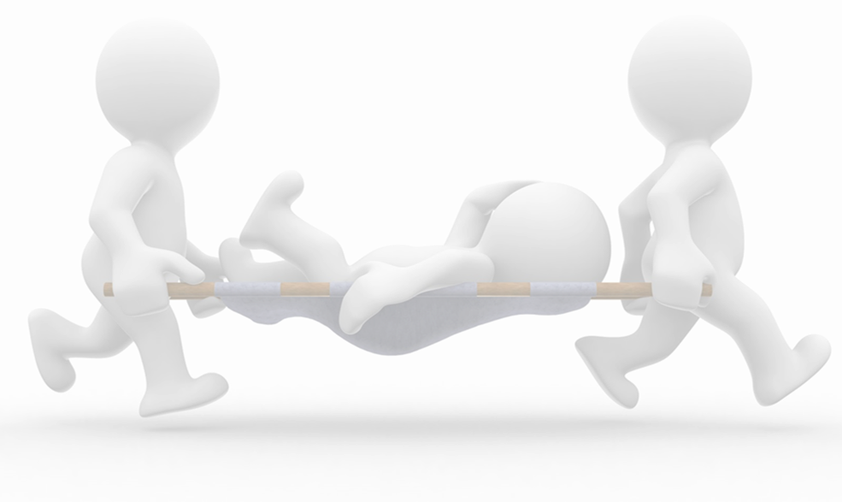
Direction of Medical
Effective Incident Management
Avoiding Uncontrolled Losses…..
If you are not directing medical treatment, you’re experiencing uncontrolled losses

Slide 42
Effective Direction of Medical
Take Advantage of the Missouri Statute:
If the employee desires, he shall have the right to select his own physician, surgeon, or other such requirement at his own expense.
Section 287.140.1
Notes:
Again, it’s statute based. Wouldn’t be talking about this in IL. Remember, we’re not doing this just to control costs, but also to insure effective and timely occupational medicine is provided to our Injured Workers. We want to make sure we’re getting what we pay for.

Slide 43
Effective Direction of Medical
Avoiding Uncontrolled Losses
Direction/Control of Medical Provides the Opportunity to Promote:
Improved medical treatment for Missouri injured workers
Treatment that is timely delivered
At reduced medical costs for Missouri employers
Improved overall claim outcomes
“Other,” non-occupational claim cost savings
Notes:
Remember, goal is not to control simply because you can. But to use the statute to provide your employee’s with effective treatment.

Slide 44
Effective Direction of Medical
Avoiding Uncontrolled Losses
Pre-planned Direction of Authorized Medical Care
Designate an occupational health provider for all initial medical treatment
Ensure all supervisors and staff are trained in and aware of the authorized medical provider – Including evening and weekend shifts!
Make sure authorized medical treatment is offered in all instances (Priority #1)
Notes:
The time to think about and choose a doctor is not when your employee is on the ground with a broken leg.

Slide 45
Effective Direction of Medical
Avoiding Uncontrolled Losses
Pre-planned Direction of Authorized Medical Care
If treatment is not specifically offered, you as the Employer run the exposure to unauthorized medical billing
And uncontrolled medical results in ineffective occupational treatment for the Injured Worker and increased claim costs (medical severity) for the Employer
Notes:
The scenario of the EE seeking trx over the weekend because no one told him/her what to do. They then walk in the bills on Monday. The ee shouldn’t have to seek out trx on their own.

Slide 46
Effective Direction of Medical
Designated Occupational Health Providers
For all authorized initial (non-emergency) medical treatment
Provide adequate training to supervisors & employees and post notice of the Designated Occupational Health Provider
Notes:
Blood & Guts goes to the Emergency Room.

Slide 47
Effective Direction of Medical
Designated Occupational Health Provider
Trained in the treatment of occupational injuries
Notes:
More benefits: Occupational Health Providers are trained to treat common on the job injuries.

Slide 48
Effective Direction of Medical
Designated Occupational Health Provider
Trained in the treatment of occupational injuries
Avoid the use of family physicians, etc., untrained in Occupational Health
Not the Emergency Room
Provides appropriate, effective and timely (efficient) occupational medical care
Notes:
A benefit. I always get in trouble here. Trained in strains, tears. PCP Treats non-occ conditions. ER inconvenient for all, no work slip, too expensive.

Slide 49
Effective Direction of Medical
Designated Occupational Health Provider
Benefit from a working relationship with your Occupational Health Provider so the medical provider is knowledgeable of and assists in:
Your modified duty program
Your post-accident drug policy
Your employee’s essential job functions/physical requirements
Your pre-employment screening
Notes:
Will be aware of your Early RTW program and know to address work restrictions.

Slide 50
Effective Direction of Medical
Why the Focus on the Costs of Medical Treatment Within Workers’ Compensation?
Medical treatment is the #1 claim outcome as perceived by the Injured Worker
Medical costs are on the rise, both in terms of severity and as a percentage of overall total claim costs
Notes:
And those measurable cost have been on the rise!

Slide 51
Return to Work Program
Known by Many Names:
Early RTW Program
Transitional Duty Program
Light Duty
Modified Duty
Temporary Work Assignment

Slide 52
Return to Work Program
A work assignment, temporary in nature, which safely accommodates the authorized physician’s work restrictions and provides the employee with continued and active employment during their recovery.
Temporary in duration
Provided during recovery/treatment
Occupational medical conditions
Maintains injured worker activity

Slide 53
Return to Work Program
Benefits of Early RTW
Promotes lower insurance premiums through reduced disability and medical costs
Promotes improved medical outcomes for the Injured Worker

Slide 54
Return to Work Program
Benefits of Early RTW
Decreased indemnity costs

Slide 55
Return to Work Program
Benefits of Early RTW
Decreased indemnity costs
Temporary Total Disability ends when an Injured Worker returns to work, resulting in lower indemnity reserves with your insurance carrier.

Slide 56
Return to Work Program
Benefits of Early RTW
Decreased indemnity costs
Lower premiums for Policyholders through better controlled workers’ compensation costs

Slide 57
Return to Work Program
Benefits of Early RTW
Decreased indemnity costs
Lower premiums for Policyholders through better controlled workers’ compensation costs
Improved medical outcomes

Slide 58
Return to Work Program
Benefits of Early RTW
Decreased indemnity costs
Lower premiums for Policyholders through better controlled workers’ compensation costs
Improved medical outcomes
Injured Employees who return to work early seek less medical treatment and realize improved medical outcomes. Some studies have suggested that “unemployment is at least as important as disability in health outcomes of claimants.”
Source: ACC Review – Return to Work, Issue 27 April 2006

Slide 59
Return to Work Program
Benefits of Early RTW
Decreased indemnity costs
Lower premiums for Policyholders through better controlled workers’ compensation costs
Improved medical outcomes
Non-Occupational benefits for the Policyholder and Injured Worker, through cost savings from replacing/retraining, job retention/maintained employment, etc.

Slide 60
Return to Work Program
Short Term Absence – Opportunities!
Effective RTW within 3 days may result in a medical-only claim and avoid indemnity….
Missouri Experience Rating Adjustment, 70% Discount towards eMod Calculation
Medical-Only claims reduced by 70% towards your experience rating calculation (weighted at 30%)
Directly & favorably impact eMod!

Slide 61
Return to Work Program
Sample Transitional Duty Jobs…
Perform regular job function subject to work restrictions
Clean & improve premises, work-sites
Light painting, grounds keeping duties
Sort & inventory supplies/parts
Clean/repair tools & equipment
Spotter or flagman
Dispatch, answer phones
Clerical, address correspondence, filing
Receptionist
You can “float” the Injured Worker to another department, location or even shift!

Slide 62
Return to Work Program
Alternative RTW Programs
Outside volunteer placement
Red Cross
Food Bank
Other non-profit organizations
MEM/Paradigm Partnership
Administers the outplacement
MEM RTW Coordinator
Individual assistance working directly with MEM Policyholders towards specific RTW challenges

Slide 63
Questions?
Steve Summers, Field Service Manager - Claims
ssummers@mem-ins.com
Thank You!

