Slide 1
EDI 3.1
Informative and educational session regarding MO DWC’s transition to EDI Claims Release 3.1

Slide 2
Hybrid Session
Ben Qualls - MO Division of Workers’ Compensation
    Deputy Division Director
    In Person
Robbie Tanner - Verisk
    Sr. Manager IAIABC Product Group, WCS - Casualty Solutions
    Recorded

Slide 3
What is EDI (Electronic Data Interchange)?
Electronic Data Interchange (EDI) is the electronic exchange of data between business trading partners, in a standardized format.
International Association of Industrial Accident Boards and Commissions (IAIABC) EDI Claims Standards are used by claims administrators to report workers' compensation first report of injury and subsequent report of injury claims data to U.S. jurisdictions. Source: https://www.iaiabc.org/edi-claims
Missouri Department of Labor and Industrial Relations Division of Workers' Compensation (MODWC) is using the IAIABC National Standard, EDI Claims Release 3.1 to replace EDI Claims Release 1 reporting.
EDI Claims Release 3.1 is the most current release and is maintained on an ongoing basis. Revised documentation for EDI Claims Release 3.1 is published on January 1 of each year. Source: https://www.iaiabc.org/edi-claims

Slide 4
Why EDI?
§287.380
8 CSR 50-2.010(1)
8 CSR 50-2.010(2)
Paraphrased:
Every employer or his insurer in this state…….shall……..file with the division…..a full and complete report of every injury or death to any employee……and every employer or insurer shall also furnish the division with such supplemental reports in regard thereto as the division shall require.
§287.650.1
Paraphrased:
The division of workers' compensation shall have such powers as may be necessary to carry out all the provisions of this chapter including the use of electronic processes

Slide 5
Current State
Future State
EDI Claims Release 1.0 – FROI Only
  68 data elements
  Only 40 are mandatory or are mandatory on a conditional basis
  The rest are frequently not submitted to the Division
Data is sent to the Division in flat files by multiple trading partners
DWC is responsible for ensuring data quality, sending acknowledgments to claims administrators, and rejecting submissions
EDI Claims Release 3.1 –FROI and SROI
  Over 250 data elements (roughly 80 FROI, 95 SROI and 80 on both)
  Roughly 140 are mandatory or are mandatory on a conditional basis
Data will be sent to the Division via XML files by a trading partner (Verisk)
Verisk is responsible for ensuring data quality, sending acknowledgments to claims administrators, and rejecting submissions

Slide 6
Why Move to 3.1?
Industry Standard
Improve Case Records
Reduction in Manual Data Entry/Paperwork Completion
Improvee Data Quality
Better Insights/Improved Decision Making

Slide 7
Why Move to 3.1? (cont’d)
To Improve the Health of the Missouri Workers’ Compensation System!

Slide 8
Where We Have Been
Prior to COVID DWC partnered with Verisk and started a multi-year journey defining the data elements in the EDI 3.1 standard that MO wanted to accept, which ones were going to be mandatory, which ones would be mandatory based on conditions, what those conditions were, and which fields would be optional (Element Requirement Table). This table lists the individual data element requirements

Slide 9
Where We Have Been (cont’d)
Many data elements are restricted to only certain values being able to be reported. As part of the journey, we identified which of the possible values MO would allow (Edit Matrix). This table provides information on the edits that will apply to each data element and the edits that will be applied based on the population of the data element.

Slide 10
Where We Have Been (cont’d)
We also defined the sequencing of events (Event Table). This table relates EDI information to the circumstances under which they are initiated as well as the timeframes for sending the information.

Slide 11
Where We Are
We are currently working with Objectstream and Verisk to design EDI 3.1 in Work Comp Connect
  This entails items such as designing the user screens to see the EDI data, designing data models regarding how the data will be stored, defining staff alerts, tasks, automated processes and correspondence that will be triggered by the incoming data

Slide 12
What Are The Benefits of EDI 3.1?
Provide a current and in-depth picture of the status of any injury by continuously receiving updates to injury information and benefits paid, specifically with respect to Case Management, Adjudication and Self-Insurance audits
Automate Division processes and generate necessary correspondence
Reporting/Payment timelines can be leveraged by Self-Insurance and Fraud and Noncompliance Units to ensure compliance with MO Statutes and Regulations
Additional data, such as changes in an employee’s address, can be used by the Benefits Administration Unit to improve efficiency in issuing payments and reducing returned mail
Accurate and timely payment information can be aggregated to provide Administration with increased insights into the Health of the System

Slide 13
Robbie With Verisk!

Slide 14


Welcome to Claims EDI Implementation Overview
Notes:
Welcome to Claims EDI Implementation Overview
My name is Robbie Tanner and I am with Verisk.
Missouri has selected Verisk to help implement their FROI and SROI EDI Reporting. In addition to managing the technical aspects of data submittal, Verisk will be your main contact for implementation, technical requirements, and any questions you may have.

Slide 15


Overview of
Electronic Data Interchange (EDI) for Claims
Notes:
Today I will provide an Overview of
MODWC Electronic Data Interchange (EDI) for Claims

Slide 16

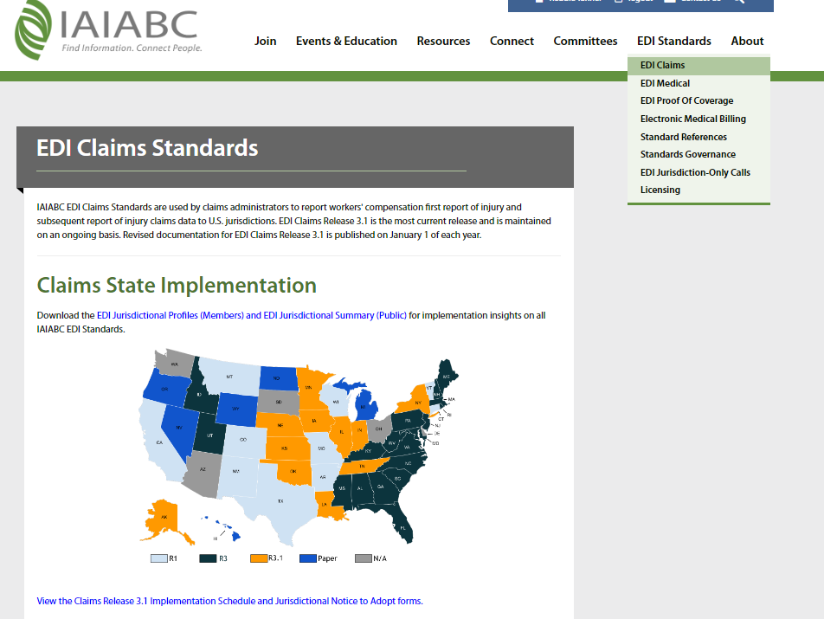
Implementation Considerations and Coordination
Access IAIABC Claims Release 3.1 Implementation schedule at: https://www.iaiabc.org/edi-claims
Select EDI Claims from the EDI Standards menu
Claims Release 3.1 Implementation schedule and Jurisdiction Notice to adopt
Notes:
Additional information on the IAIABC EDI transactions for FROI and SROI can be found online on the website as shown here.
The website also provides information such as how to become a member, Resources to support the standards, Events such as the annual Forum and Convention and also Education information.
In this example, to access the Claims Release 3.1 standards,
First select EDI Claims from the EDI Standards menu
and you will be taken to the EDI Claims Standards page where the information is located.
From that page, you can click on the link to View the Claims Release 3.1 Implementation Schedule and Jurisdictional Notice to Adopt forms.

Slide 17
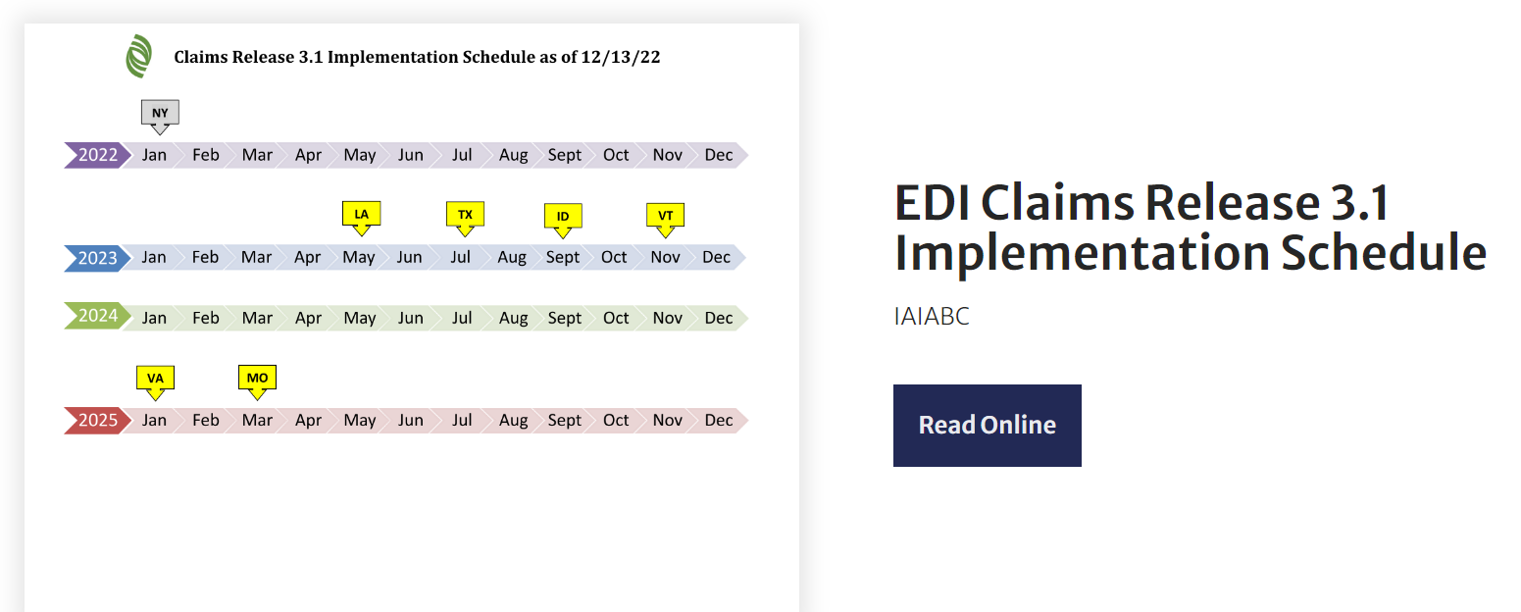
Implementation Considerations and Coordination
IAIABC Claims Release 3.1 Implementation schedule as of 12-13-22
Notes:
IAIABC Claims Release 3.1 Implementation schedule as of 12-13-22 is shown here.
LA in May 2023 and TX in July 2023 have implemented R3.1 and next is ID in Sept 2023 and VT in November 2023
Per the schedule, we have VA implementing R3.1 in January 2025 and MO in March 2025

Slide 18
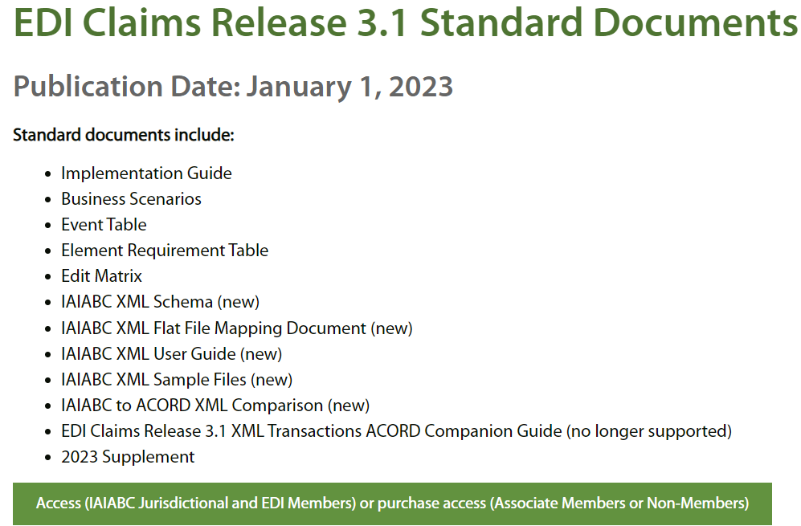
Implementation Considerations and Coordination
Claims Release 3.1 Implementation Guide, Business Scenarios, Trading Partner Tables access.
IAIABC Contact: https://www.iaiabc.org/contact-us
Notes:
If you will scroll further down on the page, then you will see the IAIABC EDI Claims Release 3.1 Standard Documents section where you can obtain access to
Claims Release 3.1 Implementation Guide, Business Scenarios, Trading Partner Tables.
The Standard Documents are Accessible to These Member Types: U.S. Jurisdictional members, Non-U.S. Jurisdictional members, EDI members, and Purchasers if not a member, then you may Purchaser these Purchasers
If you have any questions, then contact the IAIABC https://www.iaiabc.org/contact-us

Slide 19
EDI Initiative and Timelines for EDI Claims Release 3.1 Implementation
Notes:
In this section, we will review Missouri’s EDI Initiative and Timelines for the Release 3.1 Implementation

Slide 20
The Missouri Department of Labor and Industrial Relations Division of Workers' Compensation (MODWC) will be transitioning from electronic reporting of workers’ compensation First Reports of Injury (FROI) and Subsequent Reports of Injury (SROI) via Release 1 (R1), to First Reports of Injury (FROI) and Subsequent Reports of Injury (SROI) in Release 3.1 (R3.1).
Release 3.1 electronic reporting will be required for all trading partners: insurers, self-insured employers, risk management pools and claim administrators. Mandatory implementation is planned for March 21, 2025.
Missouri’s Initiative and Timeline for EDI Claims
Release 3.1 Implementation
Notes:
Missouri is currently receiving electronic reporting of workers’ compensation First Reports of Injury (FROI) in the IAIABC Release 1 format.
Starting on March 21, 2025 MODWC will stop accepting Release 1 FROI data and will begin to receive only First Reports of Injury (FROI) and Subsequent Reports of Injury (SROI) in Release 3.1 format.
Release 3.1 electronic reporting will be required for all trading partners: Insurers, Self-Insured employers, Risk management pools and Claim Administrators.
Again, this reporting change from Release 1 to Release 3.1 is mandatory for Missouri and the implementation is planned for March 21, 2025 .

Slide 21
Missouri’s Initiative and Timeline for EDI Claims
Release 3.1 Implementation
Effective March 20, 2025, ensure the last reportable Release 1 data is sent to and received by Missouri.
All Release 1 EDI not received by MODWC on 3/20/2025 must be submitted electronically in the Release 3.1 format as communicated on the Release 3.1 Event Table, effective on the mandate date of 3/21/2025.
Effective March 21, 2025, electronic reporting using Release 3.1 for all Trading Partners will begin.
Notes:
All trading partners sending EDI data to MO should ensure that they send the last reportable Release 1 EDI transactions to Missouri by March 20 2025.
All Release 1 EDI transactions that are not sent to and received by Missouri on March 20 2025 will need to be submitted electronically in the Release 3.1 format as communicated on the Release 3.1 Event Table Effective March 21 2025

Slide 22
EDI Claims Release 3.1 Website
Notes:
In this section, we will review Missouri’s EDI Claims Release 3.1 Website for Trading Partners and EDI Vendors
MODWC is in the process of updating various sections of their EDI website.

Slide 23
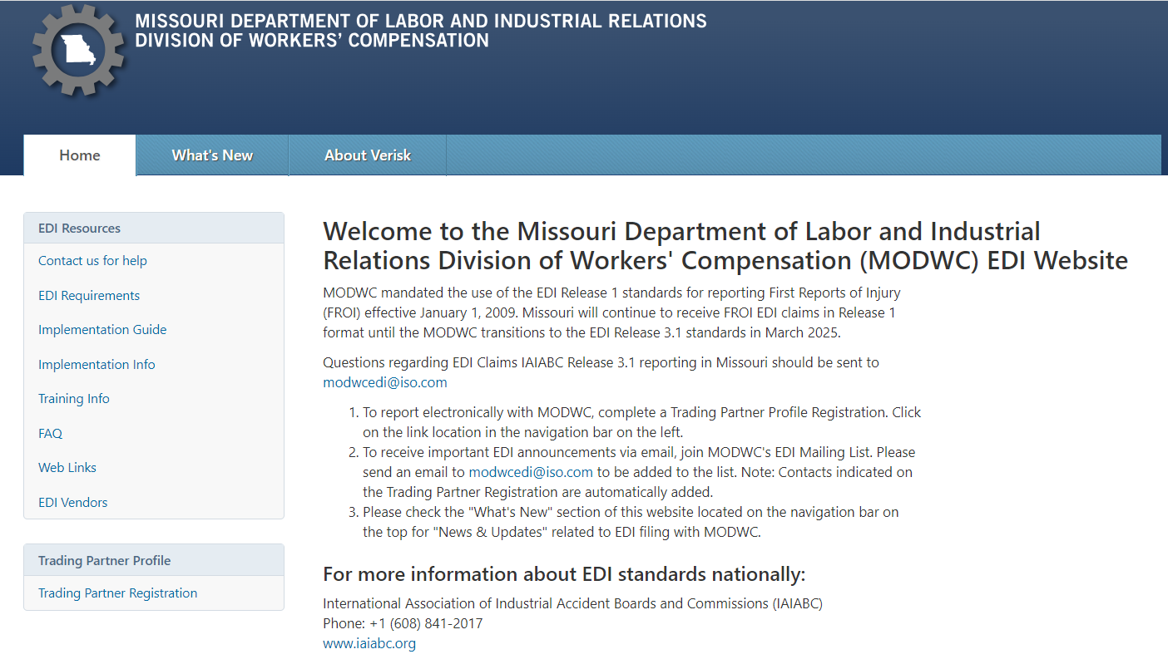
MODWC EDI Claims Release 3.1 Website
https://modwcedi.info
Notes:
To access the MODWC EDI Claims Release 3.1 Website
Open your browser and go to https://modwcedi.info
This will take you to the Home Welcome screen that provides information about MODWC EDI.
MO had mandated the use of the EDI Release 1 standards for reporting First Reports of Injury (FROI) effective January 1, 2009.
Missouri will continue to receive FROI EDI claims in Release 1 format until the MODWC transitions to the EDI Release 3.1 standards in March 2025.
Questions regarding EDI Claims IAIABC Release 3.1 reporting in Missouri should be sent to modwcedi@iso.com
To receive important EDI announcements via email, join MODWC's EDI Mailing List. Please send an email to modwcedi@iso.com to be added to the list.
For more information about EDI standards nationally:
International Association of Industrial Accident Boards and Commissions (IAIABC)
Phone: +1 (608) 841-2017
www.iaiabc.org
Next let’s go through all the links on the left side of the page on the following slides.

Slide 24
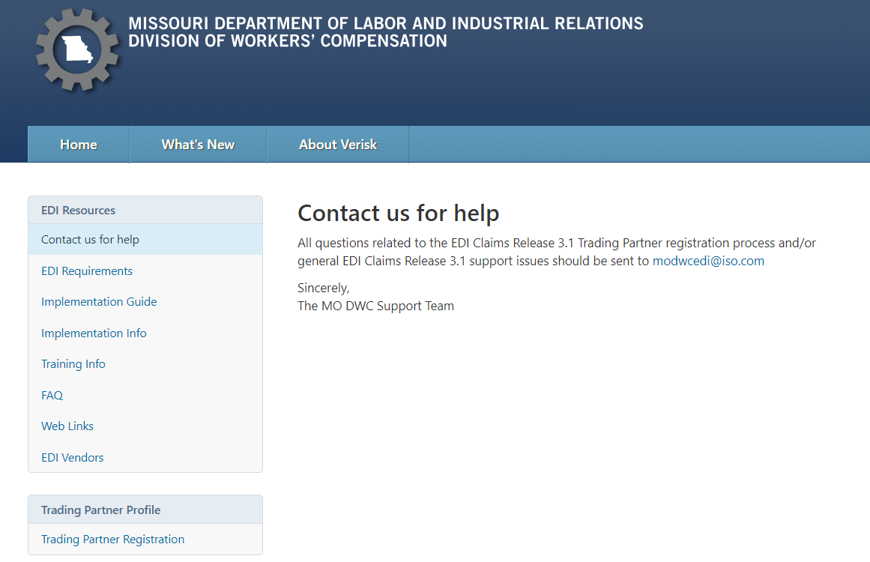
EDI Claims Release 3.1 Website
Contact us for help
Notes:
After clicking on the ‘Contact us for help’ link.
All questions related to the EDI Claims Release 3.1 Trading Partner registration process and/or general EDI Claims Release 3.1 support issues should be sent to modwcedi@iso.com
The MO DWC Support Team is here for you.

Slide 25
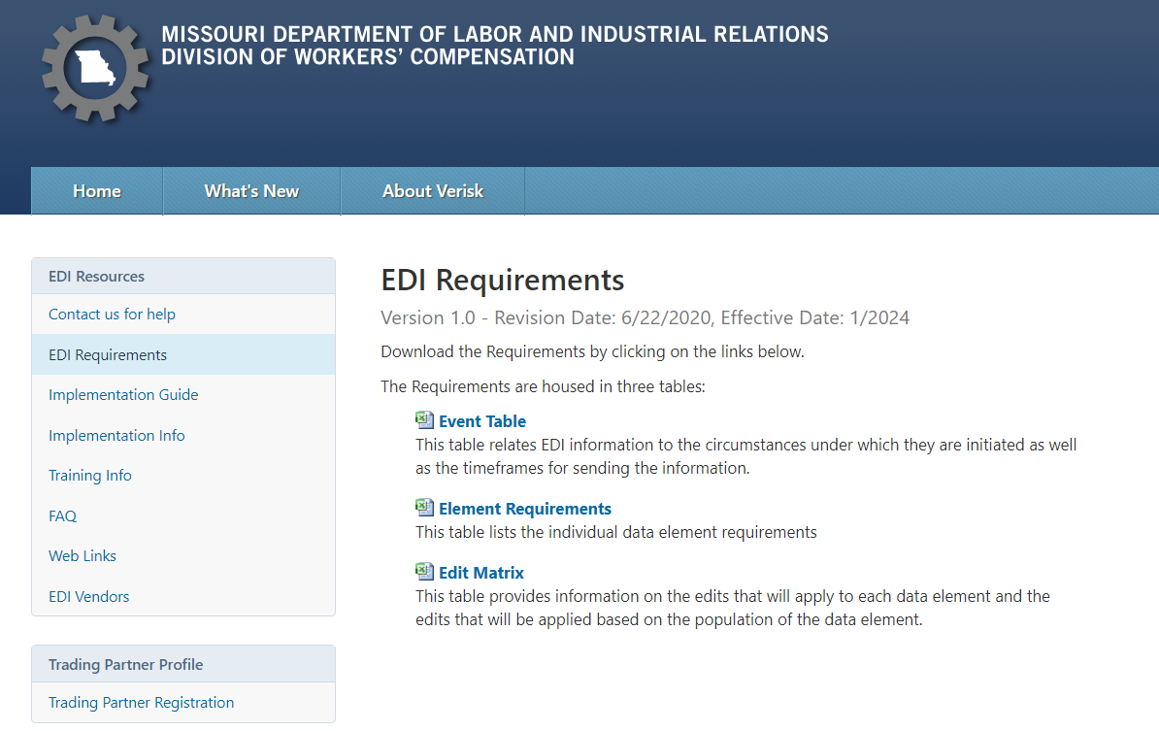
EDI Claims Release 3.1 Website
EDI Requirements
Notes:
After clicking on the ‘EDI Requirements’ link, you will see the links to the
MODWC FROI SROI EDI Requirements tables that include the Event Table, Element Requirement Table, Edit Matrix Table.

Slide 26
EDI Claims Release 3.1 Website
Event Table
What FROI SROI Reports should be filed and when?
Notes:
The Event table answers the question: What FROI SROI EDI reports should be filed and when?
The Event Table relates EDI information, to the circumstances under which the information is initiated, as well as the timeframes for sending the information.
These circumstances and timeframes reflect legislative mandates and specifications relative to reporting requirements, based on various criteria.

Slide 27
EDI Claims Release 3.1 Website
Element Requirements
What data elements are required on the FROI or SROI EDI reports?
Notes:
So what data is needed on the EDI reports?
The Element Requirements table lists the individual data element requirements for each FROI and SROI report type.
Data Element requirements are defined for each FROI and SROI report, at the Maintenance Type Code (MTC) level, on the Missouri Element Requirement Table.
The Element Requirement Table was designed to provide a tool to communicate Missouri's business and technical requirements on each data element.
As I mentioned, this allows for data element requirements, to be defined for each record layout, both FROI and SROI, down to the level of each Maintenance Type Code.
Further, it provides for element requirements to differ, based on Report Type criteria established on the Event Table.

Slide 28
EDI Claims Release 3.1 Website
Edit Matrix
What other edits will be applied to the EDI Data?
Notes:
Our question now is What other edits will be applied to the EDI Data?
Edit Matrix table provides information on the edits that will apply to each data element and the edits that will be applied based on the population of the data element.
The Edit Matrix answers that question.
In addition to the requirements that we discussed on the Element Requirement table, the Edit Matrix is provided to communicate the remaining edits that will be applied to each FROI and SROI report and most specifically to each data element.
It is very detailed because it provides the standard errors applied as defined by the IAIABC Standards and also additional edits that are applied specifically for Missouri’s requirements.
We will discuss these requirement tables planning for a future presentation.

Slide 29
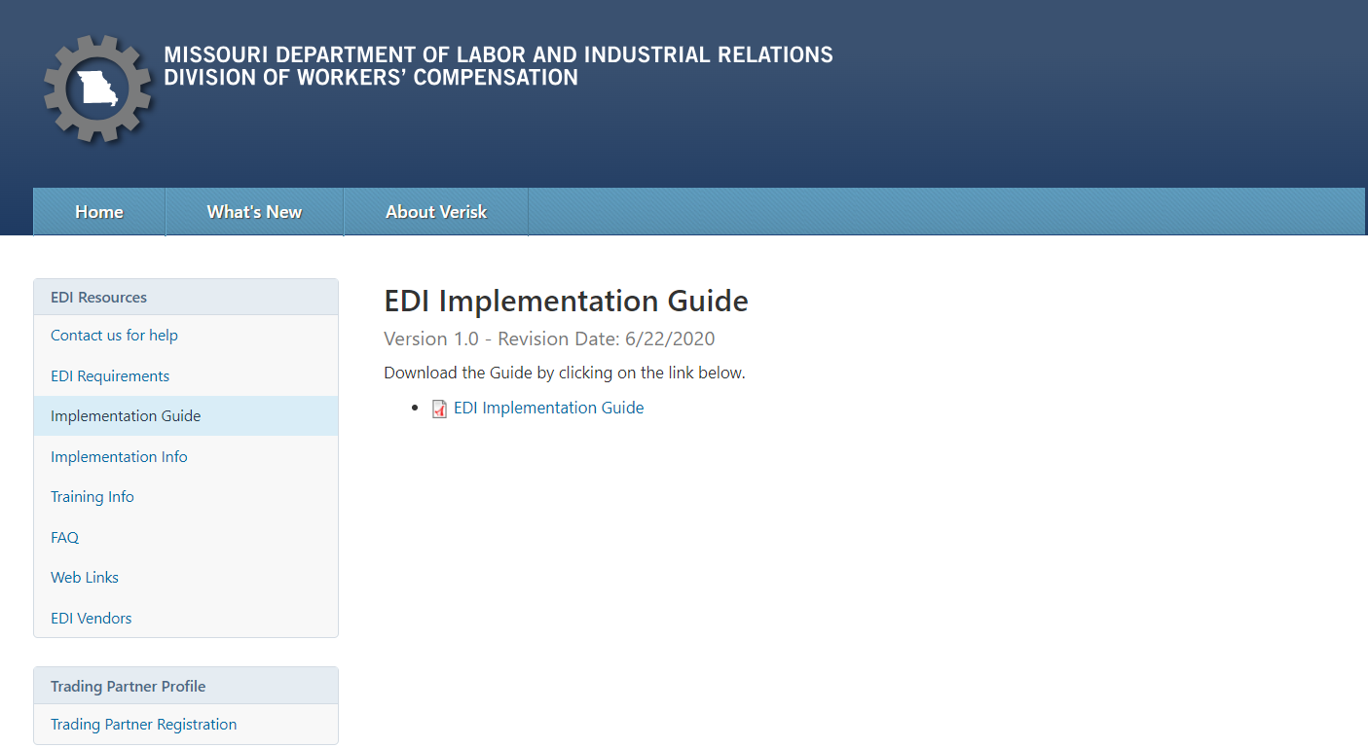
EDI Claims Release 3.1 Website
EDI Implementation Guide
Notes:
After clicking on the ‘Implementation Guide’ link, the Missouri R3.1 Implementation Guide link is displayed. This guide provides additional information for Missouri’s EDI reporting in addition to the requirement tables.

Slide 30
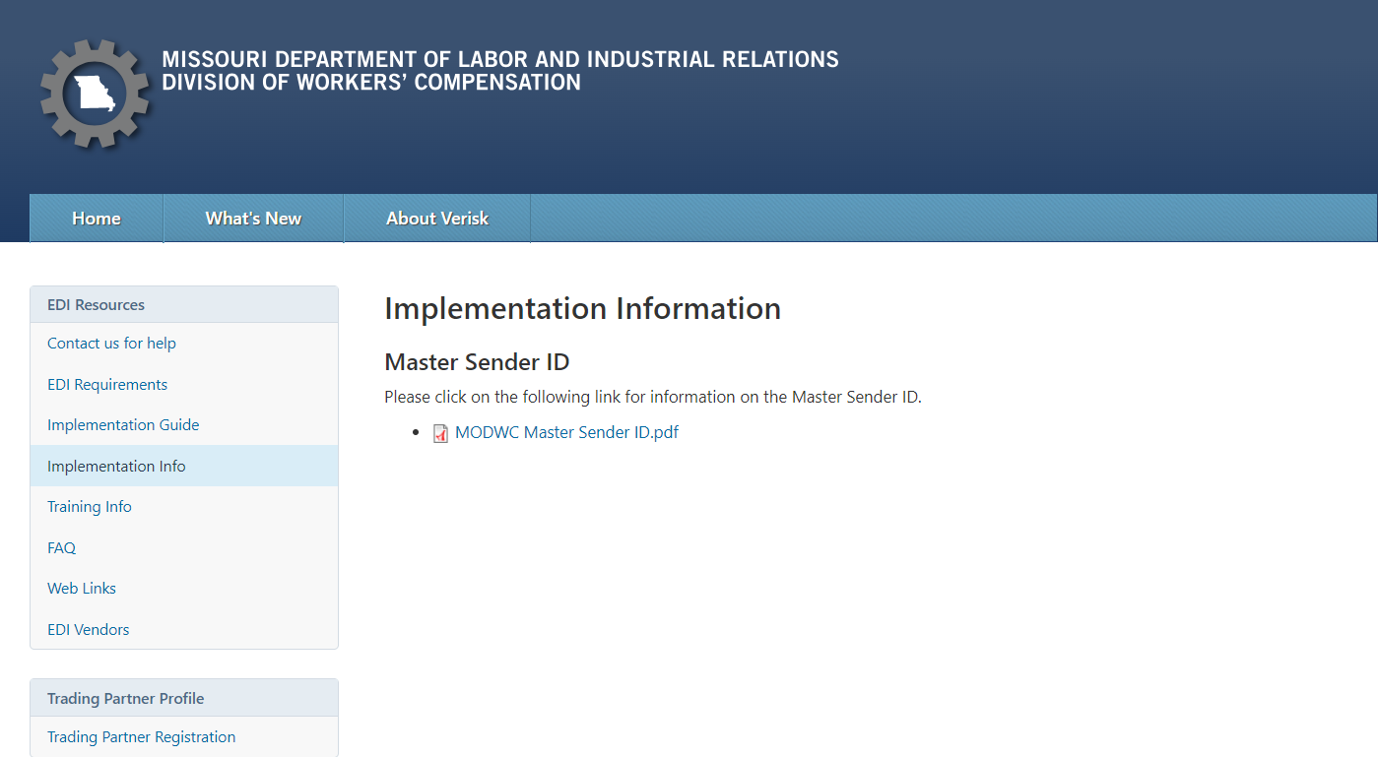
EDI Claims Release 3.1 Website
Implementation Info
Notes:
By clicking on the ‘Implementation Information’ page you will find documents to assist with the implementation
For example, you can see here Missouri’s Master Sender ID that provides Missouri’s Master FEIN that should be used when sending the EDI Claims Release 3.1 data and returned as part of the acknowledgment file.
We will be adding additional documents in the coming weeks as they become available.

Slide 31
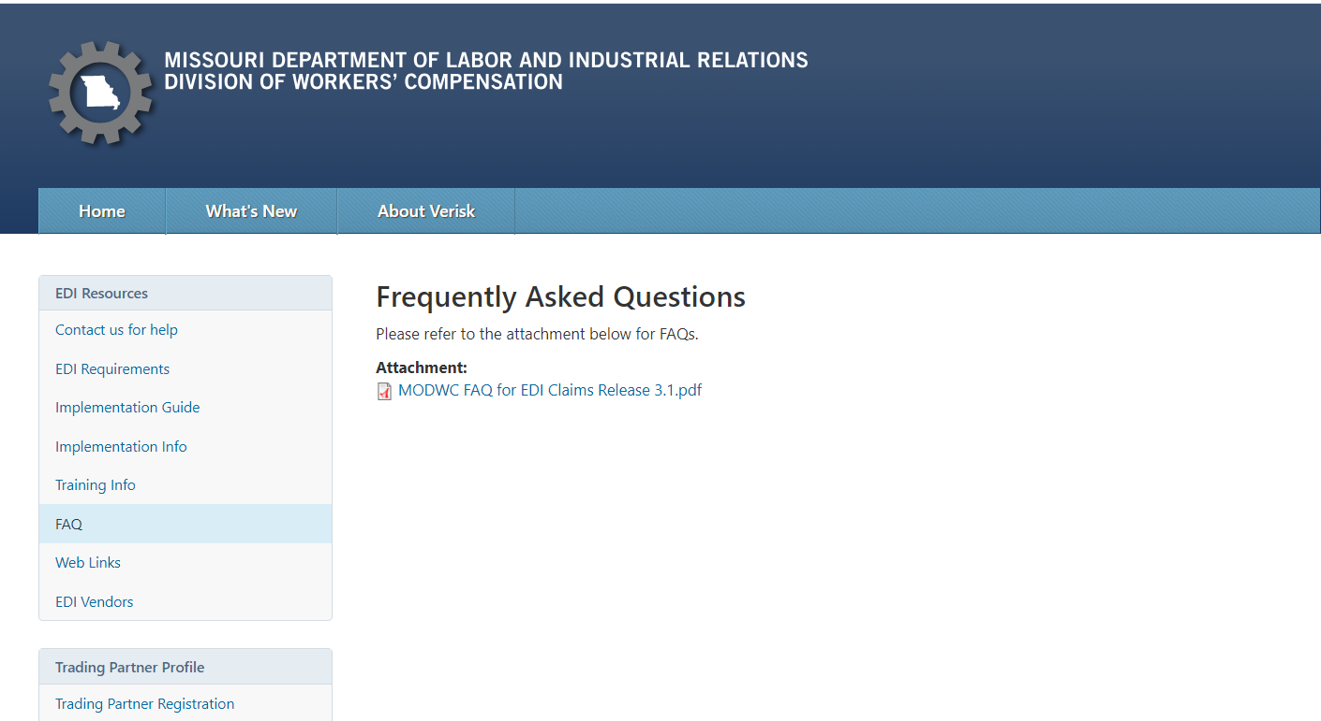
EDI Claims Release 3.1 Website
Frequently Asked Questions
Notes:
After clicking on the ‘FAQ’ link, you will have access to the Frequently Asked Questions. This will be updated as we receive additional questions.

Slide 32
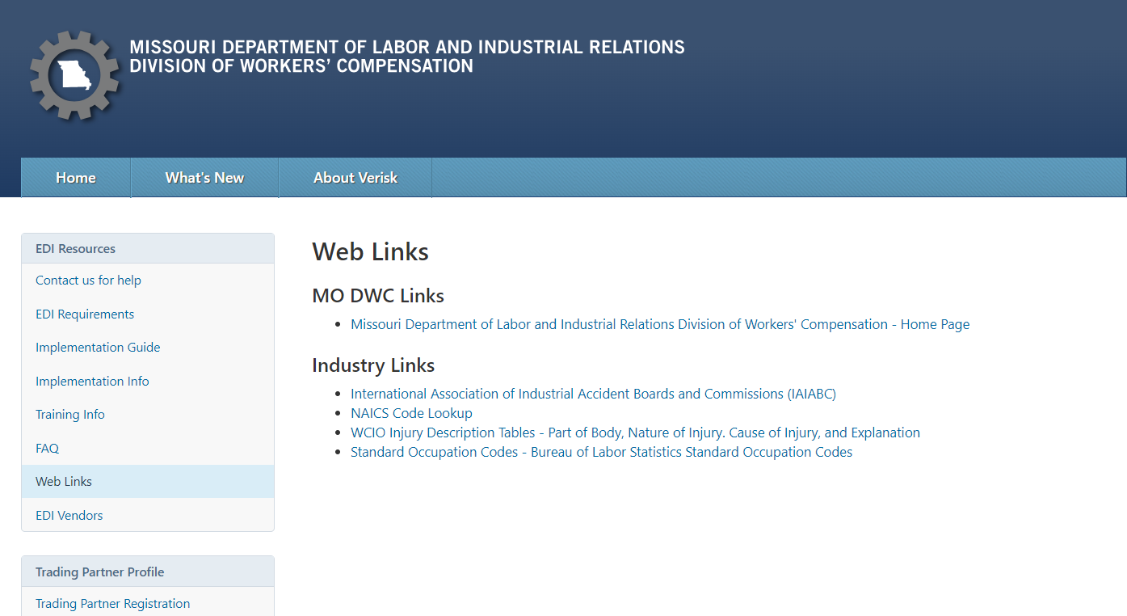
EDI Claims Release 3.1 Website
Web Links
Notes:
By clicking on the ‘Web Links’ page you will find MO DWC Links and Industry Links that you may find helpful.

Slide 33
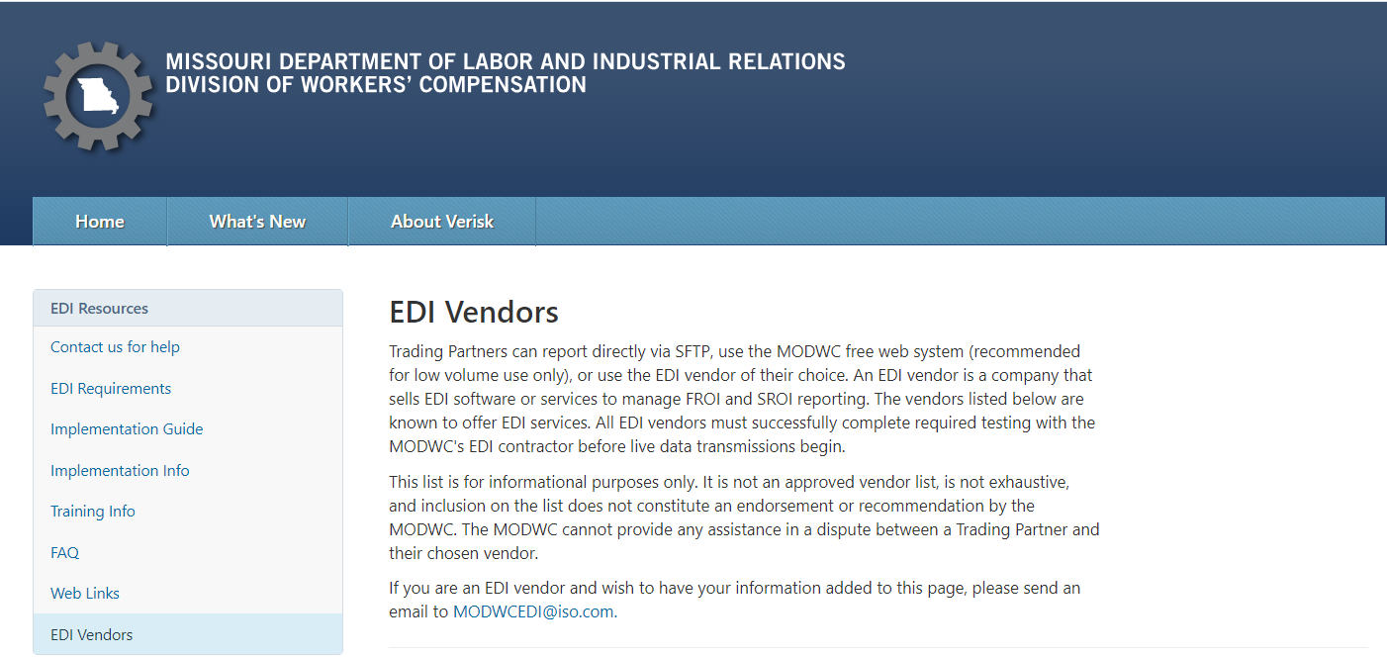
EDI Claims Release 3.1 Website
EDI Vendors
Trading Partners can use an EDI vendor that sells EDI software or services to support FROI and SROI reporting.
Notes:
EDI Vendors
Trading Partners can:
report directly through secure file transfer protocol;
use the DWC free web system or Jurisdiction Web Entry (recommended for low volume use only); or
use the EDI vendor of their choice.
All insurance carriers must successfully complete required testing with their vendor before live data transmissions begin.
Trading Partners can use an EDI vendor that sells EDI software or services to support FROI and SROI reporting.
We have provided a list of vendors that known to offer EDI services and these vendors must successfully complete required testing with the MODWC's EDI contractor Verisk before live data transmissions begin.
This list is for informational purposes only. It is not an approved vendor list, is not exhaustive, and inclusion on the list does not constitute an endorsement or recommendation by the MODWC.

Slide 34
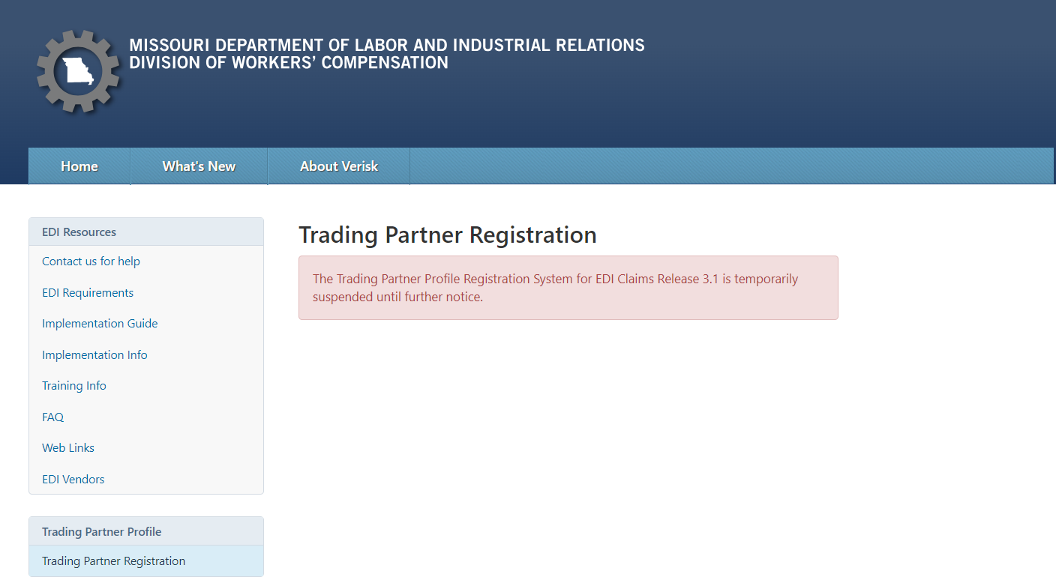
EDI Claims Release 3.1 Website
Trading Partner Registration
A Trading Partner is an entity that
exchanges data electronically with MODWC. This registration is for the future R3.1 EDI reporting to MODWC.
Notes:
The MODWC Trading Partner Profile Registration System for EDI Claims Release 3.1 is suspended until further notice. MODWC will send an announcement when it is resumed. after you receive notification from
When that is received then please Complete the Trading Partner Profile Registration online.
You will need to register even if you are a current registered Release 1 Trading Partner.

Slide 35
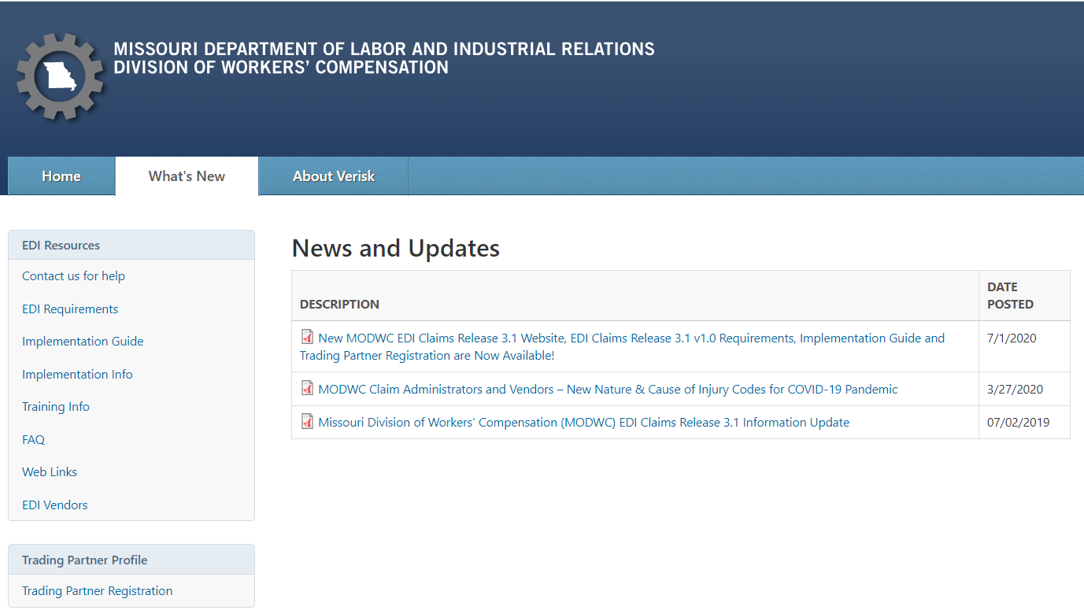
EDI Claims Release 3.1 Website
What New
Notes:
Click on ‘What’s New’ link to obtain access to News and Updates where you will find the announcements and other various information related to EDI filing for MODWC.
There are several new worthy items here where it is Showing the DESCRIPTION and the DATE POSTED. Click on the link to view the:
Missouri Division of Workers' Compensation (MODWC) EDI Claims Release 3.1 Information Update posted 07/02/2019
MODWC Claim Administrators and Vendors – New Nature & Cause of Injury Codes for COVID-19 Pandemic posted 3/27/2020
New MODWC EDI Claims Release 3.1 Website, EDI Claims Release 3.1 v1.0 Requirements, Implementation Guide and Trading Partner Registration are Now Available! Posted: 7/1/2020

Slide 36
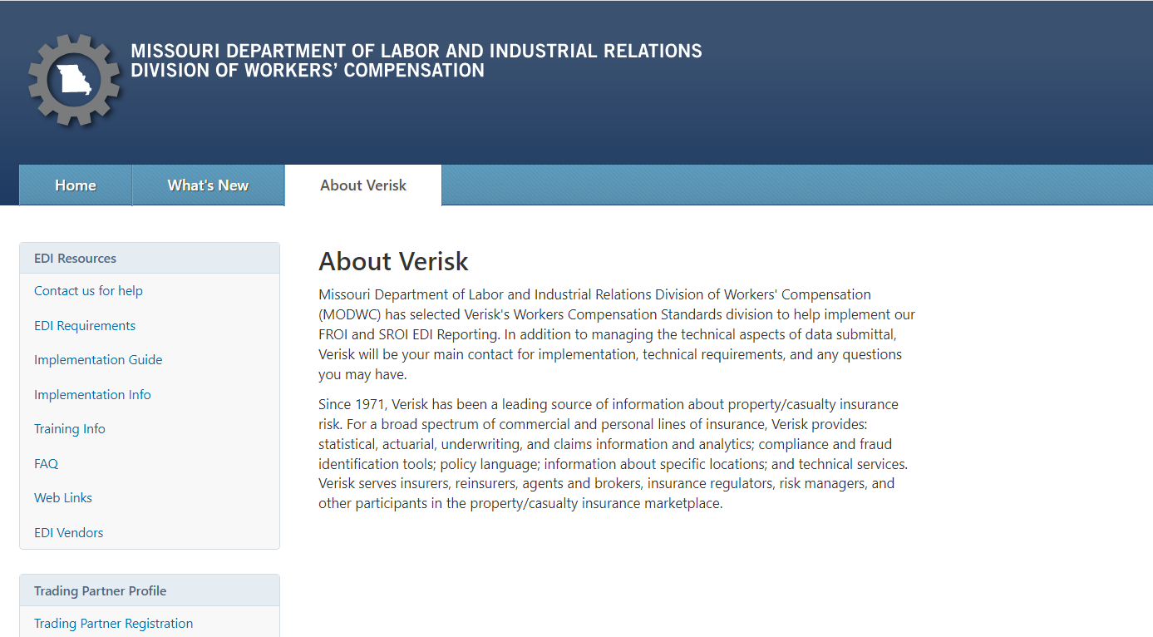
EDI Claims Release 3.1 Website
About Verisk @ https://www.verisk.com
Notes:
We covered some details about Verisk earlier today however you can
read more about Verisk on this ‘About Verisk’ page or on the Verisk website at https://www.verisk.com

Slide 37

Summary of Steps to Implement
EDI Claims Release 3.1 with Missouri
Notes:
Let’s walk through a summary of Steps for Implementing EDI Claims Release 3.1 with Missouri

Slide 38
Summary of Steps for Implementation
Determine how you will handle your EDI reporting
Obtain the MODWC Implementation Guide and MODWC
Requirements Information
Summary of Steps
Obtain the IAIABC R3.1 Implementation Guide
Summary of Steps
Notes:
First Obtain the IAIABC R3.1 Implementation Guide
Then Obtain Missouri’s Implementation guide and Requirements Information located on their EDI website.
Then you must Determine how you will handle your EDI reporting. This of course could be your first step, and if so the steps will change accordingly.

Slide 39
Summary of Steps for Implementation
Move to Production
Test: Prepare to send and receive EDI data and Begin the Testing Process
Register: Complete the Trading Partner Profile Registration online.
summary of Steps
Summary of Steps
Notes:
Register: Every Trading Partner must Register.
As I mentioned, MODWC will send a notification that says MO has resumed the trading partner registrations in the coming weeks.
Just Complete the Trading Partner Profile Registration online.
You will need to register even if you are a current registered Release 1 Trading Partner.
Prepare to send and receive EDI data based on the option that you choose to send, and Begin the Testing Process in accordance with Missouri’s Test Plan or work with your vendor for the testing, if applicable. MODWC will let you know when testing will be available anticipated to begin in the March 2024 timeframe.
Begin Production Reporting on March 21, 2025 for Release 3.1.

Slide 40

How do I get help?
All Release 3.1 questions related to the Trading Partner Registration Process and/or General EDI Support, please contact the Missouri EDI Support Team via email at modwcedi@iso.com.
Notes:
How do I get help?
For all questions related to the Trading Partner Registration Process and/or General EDI Support, please contact the Missouri EDI Support Team at this email address, modwcedi@iso.com.

Slide 41
Thank you for attending the Missouri
Claims EDI Information
Overview
Notes:
Thank you for attending the Missouri Claims EDI Information Overview

Slide 42
Questions?
?

Slide 43
What Does All of This Look Like?
Element Requirement Table
Edit Matrix
Event Table

