Slide 2
Brian J. Gray, BS, DC
Chiropractic Physician ---30 years
Case Review, Fraud and Abuse investigator ---17 years
Assistant Medical Director; Group Health Plan
SIU investigator; Coventry Health Plan/ Aetna Health Plan
Onsite Workers’ Compensation provider; Ford/Labor and Health Institute

Slide 3
Where did it begin?
AMA AGENDA: TO DESTROY THE PROFESSION OF CHIROPRACTIC
“Since the AMA Board of Trustees’ decision at it’s meeting on November 2-3, 1963, to establish a Committee on Quackery,
your Committee has considered its prime mission to be,
First, the containment of chiropractic and, ultimately, the elimination of chiropractic.
“Your Committee believes it is well along in its first mission and is, at the same time, moving toward the ultimate goal.
This, then, might be considered a progress report on developments in the past seven years.
The committee has not previously submitted such a report because it believes that to make public some of its activities would have been and continues to be unwise. Thus, this report is intended only for the information of the Board of Trustees.”
Internal Memo- AMA (1970)

Slide 4
AMA –vs.- Chiropractic
Summary of Judge's Opinion and Order
In August 1987, Judge Susan Getzendanner, United States District Judge for the Northern District of Illinois Eastern Division, found the American Medical Association, The American College of Surgeons, and The American College of Radiology, guilty of
having conspired to destroy the profession of chiropractic in the United States.
In a 101-page opinion, Judge Getzendanner ruled that the American Medical Association and its co-conspirators had violated the Sherman Antitrust Laws of the United States. Judge Getzendanner ruled that they had done this by organizing a national boycott of doctors of chiropractic by medical physicians and hospitals using an ethics ban on interprofessional cooperation.
Evidence at the trial showed that the defendants took active steps, often covert, to undermine chiropractic educational institutions, conceal evidence of the usefulness of chiropractic care, undercut insurance programs for patients of chiropractors, subvert government inquiries into the efficacy of chiropractic, engage in a massive disinformation campaign to discredit and destabilize the chiropractic profession and engage in numerous other activities to maintain a medical physician monopoly over health care in this country.

Slide 5
Troubling times…
During the 1990s work comp insurance experienced an alarming rise in
costs.
Employer cost rose from $1.49/$100 payroll in 1984 to $2.18 in 1990.
As a result, cost controls were put in place to decrease utilization, and
chiropractic care was one of those targeted for control through
limitation and exclusion.
The over-utilization continues.

Slide 6
Appropriate referrals for chiropractic management…
A 2022 NSC report of the top 10 most disabling workplace injuries showed that ALL
involve orthopedic injuries. Overexertion, falls and being struck encompass all 10.
The National Safety Council reported that in 2019, these accounted for 58.5% of the top workplace injuries and the top 5 account for 65% of the total cost burden.
Chiropractic physicians are uniquely positioned to address orthopedic injuries and
are shown to be not just successful in the diagnosis and management of orthopedic
injuries, but the perfect blend of physician and therapist.

Slide 7
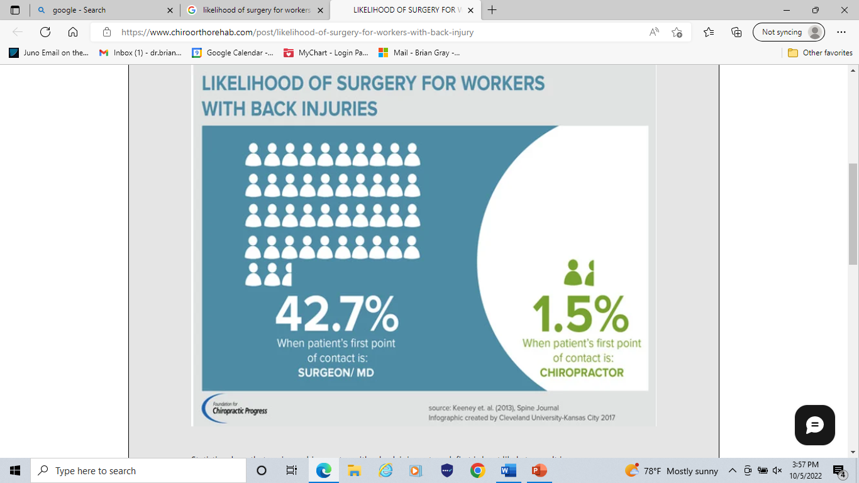

Slide 8
About1 out of 5 workers, 1/5th of the injuries covered by worker’s compensation are spine injuries.
Although a very common injury, how to best manage the injury--- when surgery is appropriate?, or when to proceed to epidural steroid injections?--- are controversial and lack clinical consensus. Moreover, the frequency of surgery among workers with back injuries varies widely from state to state.
For example, less than 10% of workers in California and Florida with back pain had surgery, meanwhile, nearly 20% of injured workers Oklahoma and Tennessee with the same diagnosis had surgery.

Slide 10
2019-202 National Safety Council and the National Council on Compensation Insurance data base
The most costly work comp injury by cause is from MVA. Next is burns, falls and slips. The cost for
burns are primarily for indemnity payments.
Work comp costs by body part is head/CNS, again, primarily due to indemnity costs. Next is;
Multiple body parts (MVA)
Hip/thigh/pelvis
Leg
Neck
Arm/shoulder
Low back
Upper back
Knee

Slide 11
American Journal of Public Health (AJPH)
October 2002
The National Council on Compensation Insurance report (2020) showed that the average
indemnity claim has risen 3%, and continues to rise.
Multiple studies have shown that patients are consistently happier with chiropractic management of
their injuries than they are with medical management.
Am J Public Health. 2002 October; 92(10): 1628–1633.
JAMA Netw Open. 2018;1(1):e180105. doi:10.1001/jamanetworkopen.2018.0105
BMJ. 1990;300:1431–1437. Crossref, Medline, Google Scholar
N Engl J Med. 1998;339:1021–1029. Crossref, Medline, Google Scholar
N Engl J Med. 1999;341:1426–1431.

Slide 15
Neurogenic compromise and the implication of lumbar spine decompression are over-diagnosed and leads to unnecessary surgery in many cases of workers injuries.
Abnormalities within the spinal structure are often incidental findings that have no correlation to the symptoms.
The New England Journal of Medicine study: MRI of the Lumbar Spine In People Without Back Pain
52% had bulge to at least 1 level
27% had a protrusion 1% had an extrusion
38% had an abnormality of more than 1 intervertebral disk
* NEJM Vol. 331,(2); July 14,1994

Slide 16
The New England Journal of Medicine study, as well as many that came
after that, showed similar findings.
This highlighted the importance of correlating imaging findings, with clinical symptoms and differential causative pathology before making any decisions on invasive therapeutic interventions.
A+B+C=D
A. Extremity symptoms past the knee B. Reproducible symptoms with clinical testing C. Imaging that correlates with the involved pathophysiology

Slide 18
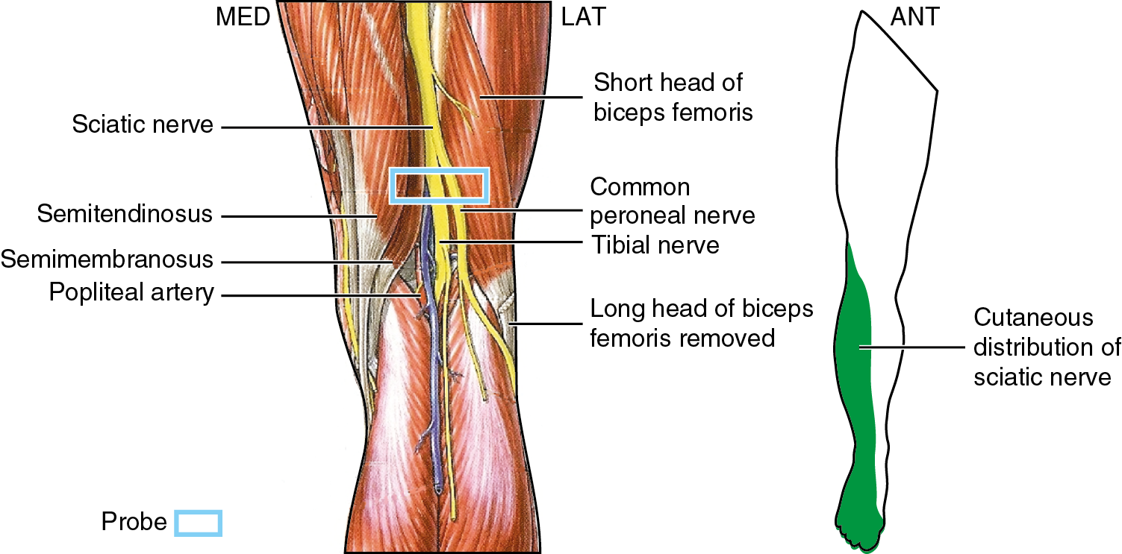
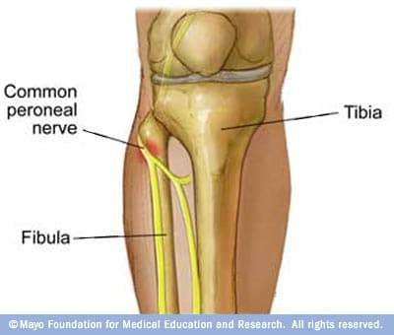

Slide 22
May 2022 Report by the Workers Compensation Research Institute
“Chiropractic Care for Workers with Low Back Pain”
A 28 state comparison evaluating the cost and effectiveness of care provided by non-chiropractic providers (allopathic), chiropractic providers and a mix of both chiropractic and allopathic providers. The states included employee control and employer control work injury provisions. The report found wildly differing utilization across the 28 states. The states with employee control showed a much higher utilization of chiropractic management than those with employer control. Minnesota, Wisconsin, California and New York were the highest employee choice states with chiropractic utilization. The states with the lowest were S. Carolina, Arkansas, Georgia and N. Carolina, with Missouri, at number 8. Chiropractic utilization outside of the work comp arena is estimated to be between 12 and 31%. Of the 28 states in the study, 12 used chiropractic care less than 5%.
The average medical cost per claim for the chiropractic only (PM/EM) group was 47% lower than that for the non-chiropractic claims. The chiropractic only claims also had 35% lower indemnity payments per claim and 26% shorter TD durations. Studies show that workers receiving chiropractic care are far more likely to see their treatment as favorable when compared to allopathic management. The chiropractic only group had an indemnity payment of $492, while the non-chiropractic group had an indemnity payment of $3,604. Interestingly, when the initial E&M was performed by a non-chiropractic provider and then referred out for chiropractic management the indemnity payment rose to $2,502. The weeks of temporary disability for chiropractic only was .7, the non-chiropractic was 4.9, for the non-chiropractic referral to chiropractic was 3.

Slide 23
Recap!
Average medical cost per claim for the chiropractic only (PM/EM) group was 47% lower than
for the non-chiropractic claims.
The chiropractic only claims also had 35% lower indemnity payments per claim.
The chiropractic only group had a $492 indemnity payment The non-chiropractic group had an indemnity payment of $3,604.
The chiropractic only claims 26% shorter TD durations.
The weeks of temporary disability for chiropractic only was .7, the non-chiropractic was 4.9, the non-chiropractic referral to chiropractic was 3.

Slide 24
Why??
This study and many other studies show that workers who see chiropractic providers as their initial point of contact have significantly lower costs per claim due to the lower utilization of;
Advanced imaging (MRI, CT)
Pain management injections
Referrals to spine surgeons
Reduced opioid use.
(MD referral)
The percent of claims referred for MRI for the chiropractic only (PM/EM) group was 3%, the non-chiropractic referral
for MRI was 25%, the mixed-chiropractic was 17%. The utilization of pain injections for chiropractic only was .2%, for medical providers it was 9% and the mixed-chiropractic referral was 6%. The chiropractic only group had a utilization of opioids of .8%, while the medical group had an 17% and the mixed group had 11%.

Slide 25
Using the statistics from the study. But we can extrapolate the
findings to Missouri. We see that in Missouri we had 4,277 cases of LBP reported
within a 2 year period, with a chiropractic utilization rate of ~2%.
Using the number from the study, if we were to increase the chiropractic only
utilization rate to 25%-50% (1,069-2,139) we would see a cost savings of $2,156
in treatment cost/case and $3,112 indemnity payout/case.
This would save between $2.30 million-$4.61 million in medical costs and
$3.33 million - $6.65 million indemnity payments.
Adding these together, we could save up to $5.63 million - $11.26 millions.

Slide 27
Optum insurance findings:
Findings from Optum, subsidiary of UnitedHealth Group: Data shows patients, 70% of the time, choose primary care providers (PCPs) and specialists to treat their lower back pain compared to 30% who choose conservative care.
The data shows conservative care, chiropractic, can save $230 million dollars in annual medical expenditures and can reduce opioid prescribing by 26%.
Goal for Optum: Increase the use of conservative care in two years.
In 2020: Raise the referrals to DCs from MDs from 2% to 10%.
Raise the use of conservative care pathway, which is increasing patient access to DCs, from 31% to 50%.

Slide 31
Brian J. Gray, BS, DC
dr.briangray@gmail.com
(314) 494-1542
(314) 229-6784

Slide 32
Questions?

