Slide 1
Updates & Accomplishments
Missouri Department of Labor & Industrial Relations

Slide 2
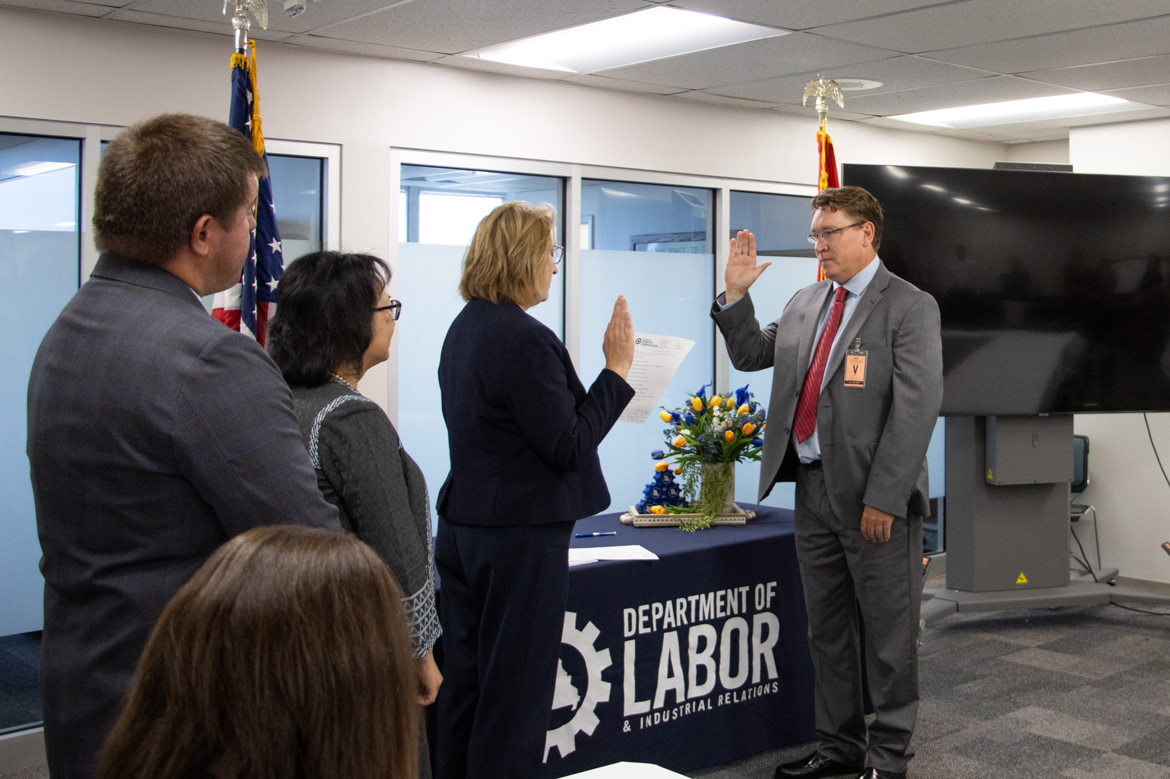
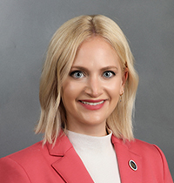
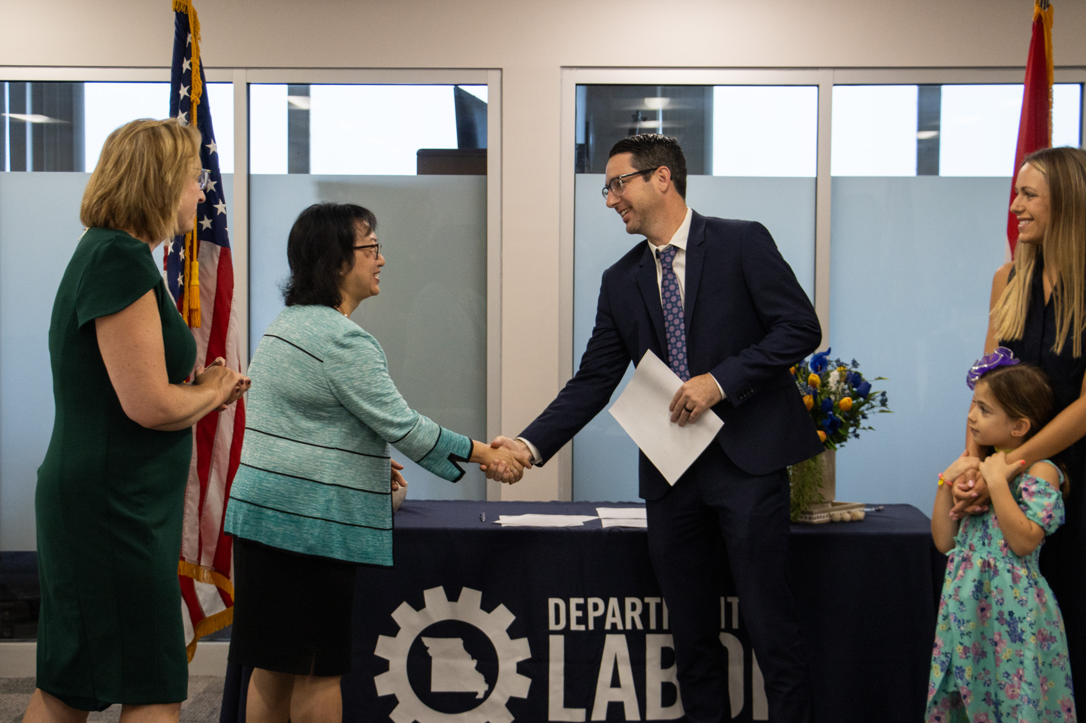
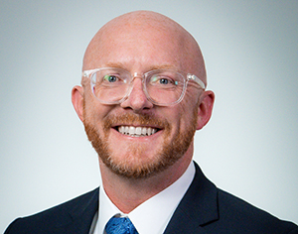
Team Member Updates
Administrative Law Judge Kevin Fick, Division of Workers’ Compensation
Commissioner Lauren Arthur, Labor and Industrial Relations Commission
Administrative Law Judge Skylar Burkes, Division of Workers’ Compensation
Chairperson and Commissioner Rodney Campbell, Labor and Industrial Relations Commission
Notes:
On July 19, Governor Parson appointed Senator Lauren Arthur to the Labor and Industrial Relations Commission. Please welcome Commissioner Arthur, who was sworn in July 22!
Chair Rodney Campbell, whose term recently expired, was also appointed and will remain as Chair of the LIRC. Congratulations, Chairman Campbell!
On July 1, Administrative Law Judge Kevin Fick took the oath of office. He will work from the Springfield adjudication office in the Southern region.
Administrative Law Judge Skyler Burks took the oath of office on July 15 and will work from the Springfield adjudication office.

Slide 3
Safety ~ Growth ~ Opportunity
Promote economic vitality, safety and fairness for Missouri’s businesses and workers.

Slide 4
labor.mo.gov/safe-at-work
Helps identify and correct workplace hazards
Reduces workers' compensation insurance costs
No fines or penalties are assessed
Consultations are confidential and controlled by the employer
No cost
Ensures insurance carriers provide individualized safety assistance when requested
Maintains a list of certified safety consultants that offer independent services
Helps develop a safety and health management program
No cost
Assists miners in implementing safe and healthy work habits
Offers customized consultation and implementation services
Provides specialized trainings, including safety and health, first aid, substance abuse, mine rescue and more
No cost

Slide 5
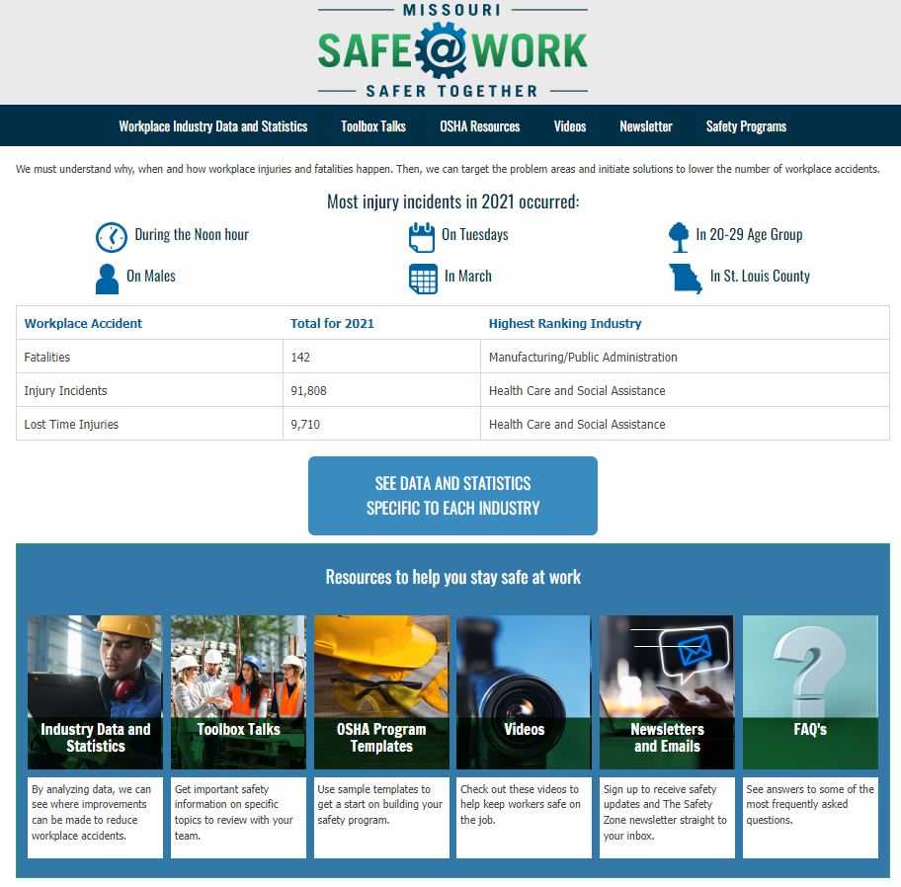
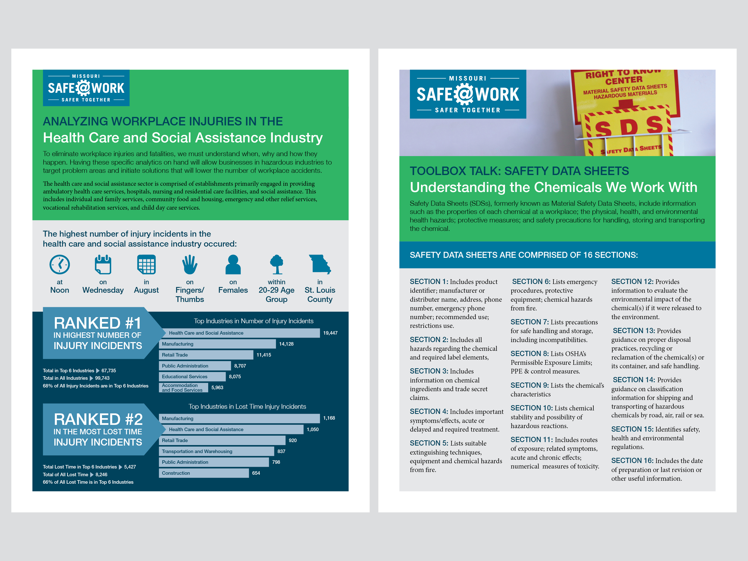
labor.mo.gov/safe-at-work

Slide 6
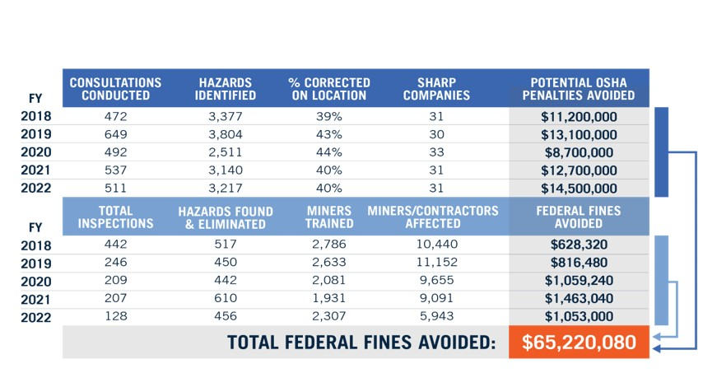
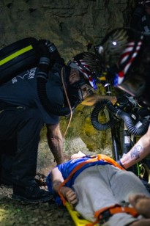
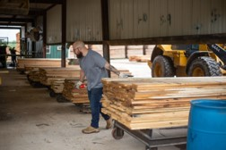
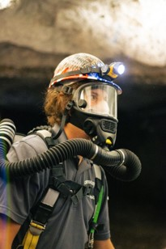
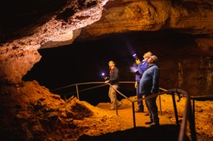
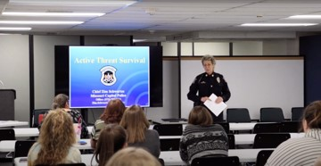
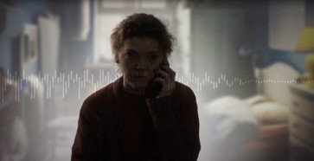
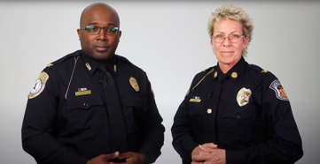
Safety Programs/Initiatives
Division of Labor Standards – On-site Health & Safety/ Mine & Cave Safety Programs
DOLIR Team Safety – A DOLIR strategic initiative team, partnered with Missouri Capitol Police and the Lincoln University Police Department, to create training to improve the safety and security of staff and the citizens they serve.
Threatening Calls Video
DOLIR Safety Training Video
Active Threat Training
Notes:
A strategic initiative team of DOLIR staff, partnering with Missouri Capitol Police and the Lincoln University Police Department, took steps to improve the safety and security of staff and the citizens they serve. This initiative was a winner in the overall state’s 2023 Show Me Challenge competition, based on the “Shark Tank” TV pitch program. They are now finalizing a safety playbook to be shared across state agencies.

Slide 7
farmsafety.mo.gov
Farming in Missouri is a family affair, where generations work alongside one another and pass on valuable lessons about being good stewards of the land. Living on a farm provides youth an opportunity to learn about responsibilities, the value of hard work and many other life skills.
Through a partnership with University of Missouri Extension program and DOLIR, “Gearing Up for Safety” is curriculum produced by Purdue University to assist agricultural educators in educating youth on how to work safely on the farm. Upon completion of all lessons, students will meet the HOOA certification for youth ages 14-15 to perform certain hazardous agriculture tasks for hire.
The curriculum covers 16 different topics on farm safety. Each topic contains a lesson overview, PowerPoint slides and slide notes, videos, activity sheets, teaching aids, quizzes, and case studies. A final written exam is also provided.
Notes:
For youth who are 14 and 15 years of age, this course will provide them with the materials needed to be certified through the Department of Labor’s Hazardous Occupations in Agriculture Order (HOOA). Receiving this certificate enable youth 14 to 15 years of age to perform jobs listed as potentially hazardous such as operating a tractor over 20 PTO hp.

Slide 8
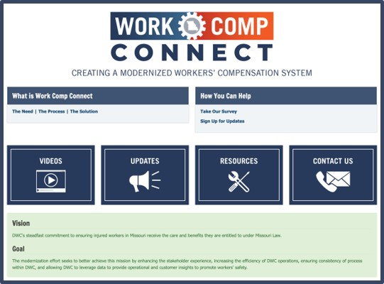
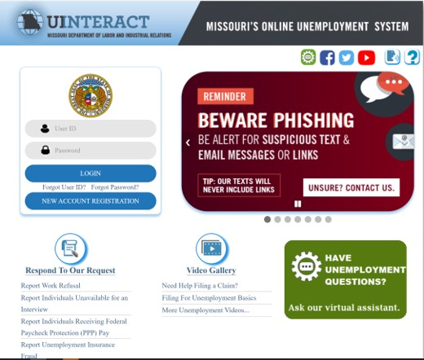
Modernization Efforts
Division of Workers Compensation – Work Comp Connect
Enhancing the stakeholder experience
Increasing the efficiency of DWC operations
Ensuring consistency of process within DWC
Allowing DWC to leverage data to provide operational and customer insights to promote worker safety.
Division of Employment Security – Automation Adjustment
Effective January 1, 2023, state law (House Bill 2168) established the Unemployment Automation Fund to provide consistent funding for automated systems, and associated costs, to improve the administration of the state's UI program.

Slide 9
Investing in Our State Team Members

Slide 10
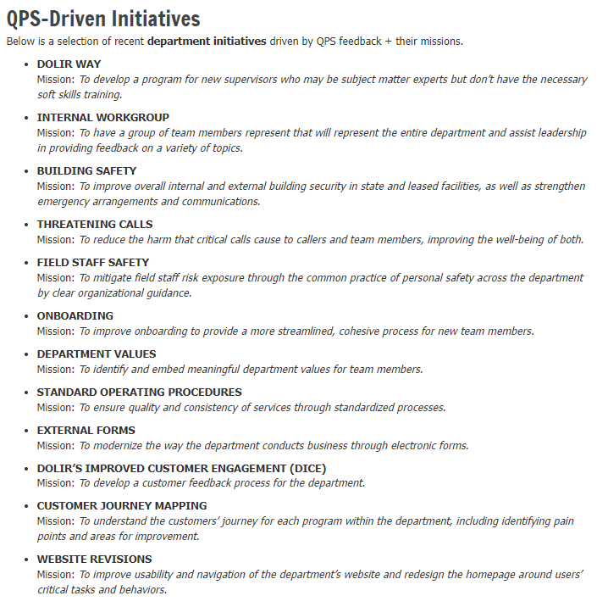
DOLIR Quarterly Pulse Survey Initiatives
The state employee quarterly pulse survey (QPS) has offered the state team members to share their perceptions, perspectives and concerns with state government leaders.
Here are some examples of how DOLIR QPS feedback has helped shape DOLIR’s strategic initiatives:

Slide 11
QPS is the foundation for change that impacts all state team members
Since then, state team members have seen an additional 8.7% increase in February 2023 and a 3.2% raise in July 2024

Slide 12
How are GEAR values exemplified in the work of your team?

Slide 13
To join us in DOLIR’s Working Better Together efforts, email feedback and suggestions to:
MOLaborDirectorsOffice@labor.mo.gov

