Slide 1
Customer Experience 101
Bobby McKee
Director of Citizen Engagement, Office of Administration

Slide 2
We are all the State of Missouri!

Slide 3
What is Customer Experience?
Customer Experience (CX) is the set of emotions, behaviors, and attitudes of people based off of a series of interactions as part of a transaction.

Slide 4
Customer Experience
Customer
Service
Encompasses the entirety of interactions between a citizen and the State of Missouri
Is one part of the entire journey a citizen would take

Slide 5
Why is Customer Experience important?
Industry research from The McKinsey Institute found that improving customer experience drives better critical outcomes for government agencies, including:
01
Continuous Improvement
02
Decreased Cost to Serve
03
Improved Employee Morale
Work smarter, not harder
Try new tools

Slide 6
Continuous Improvement
When processes are improved and customers are satisfied, customers are more likely to trust the agency and to agree that the agency is delivering on its mission.
9x
9x
More likely to trust the agency providing services
More likely to agree that the agency is delivering on its mission

Slide 7
Decreased Cost to Serve
Dissatisfied customers are twice as likely to reach out to an agency three or more times and to publicly express dissatisfaction. By having satisfied customers, who can self-serve, we are able to gain efficiencies and drive our costs down.
2x
More likely to contact the agency 3+ times
2x
More likely to publicly express dissatisfaction

Slide 8
Improved Employee Morale
Long term organizational success is fifty percent driven by organizational health and is mutually reinforced by CX.
By having satisfied customers, we can have a more engaged and happier workforce. This can be tracked easily by QPS.

Slide 9
Why is Customer Experience important?
Decreased Cost to Serve
Easy To Use Services
Reliable and Responsive Services
Improve Trust and Perception
Boost Employee Morale
Satisfied Customers
Satisfied Customers

Slide 10
State of Missouri
LISTEN
UNDERSTAND
ACT
Powered by Qualtrics

Slide 11
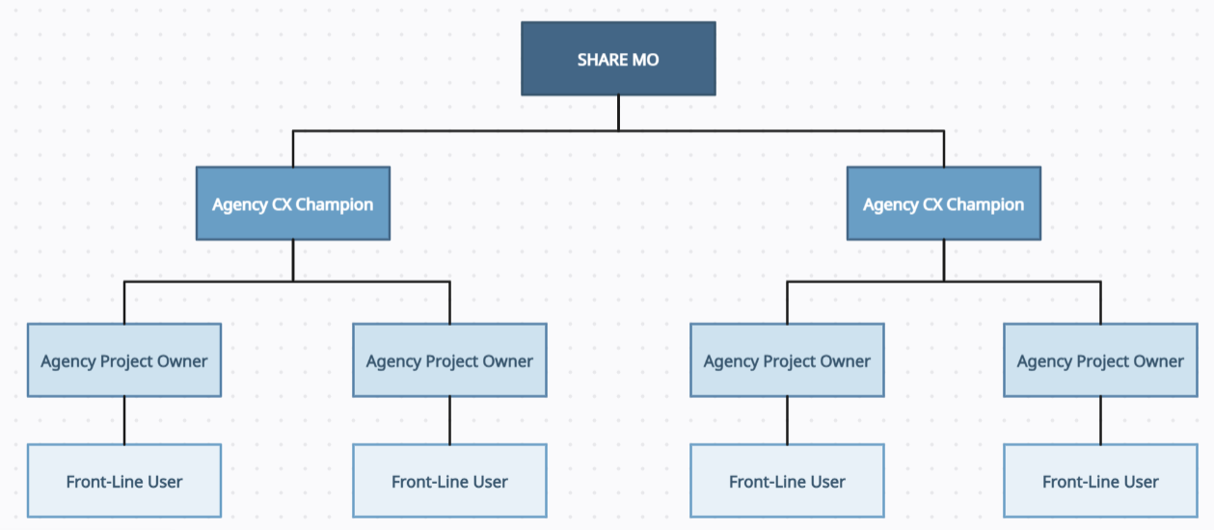
Federated Structure
Using a federated structure, the Office of Administration sets a common vision for the program and enables partner agencies to grow and tailor to meet agency needs. OA provides advisory and technical support and meets with agency representatives monthly to share learnings, track progress, and provide training.

Slide 12
How can SHARE MO help?
01
Provide CX Best Practices
02
Empower stakeholders
03
Provide training and enablement
04
Customer-centric Dashboards
Work smarter, not harder
05
Try new tools
Enable Shared Learnings

Slide 13
We are all the State of Missouri!

