Slide 1
Evidence Based Medical Reports
Nathan A. Mall, MD, CIME
Board Certified Orthopedic Surgeon
Board Certified Independent Medical Examiner

Slide 2
About Me
Grew up in St. Louis
Both parents were teachers
Undergrad – Mizzou
Med School – Duke
Orthopedic Residency – WashU
Fellowship – Rush
Sports medicine and shoulder/UE surgery
Board Certified Orthopedic Surgeon
Board Certified Indep. Medical Examiner
Team Physician
St. Louis Cardinals, St. Louis Blues, St. Louis Rams, Chicago White Sox, Chicago Bulls, Chicago Steel

Slide 3
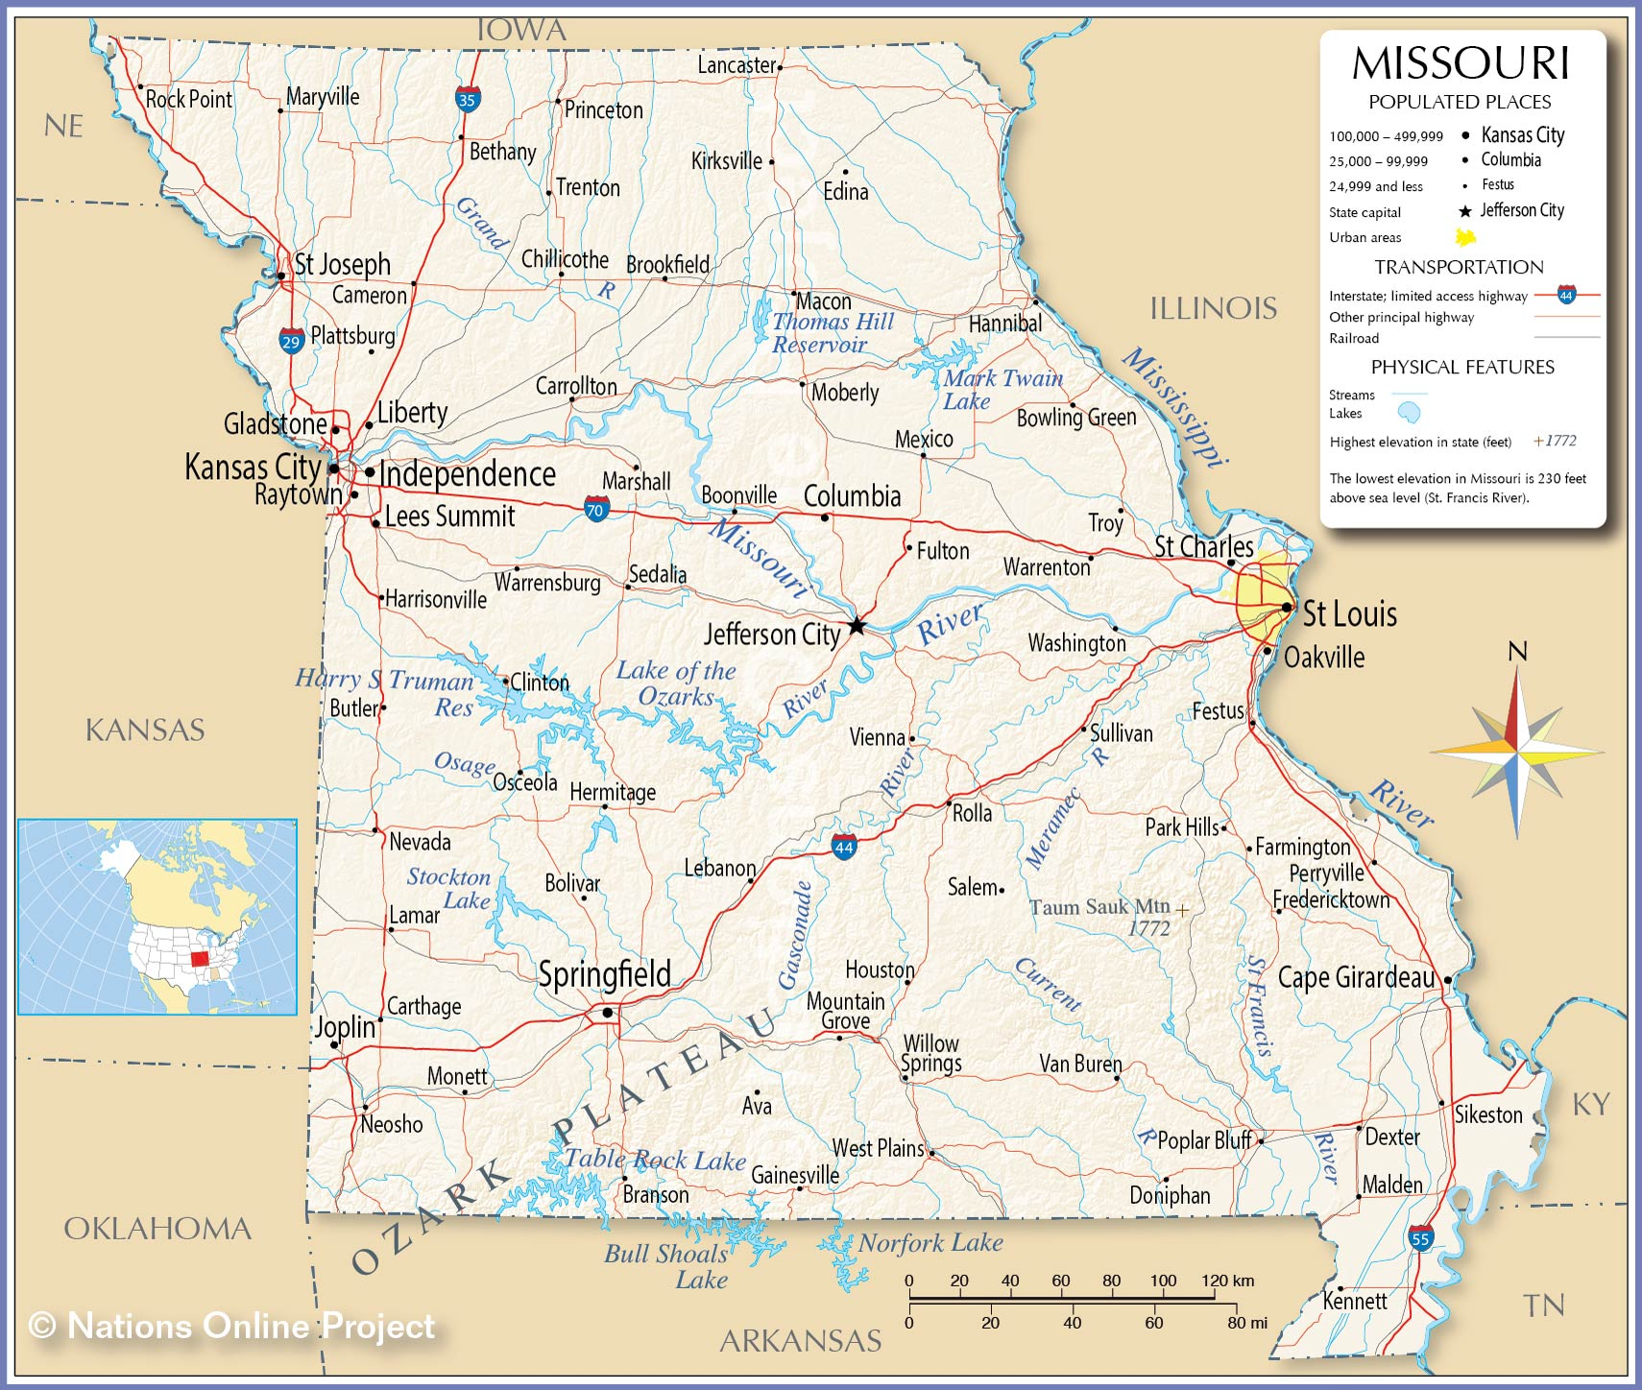
Contact us:
WC Line: (314) 392-5007
Phone: (314) 991-4335
www.nathanmallmd.com
www.motionorthodocs.com
Locations:
-St. Louis
-Jefferson City
-Cape Girardeau

Slide 4
Evidence Based Medicine
Medicine and our knowledge of the body is ever evolving
Medical research continues to improve/evolve
No longer “expert opinion”
Research now is typically considered better in general
Some well done studies are still valid
~Case Law Update

Slide 5
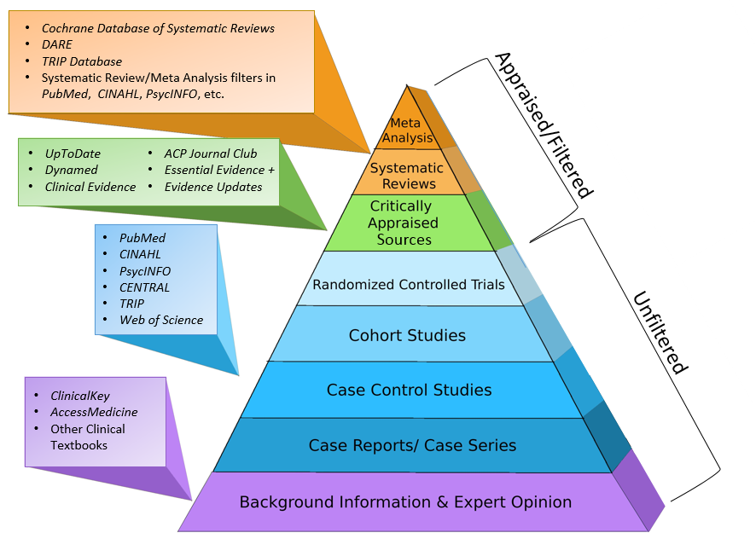
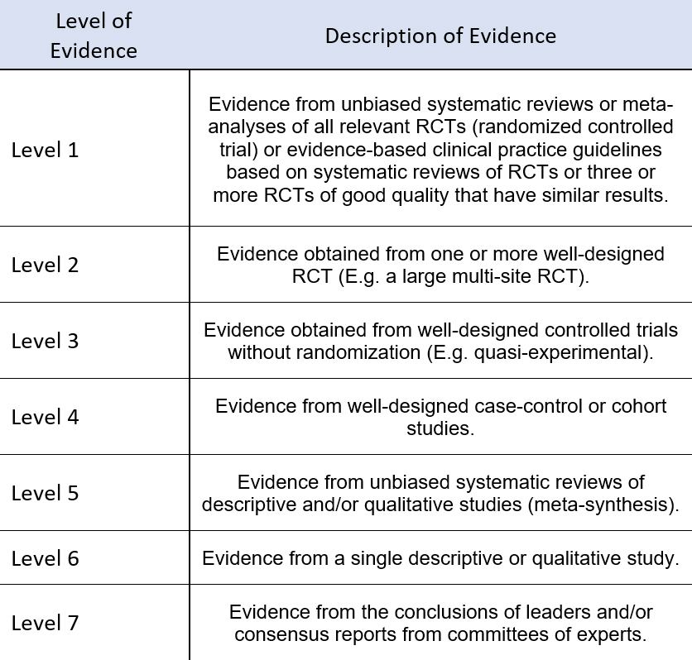

Slide 6
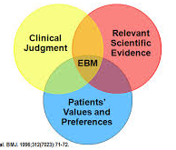
Evidence Based Medicine (EBM)
EBM IS
Combining the medical literature with physicians experience to develop a plan for the patient
Educational tool for patients
“best guess” for expected results with a given treatment
EBM IS NOT
Studies report averages-thus not every patient gets these results
Must look at quality of the study, just because its published doesn’t mean its true.

Slide 7
Evidence Based Medicine in Worker’s Compensation
Gone are the days of “to a reasonable degree of medical certainty” and “in my opinion”
Now “to a reasonable degree of medical certainty and based on current review of the medical literature”
“In my opinion” is replaced by “based on current understanding of peer reviewed research”

Slide 8
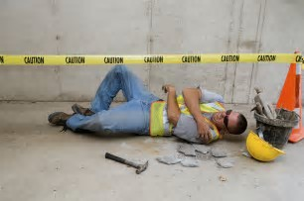
How can Evidence Based Medicine be used in Workers Compensation?
Prevention
Identify “at risk” jobs and modify
Ergonomic assessments/job rotation
Diagnosis
Accurate diagnosis is essential for appropriate treatment and to address causation
Causation
Did pathology come from work injury?
Likelihood that pathology was pre-existing
Was injury mechanism appropriate to cause the pathology present
Appropriate treatment
Surgery vs no surgery
If surgical – what is the right surgery?
Time to MMI estimation
Typical recovery time in general population
Permanent partial disability and ratings
What are normal limitations in general population
Removes secondary gain
Cost savings
Reduce unnecessary testing/treatment
Improve outcomes

Slide 9
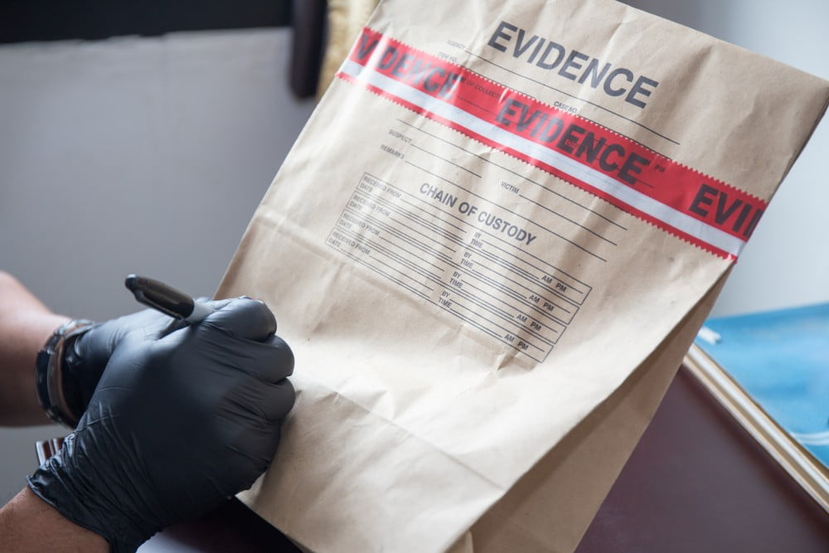
KEY POINT
This is EVIDENCE!
This is more valuable that one person’s opinion
Research studies from reputable journals are scrutinized by peer review process
Generally accepted conclusions
Statistics are appropriate
Medical evidence is independent of:
State laws
Requesting party
Employer bias

Slide 10
Medical Reports
My role:
Provide an accurate diagnosis or plan to achieve diagnosis
Based on current symptoms and examination
Provide an evidence based approach to treatment
Based on diagnosis and medical literature regarding treatment options
Provide an evidence based discussion regarding causation
Interplay between symptoms, injury mechanism, imaging findings and diagnosis
Could injury mechanism cause current diagnosis
Uses medical literature for an independent evaluation of the connection between these
Not my role:
Decide if injury is compensable
Determine how medical literature and EVIDENCE may interact with case law
Ultimate determination of payor
Private health insurance vs workers compensation carrier

Slide 11
Medical Reports
Opinions should be based on medical research and facts
These opinions should be backed by medical evidence
Pure “expert opinion” is less relevant and inferior to medical evidence
The same research is used in non-workers compensation claims
Diagnosis
Example: neck vs shoulder
Medical treatment
Example: biceps tenodesis vs SLAP repair
Recovery time
Estimated time to return to work, sports, activities, gym, etc

Slide 12
Medical Reports
Ultimate goal is to make sure someone gets the right treatment
Sometimes that treatment is NO TREATMENT
Surgery can make people worse!!!
Plastic Surgery Gone Wrong

Slide 13
Accurate Diagnosis
Probably most important step
Without an accurate diagnosis
Cannot recommend treatment
Cannot address causation
Requires full effort from the claimant
We are NOT trying to hurt anyone
Some exam maneuvers will cause pain but not long-lasting

Slide 14
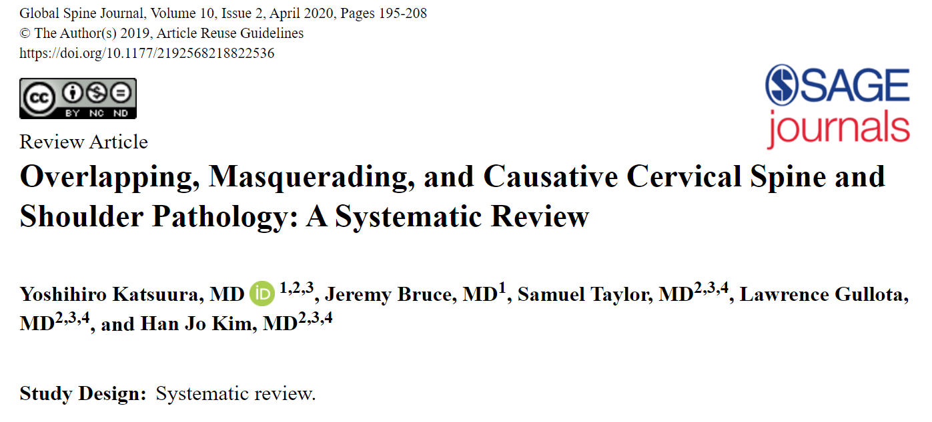
Why does this matter?
History, Exam, and Imaging align
Evidence based treatment = excellent outcomes
Operating on Imaging alone is a recipe for disaster

Slide 15
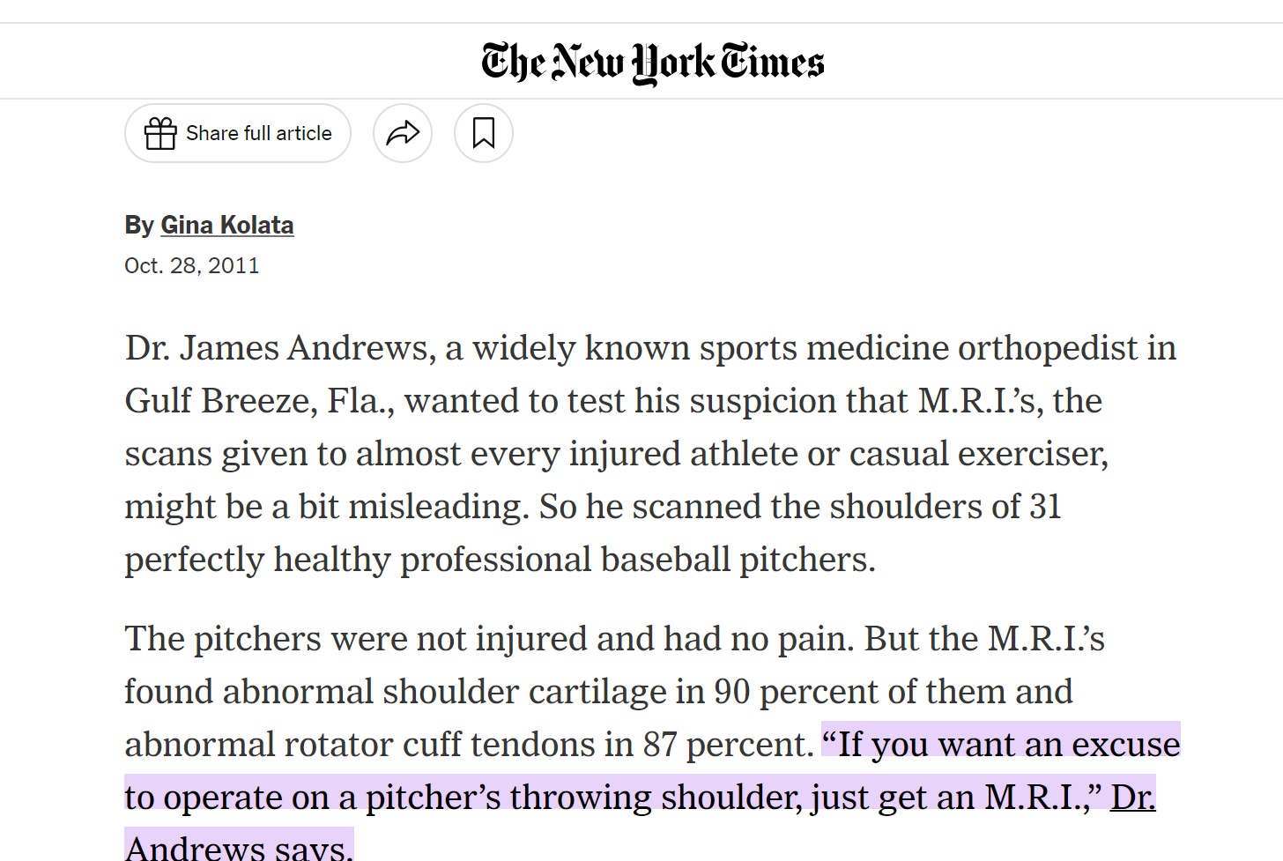
Diagnosis
History
Pain location
Amount of trauma
Timing
Injury mechanism
Examination
Subjective vs Objective findings
PROM vs AROM
Location of tenderness (although tenderness can be subjective)
Provocative manuevers
Imaging
Correlation with history and exam

Slide 16
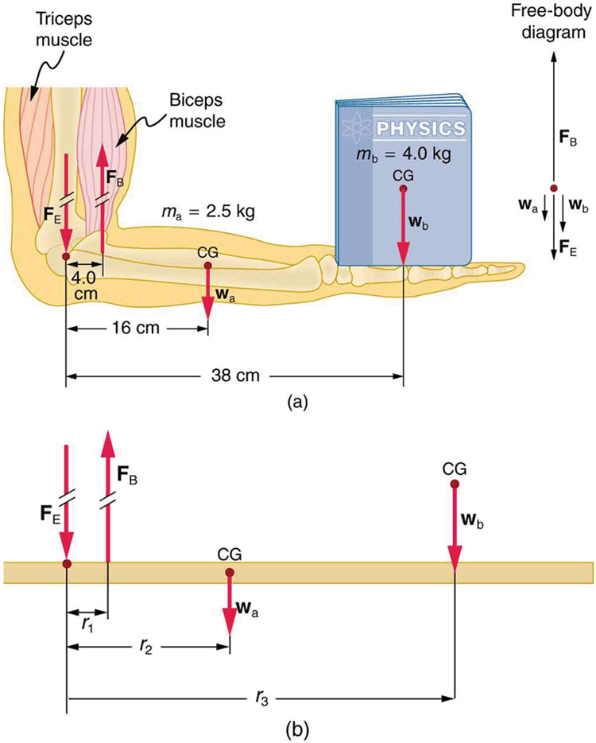
History
Hampton JR, Harrison MJG, Mitchell JRA. Relative contributions of history-taking, physical examination and laboratory investigation to diagnosis and management of medical outpatients. BMJ. 1975;2(5969):486–48
Makes up over 80% of the diagnosis
Injury Mechanism
We know how diagnoses happen
Force
Higher force, higher likelihood of structural injury
Physics
Pain location
Example: shoulder pain
Pain radiation
Numbness/tingling
Length of time
Large rotator cuff tear will not present months later
Labrum may

Slide 17
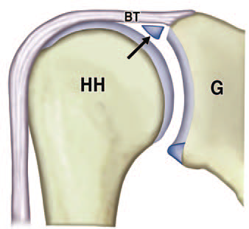
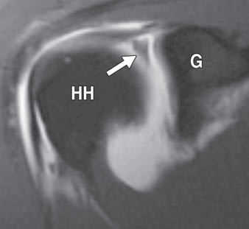
SLAP tears
Vague symptoms
Reduced strength, vague pain, poorly localized, reduced endurance
Typically hurt with overhead activity
Traumatic tears: mechanism of injury
Traction
Bey JSES 1998
fall onto outstretched hand
Impaction loading
Clavert JSES 2004
Heavy lifting or unexpected shifting of heavy objects
Common to see in older patients (can be degenerative/normal aging)
Repetitive Trauma ?
Careful history
Weightlifting, other hobbies/jobs
Modarresi AJR 2011, Keener JAAOS 2009

Slide 18
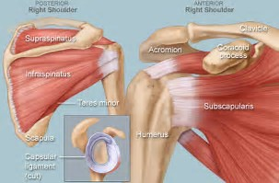
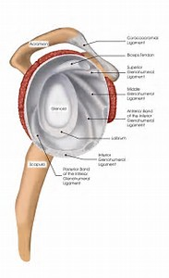
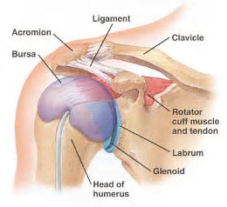
Shoulder Pain
Rotator Cuff
Subacromial bursa
Biceps/labral complex
Posterior labrum
Anterior labrum (instability only)
AC joint
Cervical Spine!

Slide 19
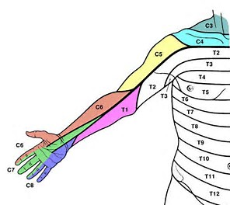
Cervical Spine
C4 and C5 to shoulder region
C6 – thumb/index finger
C7 – long finger
C8 – ring and small finger

Slide 20
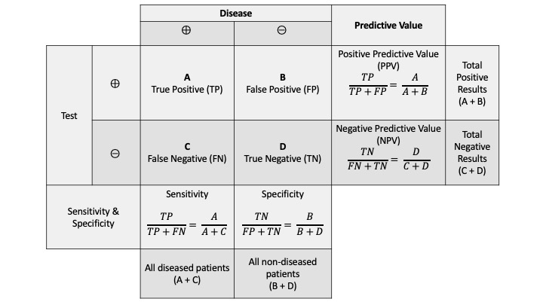
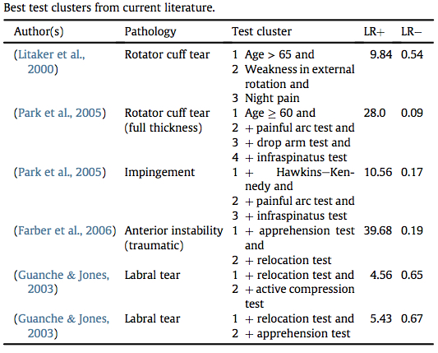
Physical Examination
Positive Predictive Value/Negative Predictive Value
Accuracy increases by number of positive/negative tests
Initial assessment
Swelling, bruising and signs of trauma
Always examine neck and back

Slide 21
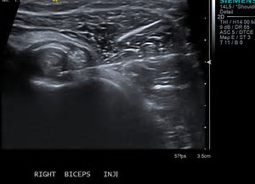
Diagnostic/Therapeutic Injections
Part of the Physical Examination
Classic “impingement test”
Important to localize pain source
Use of differential injections
Always test before and after
May need ultrasound for AC joint/biceps tendon
Shoulder
If NO improvement – cervical spine vs non-organic symptoms
Knee
If NO improvement – extra-articular source (patellofemoral pain) vs non-organic symptoms

Slide 22
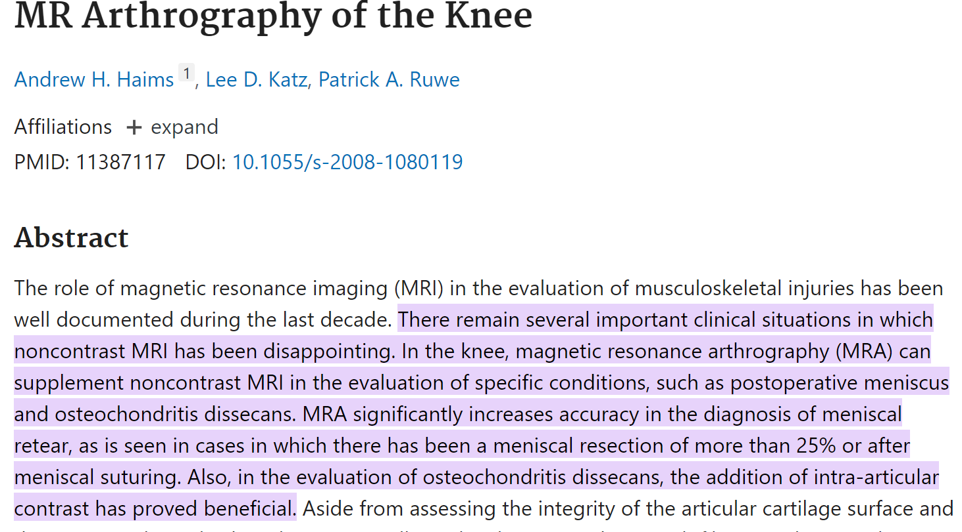
Imaging
Standing X-rays if can ambulate
Important for hip, knee and ankle
MRI
Normal x-rays
Rarely indicated prior to conservative treatment
Shoulder: inability to lift arm/severe RC weakness
Elbow: bruising, pop/pain in biceps
Knee: ligament instability, large joint effusion
Neck/Back: severe radicular symptoms
Failure of conservative care

Slide 23
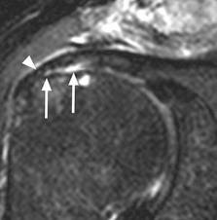
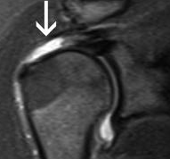
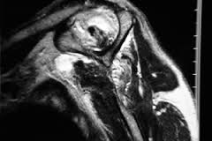
Rotator Cuff Tears
Interpreting the MRI Report
Partial thickness tear-hardest to interpret
Wide spectrum from high grade partial to tendonitis
Full thickness tear
Retracted tears – may need surgery ASAP if traumatic
Fatty atrophy or infiltration – indication of a more chronic problem (still can have acute on chronic)
Can also indicate a nerve compression

Slide 24
Evidence based treatment
Improves outcomes
Better for patient/claimant
Saves money
Better for healthcare system

Slide 25
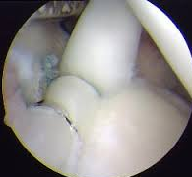
SLAP Treatment/Outcomes
Initial treatment – cortisone (intraarticular)
Physical therapy focusing on scapula and cuff
NSAIDs
Can render asymptomatic
SLAP repair in Worker’s Compensation
65% G/E outomes
Vs 95% in other patients
Denard Arthroscopy 2012
Study of 40 patients with poor results
50% were work comp
Katz Arthroscopy 2009
Return to work 84%; only 48% at same level
Verma HSS J 2007
Biceps tenodesis
7/8 return to work
Werner JSES 2014
Systematic Review
Erickson AJSM 2014

Slide 26
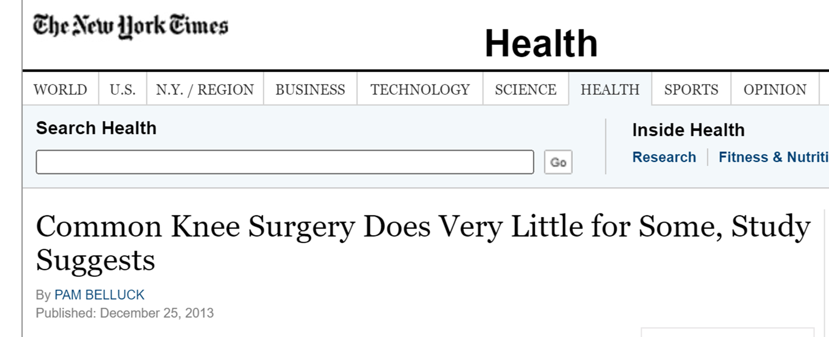
Causation
BIGGER than whose job it is to pay for the treatment
Correlates with treatment
Chronic RC tears treated ENTIRELY different than acute tears
Acute tear – surgery
Chronic tears – injections and if fails then reverse shoulder arthoplasty
Arthritis is treated ENTIRELY different than an acute meniscal tear
Acute tear – knee arthroscopy if fails conservative management
Arthritis – knee replacement if fails conservative management
Arthroscopy can make patients/claimants WORSE

Slide 27
Pre-existing Conditions
Age and activity level are significant factors
Age – some findings common in older patients
Partial thickness or full thickness rotator cuff tears
No tear (49), unilateral tear (59), bilateral tear (68)
Yamaguchi JBJS 2006
Asymptomatic tears
Meniscus tears in the presence of arthritis
Asymptomatic tears
Weight lifters – elbow arthritis, labral tears, RC tears
Athletic injuries
Secondary jobs/hobbies

Slide 28
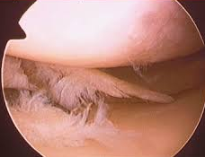
Degenerative vs Pre-Existing
As age ↑ , tissue quality ↓
Easier to tear meniscus or rotator cuff as we age
Does NOT mean that it was present before injury
Must focus on injury mechanism
Look for other clues

Slide 29
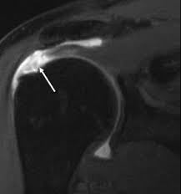
Rotator Cuff Tears
Must differentiate between degenerative and traumatic
WHY? – Treatment is ENTIRELY different
Key is mechanism of injury
Traumatic tears:
typically larger tears, edema in the subacromial space
may require urgent surgery – can become scarred and irreparable
Mall Arthroscopy 2013
Degenerative-insidious onset of pain, minimal injury
treatment is conservative
Not work-related
Acute on chronic tear
Decrease in function
Increase in or development of pain
Mall JBJS 2010

Slide 30
Acute, Traumatic Tears
Tendon quality worsens with age
Cadaver studies: Tensile strength worsens with age
Rickert, et al. 1998
Does NOT mean tendon tear was pre-existing
Fix early
Repairs later than 18 weeks had poor elasticity (compared to those fixed @ 6 wks)
Coleman, et al. JBJS 2003
Higher retear rate in those fixed after 24 mo compared to earlier surgery
Tan, et al. JSES 2015
Improved outcomes with early repair
Mall NA et al. Arthroscopy 2013

Slide 31
Acute, traumatic rotator cuff tears
Demographics:
Younger (avg age = 55 years)
Male (77%)
Injury Mechanism:
Most common was a fall, typically onto an outstretched hand
Others: MVA, forceful ER, lifting heavy object, shoulder dislocation, reaching out to grab rail to prevent fall (traction)
Tear size:
22% < 3cm; 36% 3-5cm; 42% > 5cm
High rate of concomitant pathology, esp. biceps injuries
Healing ranged from 65% - 69%
Mall NA, et al. Arthroscopy 2013

Slide 32
Example
Meniscal tears and arthritis
Evolving medical evidence
Similar to case law
Understanding of disease process and biology is exploding

Slide 33
REFERENCES:
Adelani, Mall, et al. The Use of MRI in Evaluating Knee Pain in Patients Aged 40 Years and Older. J of the Amer Acad of Orthop Surg. 2016.
Altman RD, Farrokhyar F, Fierlinger A, Niazi F, Rosen J. Analysis for prognostic factors from a database for the intra-articular hyaluronic acid (Euflexxa) treatment for osteoarthritis of the knee. Cartilage. 2016;7(3):229–37.
American Academy of Orthopedic Surgeons. Total Knee Replacement by the Numbers.mbers
Bhattacharyya, et al. The Clinical Importance of Meniscal Tears Demonstrated by Magnetic Resonance Imaging in Osteoarthritis of the Knee. J Bone & Joint Surg, 2003.
Bullock, P. Common Knee Surgery Does Very Little for Some, Study Suggests. New York Times, 2013. https://archive.nytimes.com/www.nytimes.com/2013/12/26/health/common-knee-surgery-does-very-little-for-some-study-suggests.html
Cisternas, et al. Racial Disparities in Total Knee Replacement among Medicare Enrollees — United States, 2000–2006. MMWR. 2009
Convill, et al. Clinically relevant molecular biomarkers four use in human knee osteoarthritis: a systematic review. Cartilage 2021.
Driban, et al. Accelerated Knee Osteoarthritis Is Characterized by Destabilizing Meniscal Tears and Preradiographic Structural Disease Burden. Arthritis Rheumatol. 2019
Englund, et al. The Meniscus in Knee Osteoarthritis. Rheum Dis Clin N Am, 2009.
Englund M, Guermazi A, Gale D, et al. Incidental meniscal findings on knee MRI in middle-aged and elderly persons. N Engl J Med 2008
Englund, et la. Effect of meniscal damage on the development of frequent knee pain, aching, or stiffness. Arthritis Rheum. 2007 Dec;56(12):4048-54.
Englund, et al. The role of the meniscus in knee osteoarthritis: a cause or consequence? Radiol Clin North Am. 2009
Englund, et al. Evidence that meniscus damage may be a component of osteoarthritis: the Framingham study. Osteoarthritis Cartilage 2016.
Eymard F, Chevalier X, Conrozier T. Obesity and radiological severity are associated with viscosupplementation failure in patients with knee osteoarthritis. J Orthop Res. 2017.
Farina EM et al. Meniscal and mechanical symptoms are associated with cartilage damage, not meniscal pathology. J Bone Joint Surg Am 2021 Mar 3; 103:381.
Ghouri, et al. The relationship between meniscal pathologies, cartilage loss, joint replacement and pain in knee osteoarthritis: a systematic review. Osteoarthritis and Cartilage 2022.
Guermazi, et al. Severe radiographic knee osteoarthritis – does Kellgren and Lawrence grade 4 represent end stage disease? – the MOST Study. Osteoarthritis Cartilage. 2015
Guermazi, et al. Baseline radiographic osteoarthritis and semi-quantitatively assessed meniscal damage and extrusion and cartilage damage on MRI is related to quantitatively defined cartilage thickness loss in knee osteoarthritis: the Multicenter Osteoarthritis Study. Osteoarthritis Cartilage 2015
Heidari. Knee osteoarthritis prevalence, risk factors, pathogenesis and features: Part I. Caspian J Intern Med. 2011
Holliday, et al. Lifetime body mass index, other anthropometric measures of obesity and risk of knee or hip osteoarthritis in the HOAL case-control study. Osteoarthrtitis Cartilage 2011.
Khan, et al. A family history of knee joint replacement increases the progression of knee radiographic osteoarthritis and medial tibial cartilage volume loss over 10 years. Osteoarthritis Cartilage 2015
Kim, et al. The 22 to 25-Year Survival of Cemented and Cementless Total Knee Arthroplasty in Young Patients. J Arthroplasty, 2021.
Kim, et al. 20-Year Minimum Outcomes and Survival Rate of High-Flexion Versus Standard Total Knee Arthroplasty. J Arthroplasty, 2021.
Kornaat, et al. Osteoarthritis of the knee: association between clinical features and MR imaging findings. Radiology 2006
Laupattarakasem, et al. Arthroscopic debridement for knee osteoarthritis. Cochrane Database Syst Rev 2008.
Lohmander, et al. Incidence of severe knee and hip osteoarthritis in relation to different measures of body mass: a population-based prospective cohort study. Ann Rheum Dis. 2009
Mass and Katz. The influence of meniscal pathology in the incidence of knee osteoarthritis: a review. Skeletal Radiol. 2023
McHugh, et al. Mechanical symptoms and meniscal tear: a reappraisal. Osteoarthritis and Cartilage. 2022.
Moyer, et al. Alignment, body mass and their interaction on dynamic knee joint load in patients with knee osteoarthritis. Osteoarthritis Cartilage 2010.
Newman, et al. Radiographic vs. MRI vs. arthroscopic assessment and grading of knee osteoarthritis - are we using appropriate imaging? Journal of Experimental Orthopaedics. 2022.
Okada, et al. Comparison of meniscal extrusion and osteophyte formation at the intercondylar notch as a predictive biomarker for incidence of knee osteoarthritis-Data from the Osteoarthritis Initiative-. J Orthop Sci. 2019
Pan, et al. The offspring of people with a total knee replacement for severe primary knee osteoarthritis have a higher risk of worsening knee pain over 8 years. Ann Rheum Dis. 2016
Rezuş, et al. From Pathogenesis to Therapy in Knee Osteoarthritis: Bench-to-Bedside. Int J Mol Sci. 2021
Roemer, et al. What comes first? Multitissue involvement leading to radiographic osteoarthritis: magnetic resonance imaging-based trajectory analysis over four years in the osteoarthritis initiative. Arthritis Rheumatol. 2015
Shang, et al. A systematic review, umbrella review, and quality assessment on clinical translation of stem cell therapy for knee osteoarthritis: Are we there yet? Stem Cell Research & Therapy, April 2023.
Siemieniuk, et al. Arthroscopic surgery for degenerative knee arthritis and meniscal tears: a clinical practice guideline. BMJ. 2017
Sihvonen, et al. Mechanical symptoms and arthroscopic partial meniscectomy in patients with degenerative meniscus tear: a secondary analysis of a randomized trial. Ann Intern Med. 2016
Sihvonen R, Englund M, Turkiewicz A, et al. Mechanical symptoms as an indication for knee arthroscopy in patients with degenerative meniscus tear: a prospective cohort study. Osteoarthritis Cartilage. 2016
Thorlund, et al. Arthroscopic surgery for degenerative knee: systematic review and meta-analysis of benefits and harms. Br J Sports Med 2015.
Yoshitomo, et al. Predictors of Effectiveness of Platelet-Rich Plasma Therapy for Knee Osteoarthritis: A Retrospective Cohort Study. J Clin Med. 2021 Oct; 10(19): 4514.
Zhan, et al. Radiographic OA, bone marrow lesions, higher body mass index and medial meniscal root tears are significantly associated with medial meniscus extrusion with OA or medial meniscal tears: a systematic review and meta-analysis. Knee Surg Sports Traumatol Arthrosc. 2023.

Slide 34
Common Misconceptions
Meniscus tears come from an injury
Meniscus tears lead to arthritis
Meniscus tears cause mechanical symptoms
locking, catching, popping
Arthritis pain occurs slowly over time
Arthritis occurs because of repetitive trauma
“cleaning up” arthritis is effective
Knee replacements only last 10 years

Slide 35
Skewed View
In worker’s compensation, all patients believe their tear came from an injury or from repetitive job duties
Vast majority of private health patients have no recollection of an injury or an event
present with medial or lateral knee pain
Perhaps no pain, just swelling
Over 1 M meniscus surgeries/year

Slide 36
What we’ve learned….

Slide 37
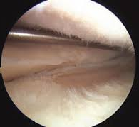
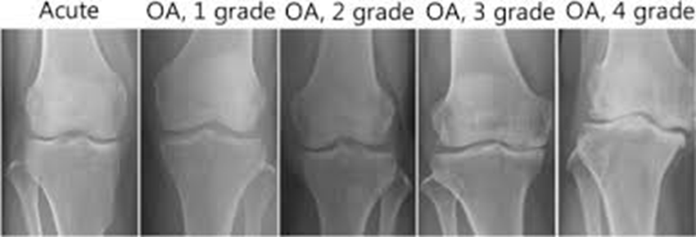
Meniscus Tears
Prevalence
60-70 per 100k
Roughly the same as stroke in Caucasions (59-63 per 100k)
In the setting of osteoarthritis (Kellgren grade 2 or more) – 63% in those with symptoms and 60% in those who are asymptomatic
Prevailing factor = >51%
Meniscus tear with OA = 60% even without symptoms
Meniscus tear without OA = 32% with symptoms and 23% without symptoms

Slide 38
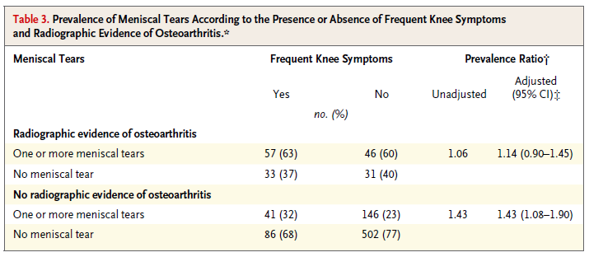

Slide 39
Advanced Imaging
Standing X-ray more valuable than MRI with respect to treatment
If greater than 50% narrowing, MRI not needed
No impact on treatment recommendations

Slide 40
MRI of Knee Arthritis
Expected Findings:
Meniscus tearing
Likely meniscal extrusion
Bone marrow edema/subchondral fracture
Grade 4 (full-thickness) chondrosis
Osteophyte formation
“Osteoarthritis is a progressive and degenerative condition, with unlikely regression and restoration of damaged structures. Diagnosis is often achieved in advanced stages when morphological alterations are already visible in conventional imaging. ”

Slide 41
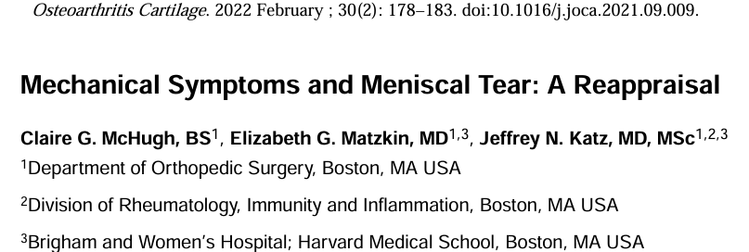
MYTH: Mechanical symptoms are caused by meniscus tears
Conclusion: Our examination of the literature does not support the hypothesis that mechanical symptoms are related to the presence of meniscal tear or portend better outcomes after arthroscopic surgery.

Slide 42
Those with mechanical symptoms did more poorly and less satisfied
Mechanical symptoms persisted despite arthroscopic surgery

Slide 43
Myth: I can scope your knee and “clean out” the arthritis

Slide 44
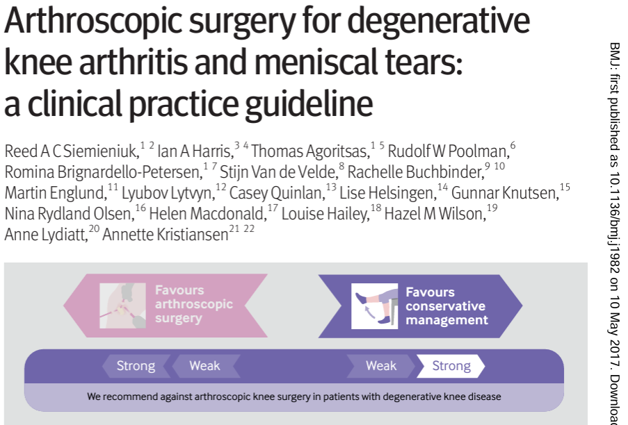
We make a strong recommendation against the use of arthroscopy in nearly all patients with degenerative knee disease, based on linked systematic reviews; further research is unlikely to alter this recommendation
This recommendation applies to patients with or without imaging evidence of osteoarthritis, mechanical symptoms, or sudden symptom onset

Slide 45
Myth: Arthritis has to be a slow, progressively worsening cause of pain
Most people think arthritis causes mild pain at first and then progressively worsens over time
Implies that people “know” they have arthritis

Slide 46
Onset of Radiographic Arthritis
Age and BMI
Higher incidence
age < 65 with BMI > 32.5
age >65 and BMI<35
Higher synovitis and infrapatellar fat pad edema
Higher incidence of bone marrow and cruciate ligament edema
Indicates this is inflammatory and NOT structural
Incidence of meniscal tearing WITHOUT trauma/injury
Driban et al. Risk factors and the natural history of accelerated knee osteoarthritis: a narrative review. BMC Musculoskelet Disord. 2020; 21: 332.

Slide 47
It never hurt before…
At the visit before incident esKOA, most knees already had moderate-to-severe radiographic osteoarthritis using the original (62%) or alternate (50%) definition (versus <15% for either definition of no esKOA).
Over 80% of knees that reached the criteria for esKOA achieved this based on increased knee symptom severity – typically without worsening radiographic severity (80%).
Driban, et al. The natural history of end-stage knee osteoarthritis: Data from the osteoarthritis initiative. Seminars in Arthritis and Rheumatism. Volume 58, February 2023

Slide 48
Synovitis in osteoarthritis: current understanding with therapeutic implications (2017)
Modern concepts of osteoarthritis (OA) have been forever changed by modern imaging phenotypes demonstrating complex and multi-tissue pathologies involving cartilage, subchondral bone and (increasingly recognized) inflammation of the synovium.
The synovium may show significant changes, even before visible cartilage degeneration has occurred, with infiltration of mononuclear cells, thickening of the synovial lining layer and production of inflammatory cytokines.

Slide 49
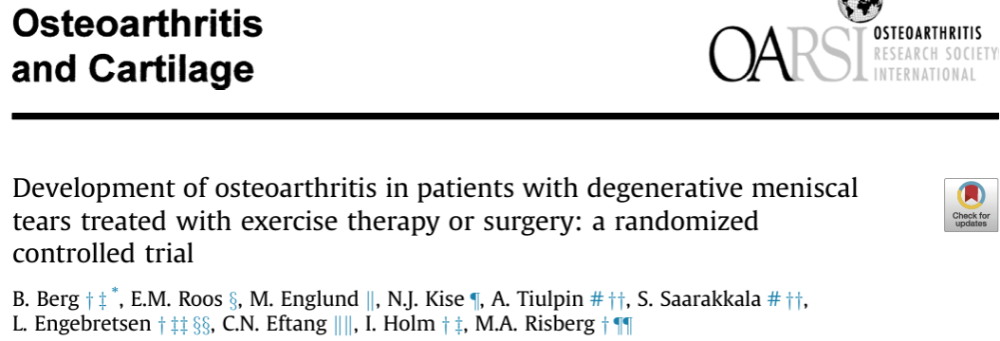
The study was inconclusive with respect to potential differences in progression of individual radiographic features after surgical and non-surgical treatment for degenerative meniscal tear.
Further, we found no strong evidence in support of differences in development of incident radiographic knee osteoarthritis or patient-reported outcomes between exercise therapy and arthroscopic partial meniscectomy.

Slide 50
Systematic review of 30 different articles
Symptom progression associated with: age, ethnicity, body mass index, co-morbidity count, magnetic resonance imaging (MRI)-detected infrapatellar synovitis, joint effusion and baseline OA severity
NOT INJURY

Slide 51
Myth: Knee replacements only last 10 years

Slide 52
“Lifespan” of Knee Arthroplasty
The 22 to 25-Year Survival of Cemented and Cementless Total Knee Arthroplasty in Young Patients.
Kim, et al. J of Arthroplasty 2021
98% of knees still in place at average 24 year follow-up
Range 22-25 yrs

Slide 53
Effect of exercise and/or educational interventions on physical activity and pain in patients with hip/knee osteoarthritis: A systematic review with meta-analysis (2022)
Discussion: The current evidence indicated that combination therapy of exercise and educational intervention leads to improved physical activity and pain reduction in hip/knee OA patients
These findings support the use of a combination therapy of exercise and educational intervention to promote physical activity levels in patients with hip/knee OA.

Slide 54
What do you believe?
“People are confused about the cause of their pain, and bewildered by its variability and randomness. Without adequate information and advice from healthcare professionals, people do not know what they should and should not do, and, as a consequence, avoid activity for fear of causing harm.”
Participants' opinions varied on whether their osteoarthritis progression could be influenced. 46% of participants attributed control to other people. Most participants believed that a previous injury had caused their osteoarthritis and that both themselves and others had some influence over their osteoarthritis symptoms
Patient beliefs about who and what influences their hip and knee osteoarthritis symptoms and progression
Exercise interventions and patient beliefs for people with hip, knee or hip and knee osteoarthritis: a mixed methods review (2018)

Slide 55
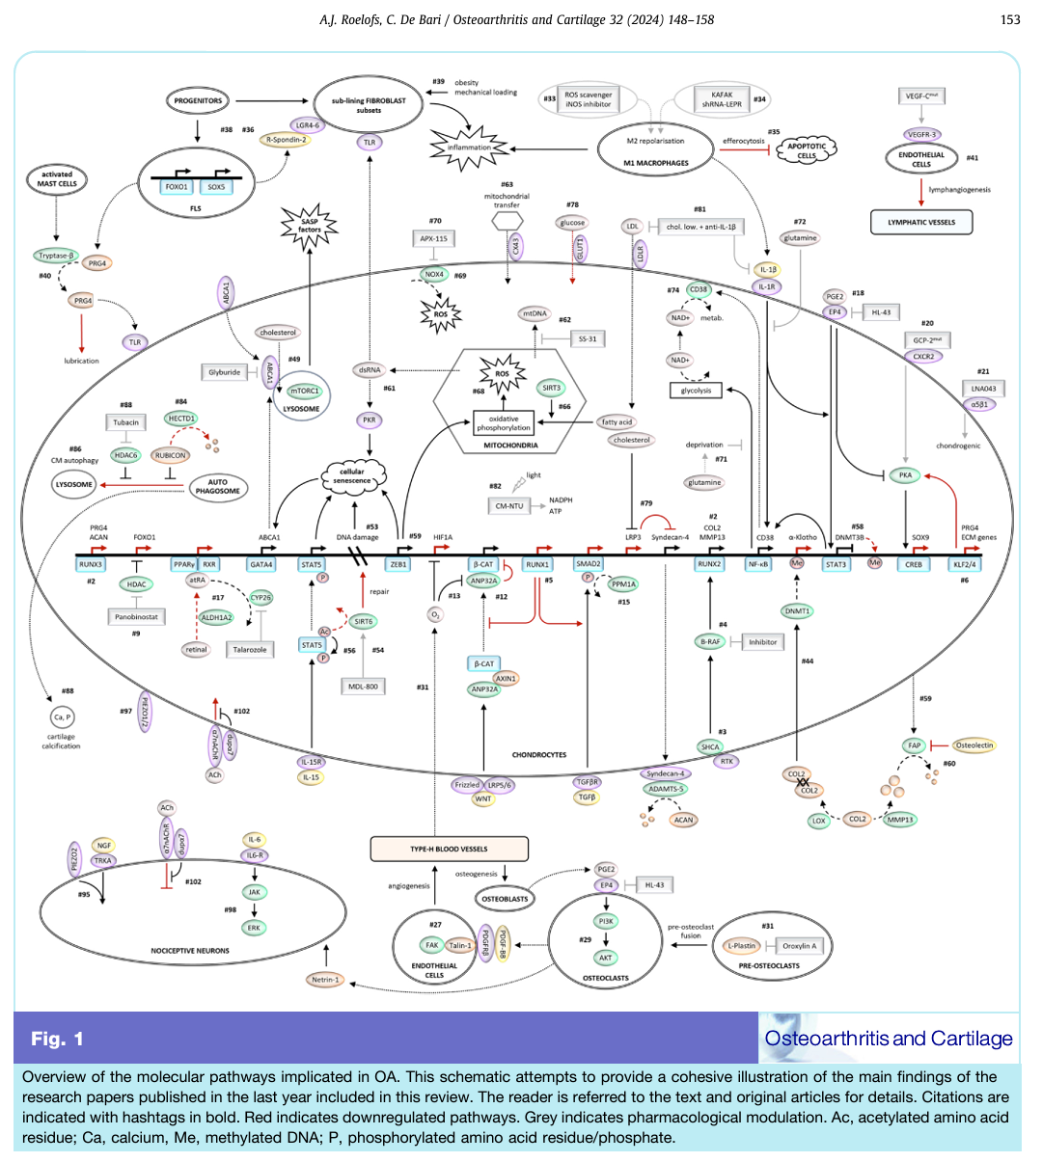

Slide 56
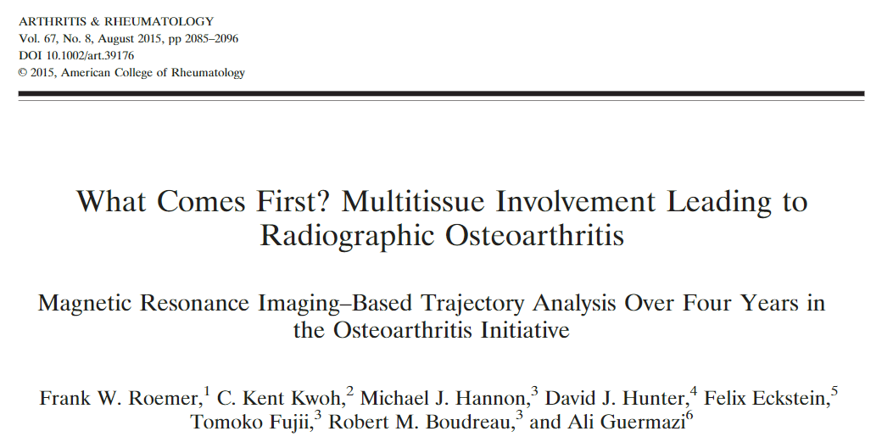
Synovitis occurs first
Bone marrow changes may predate the loss of cartilage
Meniscal damage likely predates radiographic OA
MRI evidence of synovitis or bone marrow lesion increased risk of having radiographic OA 2.5X

Slide 57
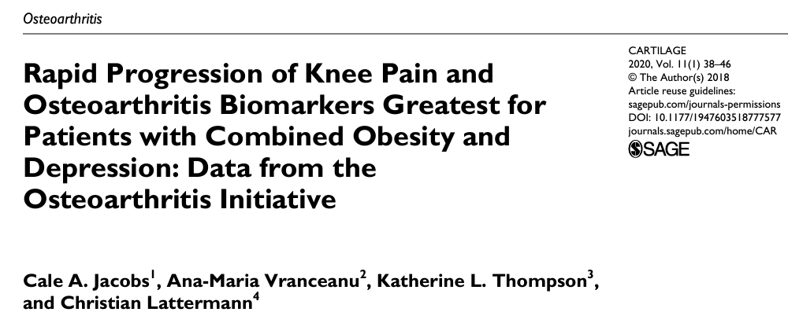
Obesity and Arthritis
Not entirely “stress” related
Biologic
O + D group also demonstrated significant increases in CtXii (P = 0.01) and CtXiα (P = 0.005), whereas the NON and OBeSe groups did not.
Conclusions: the combination of inferior knee pain, physical function, and significantly greater increases in biomarkers of cartilage degradation and bony remodelling suggest a more rapid progression for obese Oa patients with comorbid depression
the link between systemic disease, inflammatory burden, and progressive cartilage degradation is in line with increasing concerns about a degenerative synovial environment in early osteoarthritic knees that progress to treatment failure with biologic restoration procedures

Slide 58
A total of 80 studies were included in the final review and 89 statistically significant individual molecular biomarkers were identified.
C-telopeptide of type II collagen (CTXII) was shown to predict progression of knee OA in urine and serum in multiple studies.
Synovial fluid vascular endothelial growth factor concentration was reported by 2 studies to be predictive of knee OA progression.

Slide 59
Biologic Evidence
Radiographic tibiofemoral osteoarthritis (16/18 knees vs. 2/20 knees) and meniscal abnormalities (7/9 vs. 2/10 index knees) were more common among offspring with parental osteoarthritis status than not.
A Novel Approach to Studying Early Knee Osteoarthritis Illustrates that Bilateral Medial Tibiofemoral Osteoarthritis is a Heritable Phenotype: An Offspring Study. Rheumatology Int. 2022

Slide 60
The disease mechanism involves a combination of cellular and biochemical changes in the joint tissues that causes structural changes over the years
Conclusion: Urinary CTXII showed stronger associations with radiographic OA and appears to be a reliable prognostic marker, while changes in other biomarkers were found in early symptomatic OA, supporting the phasic nature of OA.

Slide 61
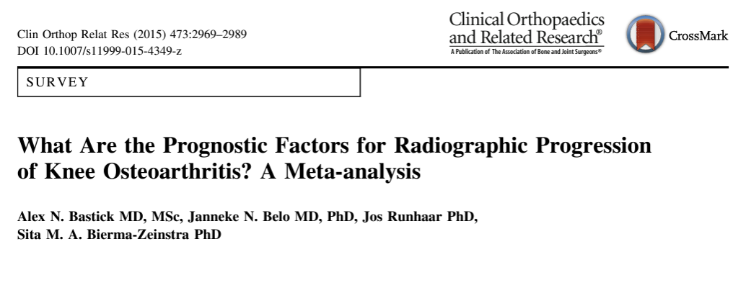
Our best-evidence synthesis showed strong evidence that varus alignment, serum hyaluronic acid, and tumor necrosis factor-α are associated with knee OA progression.
There is strong evidence that sex, former knee injury, quadriceps strength, smoking, running, and regular performance of sports are not associated with knee OA progression.

Slide 62
Biology of Knee Osteoarthritis
Key mediators in this metabolic link between obesity and OA could be resistin, among other cytokines secreted by the adipose tissue
Patients with primary knee OA had elevated levels of serum resistin compared with healthy controls. We demonstrated that elevated serum resistin positively correlated with adiposity measures, inflammatory markers and WOMAC index.
Association of adipokines with severity of knee osteoarthritis assessed clinically and on magnetic resonance imaging(2023)
Serum adipokines, particularly leptin was associated with severity of various structural defects of the knee joint on MRI beyond age, sex and BMI in earlier knee OA.
Relationship between serum resistin, body fat and inflammatory markers in females with clinical knee osteoarthritis (2020)

Slide 63
Biology of Knee Arthritis
Synovitis mediates the relationship between medial meniscus extrusion (rather than meniscus damage) and KOA progression.
The mediating role of synovitis in meniscus pathology and knee osteoarthritis radiographic progression (2024)
Effusion-synovitis worsening mediates the association between body mass index and Kellgren-Lawrence progression in obese individuals: data from the Osteoarthritis Initiative (2022)

Slide 64
KEY POINT
This is EVIDENCE!
This is more valuable that one person’s opinion
Research studies from reputable journals are scrutinized by peer review process

Slide 65
Example: Carpal Tunnel Syndrome

Slide 66
Carpal Tunnel Diagnosis
Symptoms
Night pain/numbness
Driving numbness
Dropping objects
CTS-6
Atroshi Qual Life Res 2009
Physical Exam
Phalens
Flexion/Compression
Tinels
Atrophy APB
EMG/Nerve Conduction
Guidelines outlined in AANEM Monograph 2011 (also accepted by AAOS)
Median motor distal latency > 4.5ms (8cm)
Sensory distal latency > 2.3ms (8cm)
Temp sensitive
May be negative
PPV 86% / NPV 20%
Taylor-Gjevre Can Fam Physician 2010
Surgery gets good results
Kitsis Acta Orthop Belg 2002
Ultrasound (median nerve area >10mm2) – similar sens/spec as NCS
Fowler JBJS 2014
Carpal tunnel injection

Slide 67
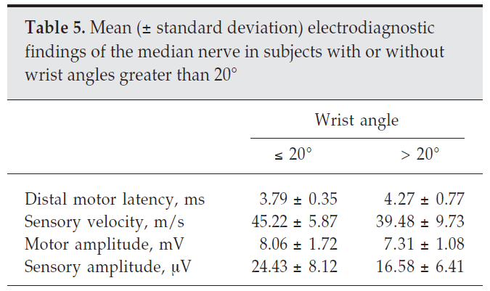
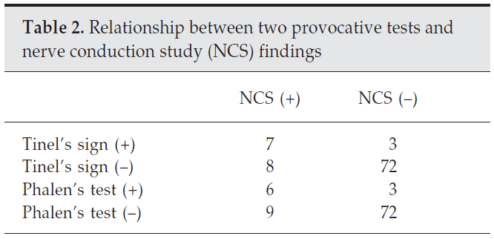
Increased risk in those with wrist extension > 20 degrees

Slide 68
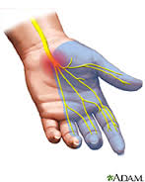
Carpal Tunnel
Prospective Study 1200 cases of CTS
Mean age in 45 in FM and 44 in Males
Higher incidence in FM (1.4 per 1,000 vs 0.6 per 1,000 persons)
30% of FM and 20% of Males had Diabetes, thyroid disease or were obese
Identified Industries with highest AFE (Attributable Risk Fractions of CTS to work among exposed persons)
National research Council, National Academy of Sciences. Musculoskeletal disorders in the Workplace. National Academy press, 2001.

Slide 69
Carpal Tunnel and Work Relatedness
Incidence in general population 3.5-7%
Ferry S. Br J Rheumatol 1998
Papanicolau J Hand Surg 2001
Incidence in typers - 3.5%
Stevens JC Neurology 2001
The American Conference for Governmental Industrial Hygienists (ACGIH) Threshold Limit Value (TLV) for hand activity level
CTS increases with each level
Burt Occup Environ Med 2013
Strain index (SI) useful to measure risk

Slide 70
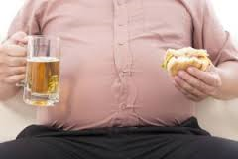
Carpal Tunnel and Obesity
“Overweight” (BMI > 25) – increased risk 1.5x
“Obese” (BMI > 30) – increased risk 2x
Risk increased with each unit increase in BMI
Shiri et al. Obesity Reviews 2015
Obese – OR 2.29
Age > 50 – OR 3.1
Highest “work-related” factor
Force worker rating (Borg) – OR 2.04
Repetition of forceful gripping > 10/min – OR 1.45
Fan et al. Amer. J Ind Med 2015

Slide 71
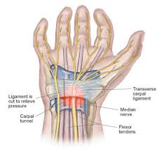
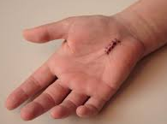
Carpal Tunnel Release
Return to work is most influenced by surgeon recommendations (Ratzon et al Occ Med 2006).
Range 1-90 days, typically I wait 1-2 weeks for incision to heal, then can return to work.
Full duty depends on job demands and length of symptoms/weakness
Low morbidity → early return to work, little permanent impairment ratings if caught early before sensory/motor deficits
Longer duration of symptoms has been associated with poorer results

Slide 72
Carpal Tunnel
Pre-surgery disability compensation had 5X odd of long term disability
Conclusion: “An integrated approach to CTS-related disability prevention could include identifying and addressing combined risk factors soon after claim filing, more efficient use of conservative treatments and appropriate work modifications to minimize early work loss, and, when indicated, timely surgical intervention.”
Spector Am J Ind Med 2012

Slide 73
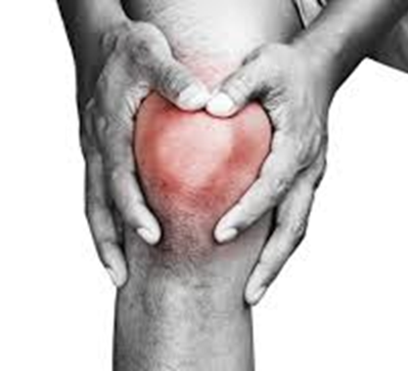
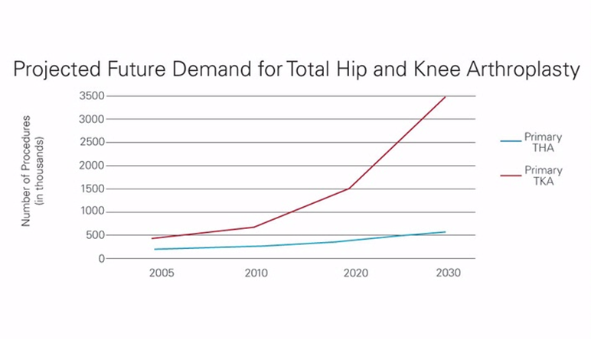
Knee Osteoarthritis
Very Common
Only going to get worse
Slippery slope

Slide 74
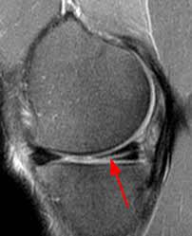
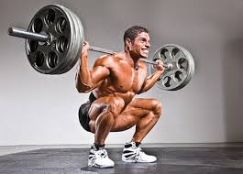
Meniscus Tears and Causation
Employee should recall mechanism of injury
Should be a hazard
Car accidents, etc may be exempt due to speed of events and possible LOC
1236 meniscus tears to determine MOI
Sporting Injuries (32%)
Avg age 33
10% while jogging or running without twisting mechanism
Non-sporting injury (39%)
Avg age 41
Trauma (i.e. car accident = 28%) / Minor trauma (72%)
52% of minor trauma caused by squatting or getting up from squatting position
No injury (29%)
Avg age 43
Drosos Knee 2003

Slide 75
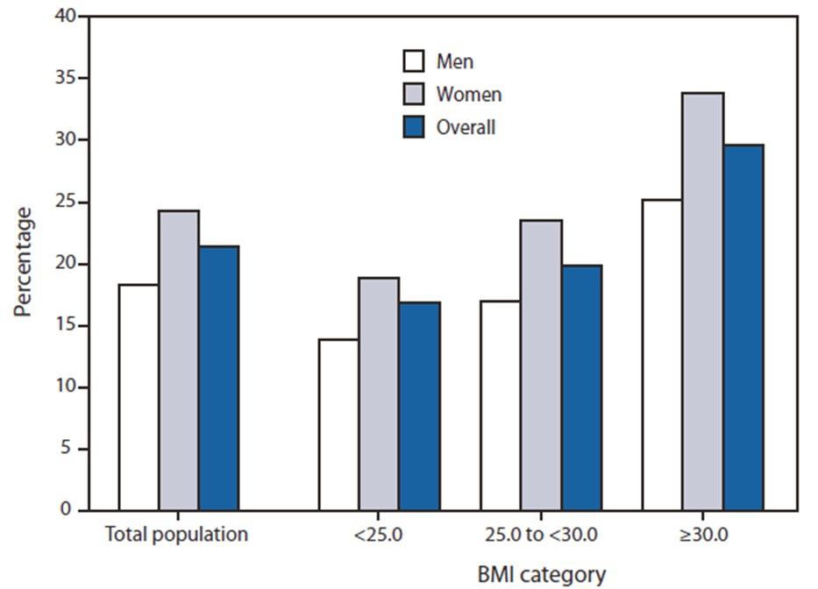
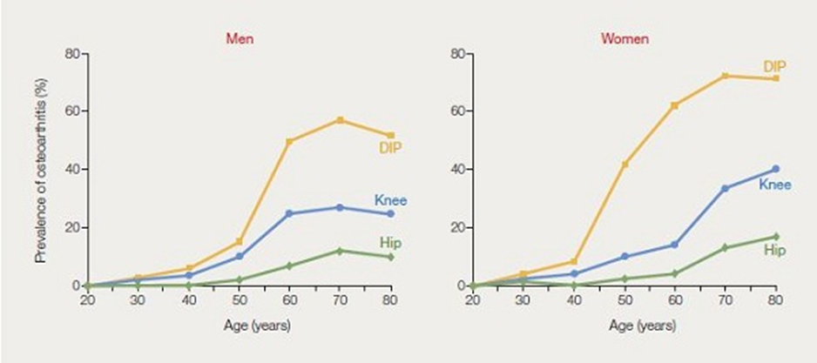
Knee Osteoarthritis – Risk Factors
Obesity:
FM OR=17.6; M OR=12.6
Genetic Predisposition:
FM OR=2.2; M OR=2.4
Malalignment:
FM OR=11.5
Squatting: >8934 hours/life
OR =2.5
Carrying/Lifting: >1088 tons/life
OR=2.1
Sports > 1400 hours/life
OR=2.5
Klussman et al. Arthritis Res and Ther 2010

