Slide 1
State and Federal Legislative and Regulatory Trends Update
David Benedict, CPCU AU WCP®
Senior State Relations Executive
August 21, 2024

Slide 2
Legislative Monitoring Overview for 2024
NCCI is tracking hundreds of state and federal WC-related bills
We also track bills that may not be directly WC-related but may impact the WC system
Notes:
Note to Speaker: Talking points for this presentation are updated monthly. You can access them here: https://ncci.sharepoint.com/:f:/s/O365-NCCIExternalSpeakersBureau/ErRn6Nb8XZpPrPHSAAPm-hABepWYHbeAKbmotQYkZ8k0-A?e=uROvkx

Slide 3
Highlights
Mental Injuries
Marijuana Legalization
Hallucinogens and Psychedelics
Independent Contractors/Gig Economy
Single-Payer Health Insurance
Notes:
The topics we will cover include:
Mental Injuries
Marijuana Legalization
Hallucinogens and Psychedelics
Independent Contractors/Gig Economy
Single-Payer Health Insurance

Slide 4
Mental Injuries
NCCI monitors bills addressing WC for workplace-related mental injuries
Many of these bills are related to post-traumatic stress disorder (PTSD)

Slide 5
Marijuana Legalization
Recreational marijuana
Medical marijuana
Reimbursement for medical marijuana in WC

Slide 6
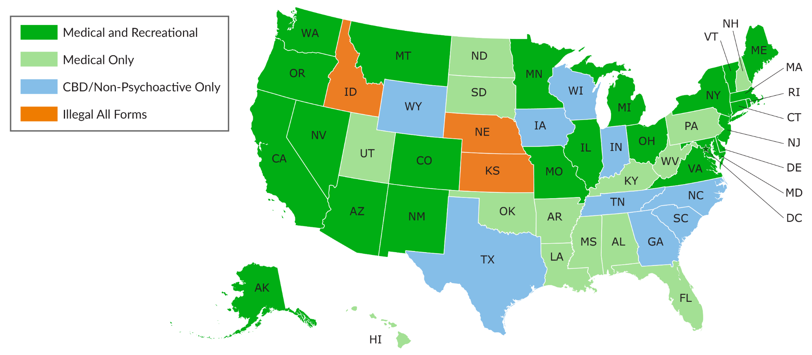
Marijuana Legalization
Notes:
This map shows the status of marijuana legalization in the US.

Slide 7
Federal Marijuana Reform
Rescheduling
Department of Justice proposed rescheduling rulemaking
Congressional activity

Slide 8
Hallucinogens and Psychedelics
NCCI is monitoring a new trend regarding legalization of certain substances
Several states introduced legislation

Slide 9
Independent Contractors/Gig Economy
Types of Legislation:
Bills establishing conditions for when a transportation network company (TNC) driver is an independent contractor rather than an employee of the company
Bills establishing whether a worker is an employee or an independent contractor

Slide 10
Single-Payer Health Insurance
Key elements of WC-related proposals:
Whether and how to continue funding for those healthcare services currently covered by the WC system
Whether and how to incorporate an element of experience rating

Slide 11
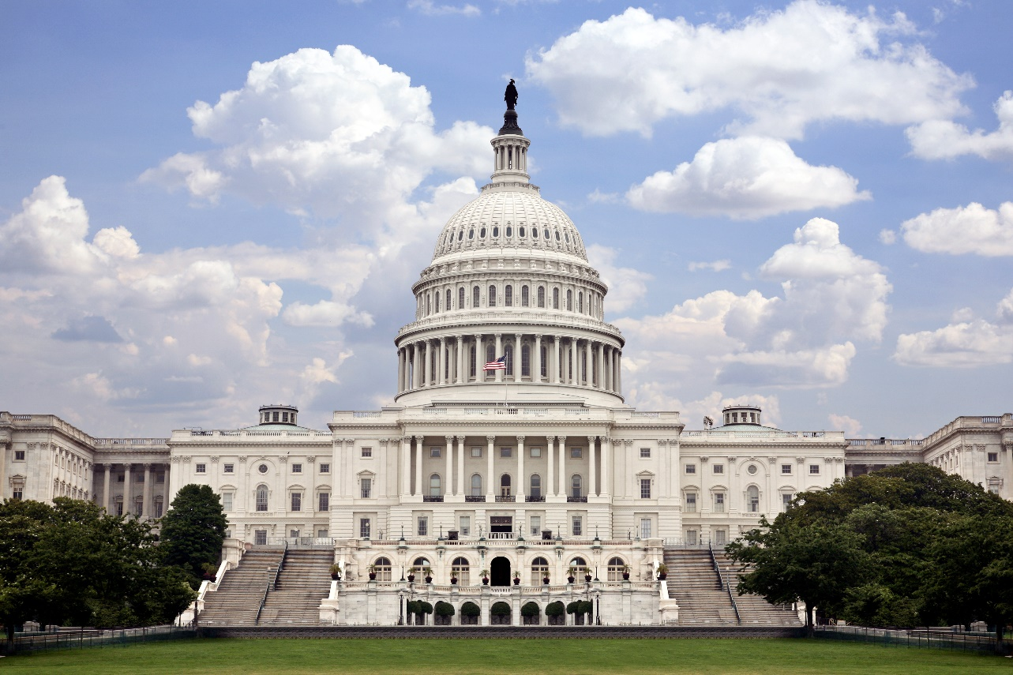
Congressional Update
Legislative Initiatives
Insurance Data Protection Act
Medicare Set Aside (MSA) Reform

Slide 12
Federal Agency Update – USDOL and FTC
US Department of Labor
Employee Classification Regulations
Heat Exposure Regulations
Federal Trade Commission
Noncompete Clause Prohibition

Slide 13
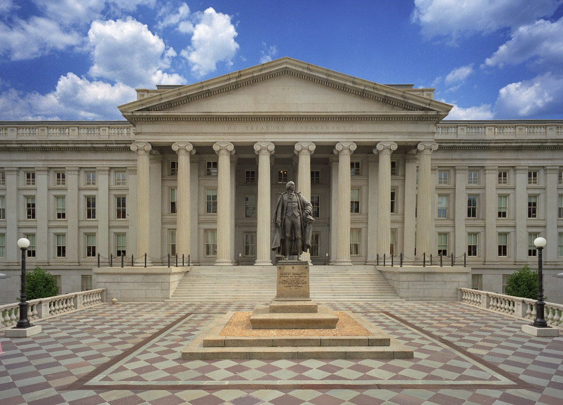
Federal Agency Update—US Department of the Treasury
Federal Insurance Office (FIO)
2024 Terrorism Data Call
Report on the effectiveness of the Terrorism Risk Insurance Program
FIO-National Science Foundation Modeling Initiative

Slide 14
Supreme Court Ruling: Loper Bright vs. Raimondo Chevron Deference Decision
Ended the 40-year-old precedent of "Chevron deference"
Overturned the precedent that if federal legislation is ambiguous or leaves an administrative gap, the courts must defer to the regulatory agency's interpretation if the interpretation is reasonable

Slide 15
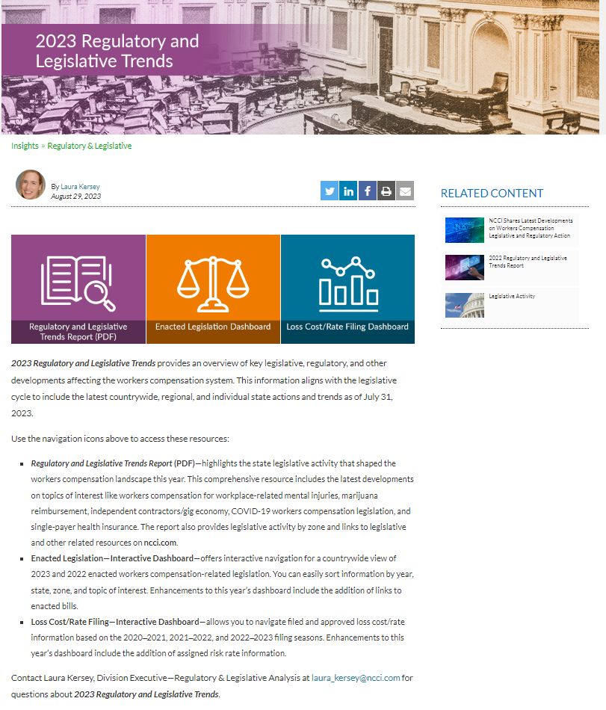
2023 Regulatory and Legislative Trends Report
Provides an overview of key legislative, regulatory, and other developments affecting the workers compensation system
Offers two interactive dashboards
Find it in the INSIGHTS section of ncci.com
Notes:
In August, NCCI released 2023 Regulatory and Legislative Trends, an overview of this year’s key legislative, regulatory, and other developments affecting the workers compensation system. The format includes a summary report and two interactive dashboards.

Slide 16
2023 Enacted Legislation Dashboard
Notes:
2023 Enacted Legislation Dashboard—offers interactive navigation for a countrywide view of 2023 and 2022 enacted workers compensation-related legislation. You can easily sort information by year, state, zone, and topic of interest. Enhancements to this year’s dashboard include the addition of links to enacted bills.

Slide 17
2023 Loss Cost/Rate Changes Dashboard
Notes:
Loss Cost/Rate Filing Dashboard—allows you to navigate filed and approved loss cost/rate information based on the 2020-2021, 2021- 2022, and 2022-2023 filing seasons. Enhancements to this year’s dashboard include the addition of assigned risk rate information.

Slide 18
Questions
and
Answers
Notes:
Q and A graphic.

Slide 19
David Benedict
Senior State Relations Executive
david_benedict@ncci.com

