Slide 2
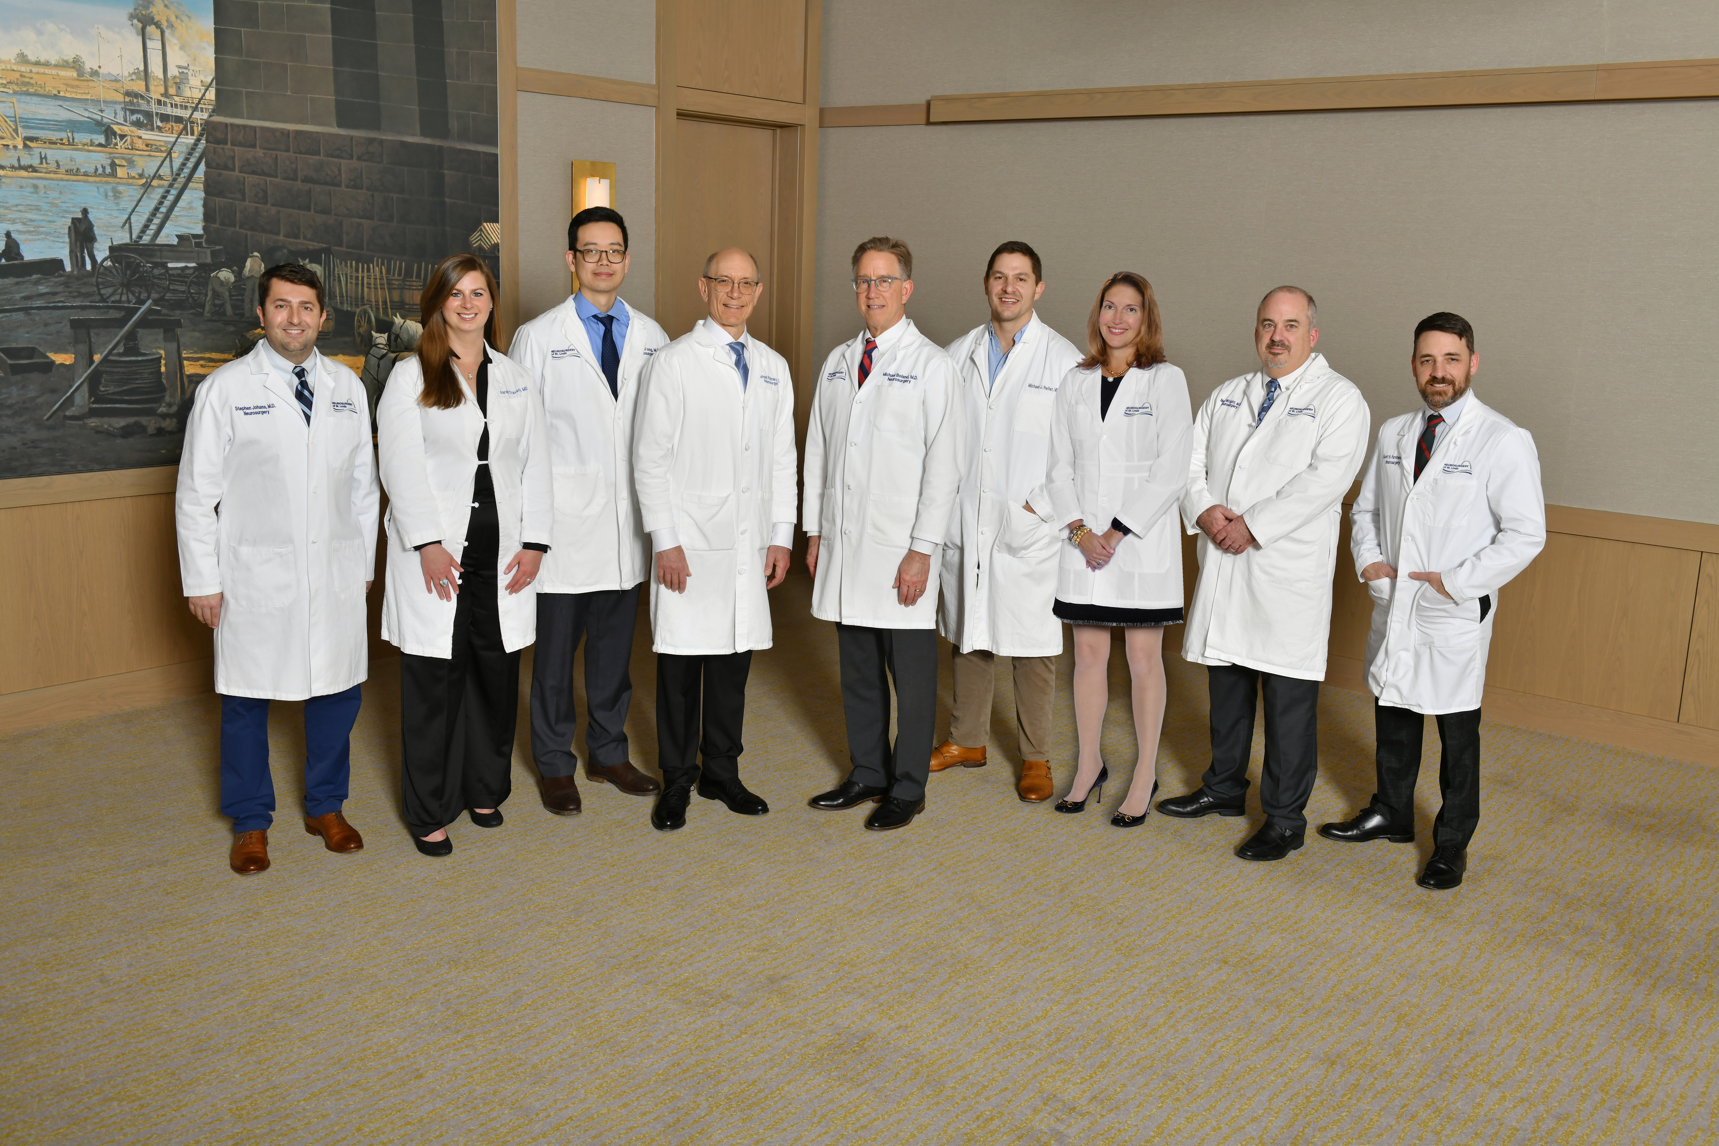
A Novel Approach to the Brain and Spine Injured Worker

Slide 3
A Novel Approach to the Brain and Spine Injured Worker
High Quality
Compassion
Cost Contain
WC compatible framework

Slide 4
A History of Integrity and Quality
1930’s – Ernest Sachs
Wash U Chairman of NS
Private Practice NS
1945 – Sachs, Furlow in full time private practice
1945 – 2022
Barnes, Jewish, St. Luke’s, Missouri Baptist, St. John’s, DePaul
2022 – Merged with Urology of St. Louis
Independent
Multispecialty

Slide 5
A History of Integrity and Quality
Hospitals
Missouri Baptist
St. Luke’s
Barnes St. Peters
Anderson
St. Elizabeth’s
Offices
West County, St. Louis - Walker Medical Building
St. Peter’s, MO
O’Fallon, IL - St. Elizabeth’s
Maryville, IL – Anderson Campus
ASC – Walker Medical Building

Slide 6
A Novel Approach to the Brain and Spine Injured Worker
High Quality
Compassion
Cost Contain
WC compatible framework

Slide 7
A Novel Approach to the Brain and Spine Injured Worker
Clinic work-ins 2-3 days from time of referral
Address causation at first visit
RTW slip day of visit
Office note completed day of visit
Meet case managers day of visit
Return to workplace safely as soon as possible with appropriate restrictions when necessary
Follow up q 3-4 weeks until MMI

Slide 8
A Novel Approach to the Brain and Spine Injured Worker
8 Neurosurgeons, 1 Ortho Spine Surgeon
Diverse Training Backgrounds
Diverse Experiences
Extensive Collective Experience – 132 years!
Clinic and OR collaboration
Dedicated Clinic Time slots
2 per MD per week
18 slots per group per week
Dedicated WC Manager – Katie
Dedicated Medical Legal Manager – Bryce

Slide 9
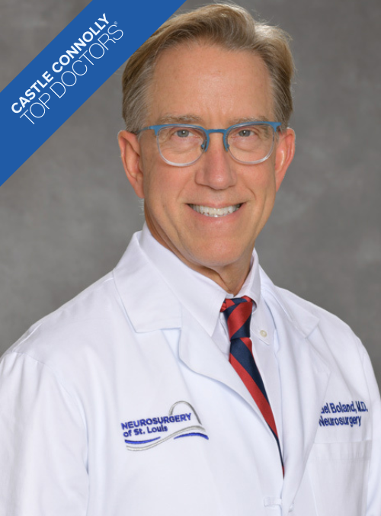
Michael F. Boland, MD
College: Benedictine College
Medical School: University of Missouri – Columbia
Residency: University of Michigan
Former Chief Neurosurgery – MBMC
Former Chief Neurosurgery – St. Luke’s Hospital
Former Chief Surgery – St. Luke’s Hospital
Current VP Neurosurgical Society of America
General Neurosurgery – Brain and Spine
St. Louis Native

Slide 10
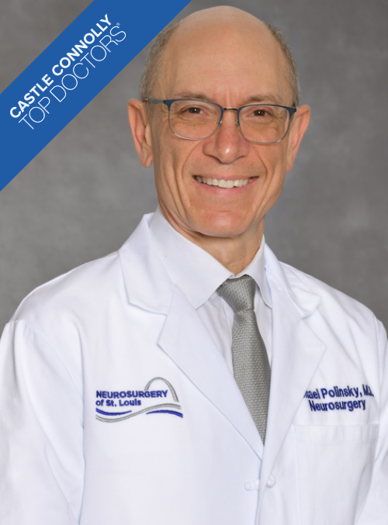
Michael N. Polinsky, MD
College: University of Illinois
Medical School: Washington University School of Medicine
Residency: University of Michigan Hospitals
Chief of Neurosurgery – MBMC
Managing Partner NSL
General Neurosurgery – Brain and Spine
St. Louis Native

Slide 11
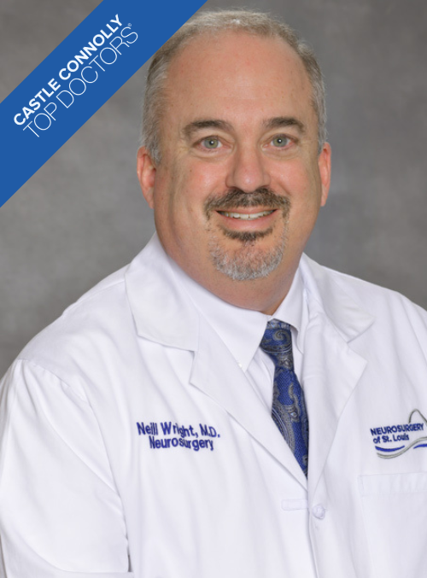
Neill M. Wright, MD
College: University of California – Berkeley, CA
Medical School: University of California, Los Angeles
Residency: Washington University School of Medicine, Neurosurgery
Spine Fellowship: UCLA, Cedars Sinai Medical Center
Professor Neurosurgery
Director of Spine Fellowship until 2020
Leadership role Cervical Spine Research Society
NSL 2022 – Medical Director
Cervical Spine

Slide 12
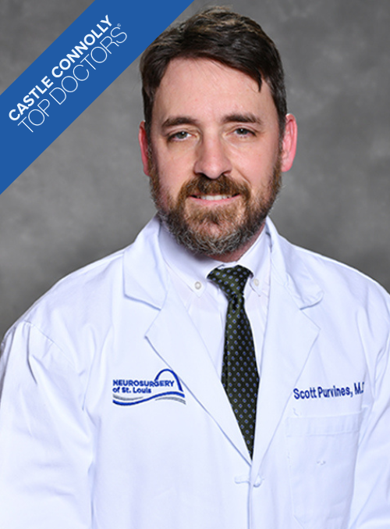
Scott H. Purvines, MD
College: Purdue University
Medical School: Indiana University School of Medicine
Residency: Indiana University School of Medicine
Focus:
General Neurosurgery – Brain and Spinal Injury
Dorsal Column Stimulation – Paddle leads
Extensive network with Pain Management MDs
St. Louis Native

Slide 13
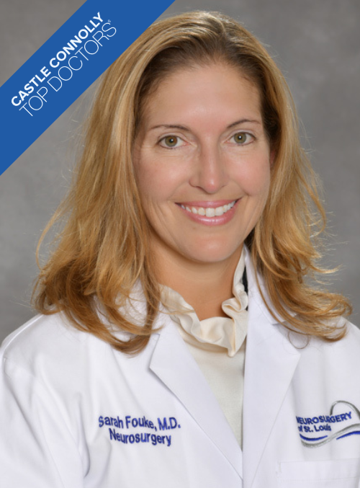
Sarah J. Fouke, MD
College: Princeton University
Medical School: Washington University – St. Louis, MO
Residency: Washington University – St. Louis, MO
Fellowship: Neurosurgical Oncology
First woman to graduate from Wash U NS residency program
WU faculty until 2008
General Neurosurgery – brain and spine injury
St. Louis Native

Slide 14
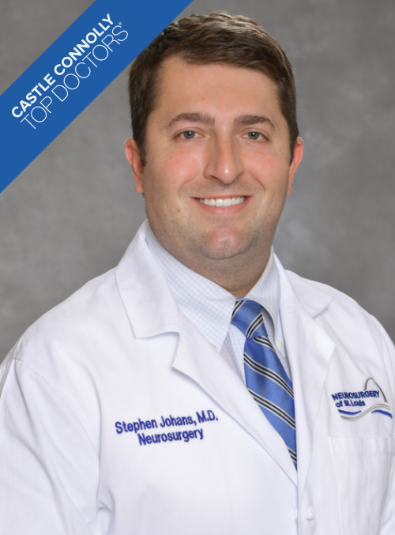
Stephen J. Johans, MD
College: Miami University (Oxford, OH)
Medical School: University of Missouri - Columbia
Residency: Loyola University Medical Center – Chicago, IL
General Neurosurgery – Brain and Spine Injury
St. Louis Native

Slide 15
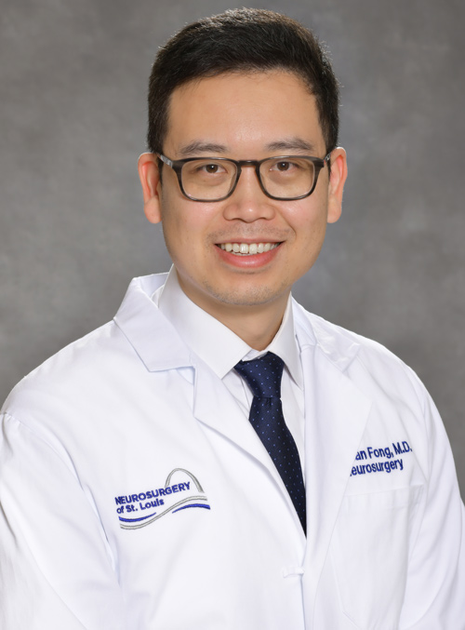
Brendan M. Fong, MD
Medical School: University of California, Los Angeles
Residency: Washington University School of Medicine
Fellowship: Skull Base - University of California, Irvine
General Neurosurgery – brain and spine injury

Slide 16
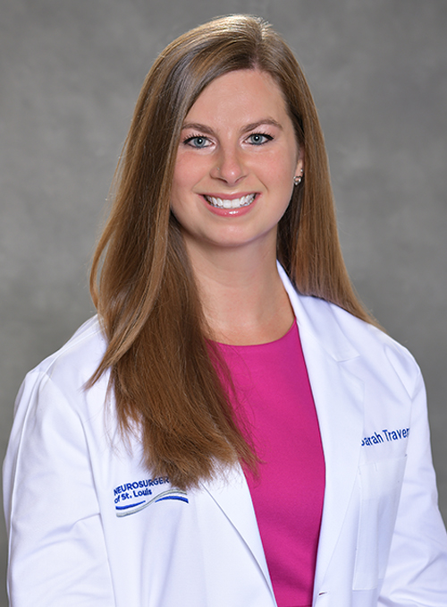
Sarah S. Travers, MD
College: Emory University
Medical School: St. George's University School of Medicine
Internship: Louisiana State University Health Sciences Center
Residency: University of Missouri
Fellowship: Neurosurgical Oncology - University of Colorado
General Neurosurgery
Brain and spine injury
Dorsal Column Stimulation
St. Louis Native

Slide 17
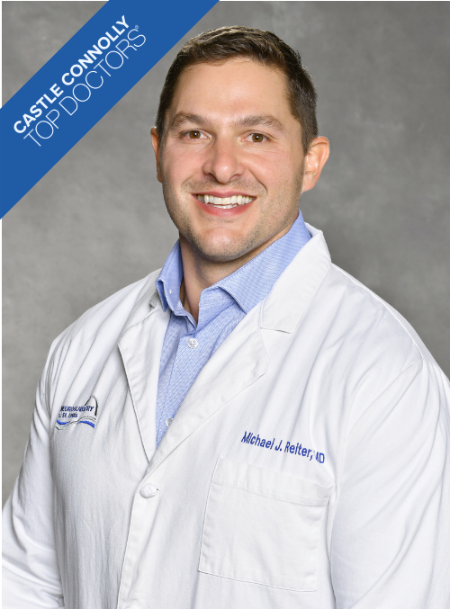
Michael J. Reiter, MD
College: Indiana University
Medical School: University of Missouri School of Medicine
Residency: University of Colorado
Fellowship: Washington University School of Medicine, Spine Surgery
Spinal Surgery:
Spine Injury
Complex Deformity
Peer Review Committee: MBMC
St. Louis Native

Slide 18
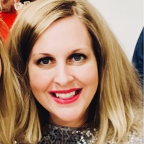
Katie Brickey Director of Workers Compensation
Bachelors in Communication
16 years in WC
11 years adjustor
5 years – marketing/management
4 Orthopedics
1 NSL (June 2023)
314-408-3070
workcomp@stlbrainandspine.com

Slide 19
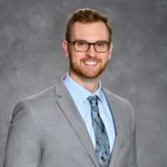
Bryce Edwards Operations Analyst
Masters – Healthcare Administration
Bachelors in Biology and Chemistry
MBMC Anesthesia Technician
USL Analyst
NSL Analyst, Medical Legal Manager (June, 2023)
314-336-4940
bedwards@stlbrainandspine.com
bedwards@stlurology.com

Slide 21
The Lumbar Spine
In the Workers’ Comp Realm
Michael Reiter, MD
Board Certified Orthopedic Surgeon

Slide 25
Degenerative Disc and Facet Disease
Most of what we see is from normal wear and tear of life
Degenerative disc disease/Spondylosis
Overgrowth of the facet joints
From gravity working against the spine and from us being upright
Genetic component, smoking, obesity, lack of aerobic exercise, and other environmental factors

Slide 26
Terms
Spondylosis
Normal wear and tear of life in the spine
Everyone is going to get spondylosis

Slide 27
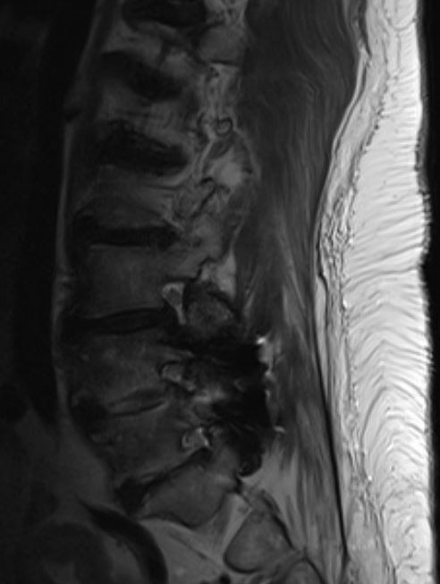
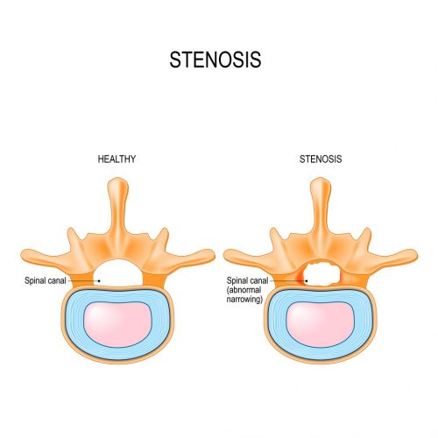
Stenosis
Central Stenosis
Foraminal Stenosis

Slide 28
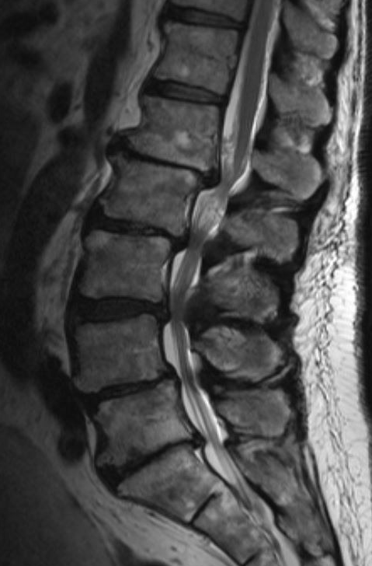
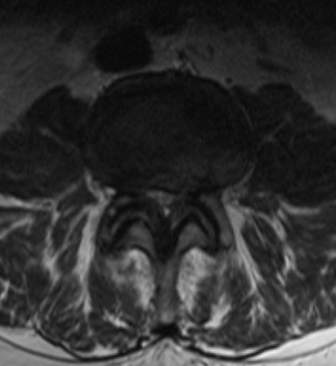
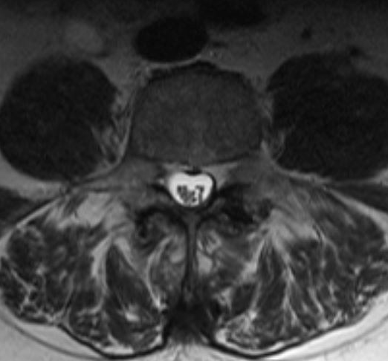

Slide 29
Spondylolisthesis

Slide 30
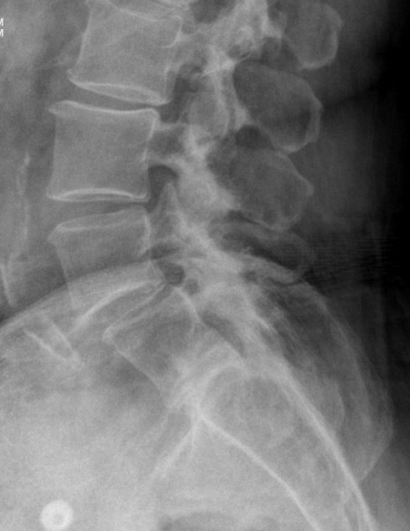
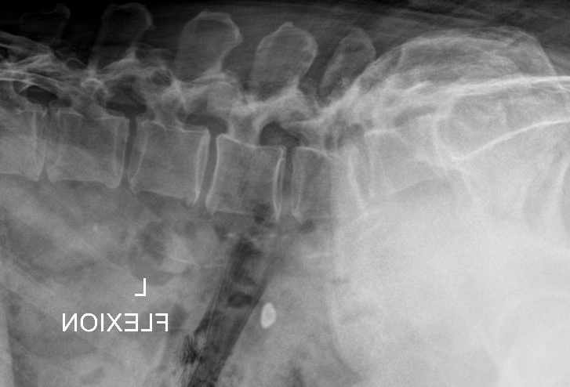
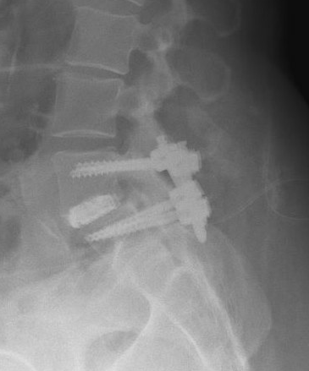
Dynamic instability and spondy at L4-5

Slide 31
Spondylolysis

Slide 32
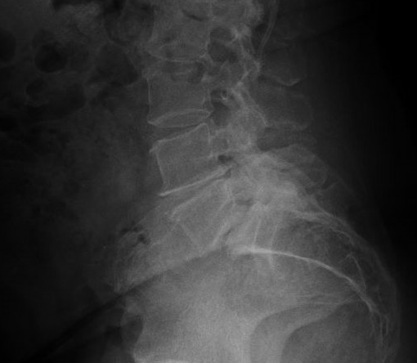
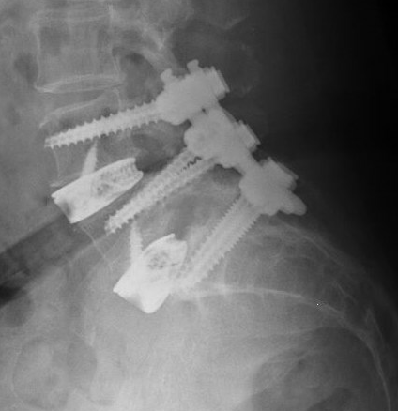

Slide 33
Spondylitis

Slide 34
Symptoms from Stenosis
Neurogenic Claudication – Symptoms usually include numbness or heaviness in your legs when you walk or stand for too long. You can also feel like you have no strength in your legs when you walk.
Most patients can only walk several hundred feet before having to stop and sit because their legs feel so weak, numb, or tired. After sitting for a short amount of time, the symptoms improve.
Symptoms may also improve with leaning over a shopping cart or chair.

Slide 35
What is Causing your Shooting Leg Pain?
Sharp pain that shoots down your leg is usually more concerning than back pain, and comes from nerve root compression, usually caused by:
Herniated Disc – A disc between the vertebrae moves and pinches a nerve
Stenosis – narrowing of the central canal (where the nerve originates) or narrowing of the foramen (where the nerve exits to go down your leg)
Spondylolisthesis – caused by a vertebra slipping out of place, leaving less room for the nerve root
Scoliosis – narrows the space for the nerve root, causing nerve root compression
Synovial Cyst – a cyst that arises from the joint of the spine

Slide 36
What is Causing your Shooting Leg Pain?

Slide 37
Symptoms related to a work injury?
Did patient have any pain prior?
Low back pain or buttock pain from normal wear and tear of life
Acute Exacerbation of Pain or symptoms?
Acute Leg pain?
Images suggestive of acute injury?
Acute large disc herniation in setting of acute leg pain
Edema or swelling around the joints or in the bone

Slide 38
Treatment
Physical Therapy
Especially for muscle related back pain
Epidural Injection
For Nerve related leg pain
Medial Branch Block with possible Radiofrequency Ablation for facet related back pain
Back pain, buttock pain, thigh pain stopping at the knee
Surgery

Slide 39
Surgery
Lumbar Microdiscectomy
Indication: Severe leg pain in the setting of a disc herniation
Lumbar Laminectomy
Indication: Severe leg pain due to stenosis, claudication symptoms
Laminectomy and Fusion
Indication: Spondylolisthesis or Instability
Scoliosis
Cervical fusion and arthroplasty
Cervical stenosis and radiculopathy

Slide 40
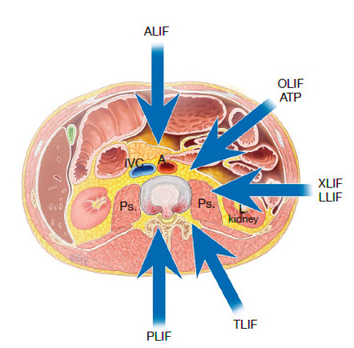
Interbody Approaches
PLIF – posterior lumbar interbody fusion
Pro: traditional teaching, knowledge of anatomy straight forward
Con: excessive nerve root retraction - arachnoiditis, minimal lordosis improvement
TLIF - transforaminal lumbar interbody fusion
Pro: traditional teaching, safe, less retraction on nerve roots, decent interbody size
Con: Dorsal root ganglion irritation, small footprint comparatively, subsidence, minimal lordosis improvement
ALIF - anterior lumbar interbody fusion
Pro: thorough discectomy, anterior release, improved lumbar lordosis and deformity correction, indirect decompression, large surface area implant, good fusion rate
Con: reliance on vascular surgeon approach, damage to retroperitoneal structures, increased risk of major vessel injury, retrograde ejaculation, supine positioning
OLIF/ATP - anterior to psoas interbody fusion
Pro: discectomy, anterior release, improve lumbar lordosis, large surface area implant, good fusion rate, indirect decompression, potential approach by surgeon
Con: damage to retroperitoneal structures, increased risk of major vessel injury, retrograde ejaculation, lateral positioning, lumbar plexus irritation
LLIF/XLIF/DLIF - direct lateral or transpsoas interbody fusion
Pro: discectomy, anterior release, improve lumbar lordosis, large surface area implant, good fusion rate, indirect decompression, lower rate of vessel injury
Con: damage to retroperitoneal structures, lateral positioning, lumbar plexus irritation, thigh pain, hip flexor weakness

Slide 41
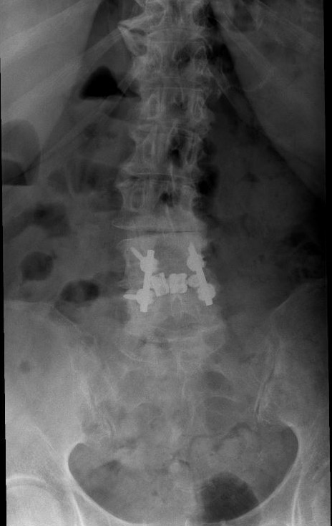
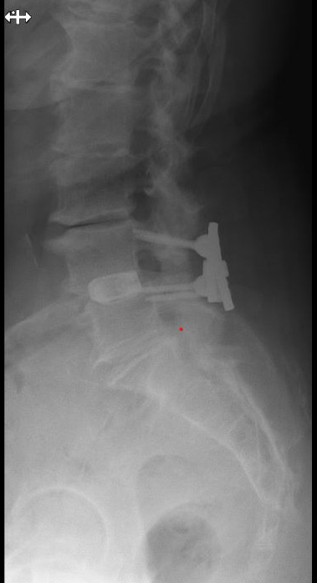
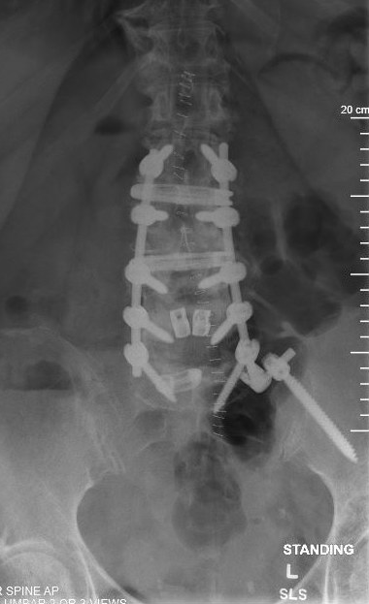
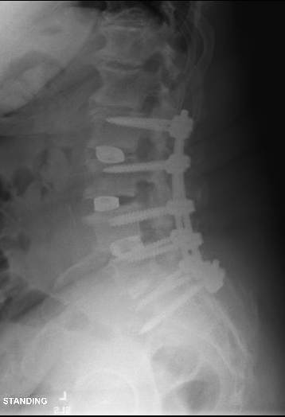
Interbody Approaches

Slide 42
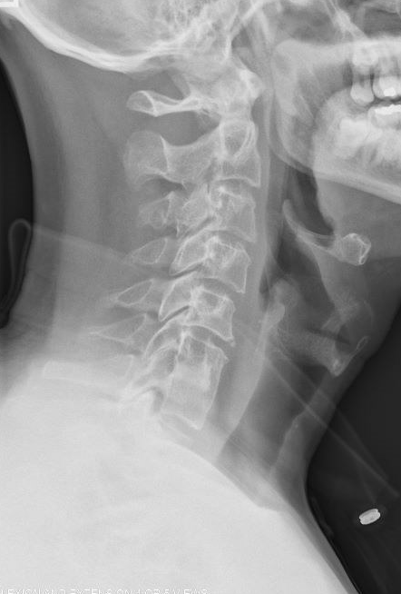
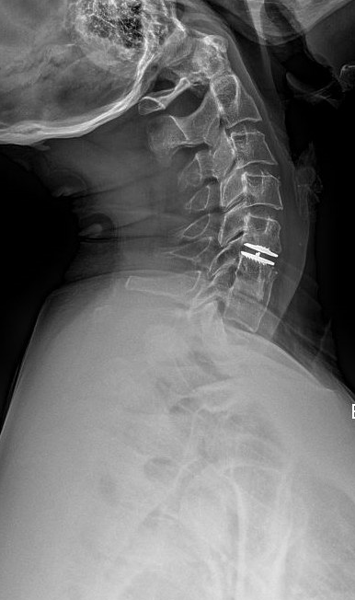
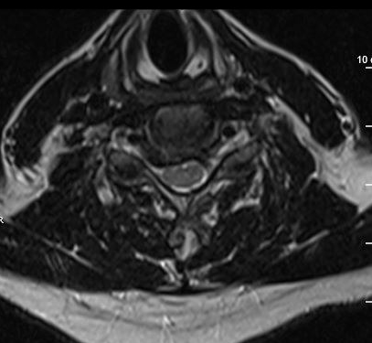
Cervical disc arthroplasty

Slide 43
My Treatment
I always try to avoid surgery
I am very conservative, especially when it comes to screws and rods
We are changing the mechanics of the spine forever
Always a risk of adjacent level disease down the road
Or we are creating a deformity that leads to more issues
PT especially for back pain
ESI for leg pain or arm pain
MBBs with possible RFA for back, buttock, and posterior thigh pain

Slide 44
Why Workers’ Compensation?

Slide 45
Why Workers’ Compensation?
A Service to the community
a group of 9 surgeons can make a difference on the quality that is currently being offered in the community
Financial Benefit for Our Company

Slide 46
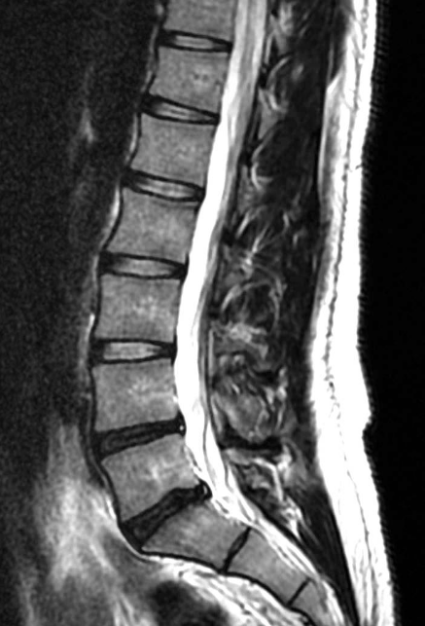
Worst Nightmare, yet Common Situation
“Black Disc Disease”
No Spondylolisthesis
No radicular leg pain

Slide 47
Posterior Lateral Fusion

Slide 48
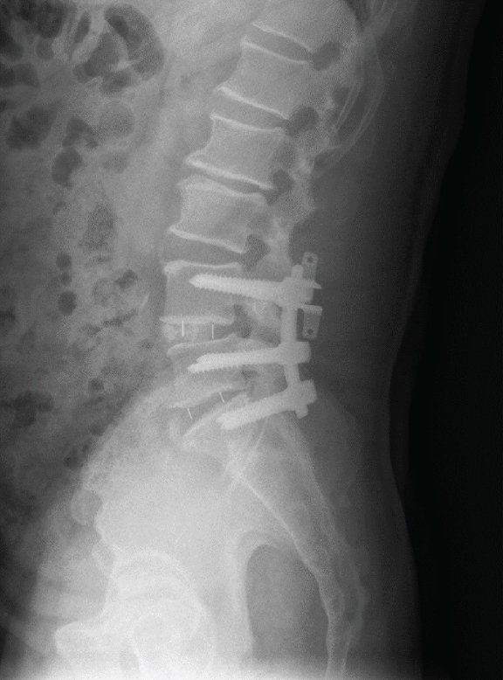
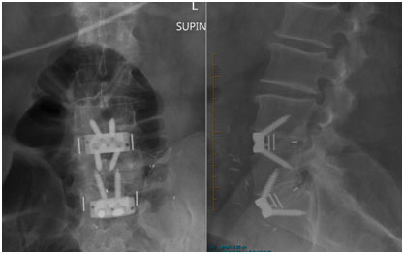
Interbody Fusion

Slide 49
Adjacent Level Disease

Slide 50
Marching Up
No longer Work Comp
Previous Surgeon doesn’t take Private Insurance
Previous Surgeon doesn’t take Medicare
And now shows up for 2nd opinion

Slide 51
How to Send Patients to us?
Patient will have initial contact with Katie
Then will have one on one contact with Surgeon and Medical Assistant through the rest of the process
Katie Brickey Bryce Edwards: bedwards@stlurology.com
Director of Workers Compensation
Direct ph- 314-408-3070
Fax- 314-788-5636
Kbrickey@stlbrainandspine.com
Workcomp@stlbrainandspine.com

Slide 52
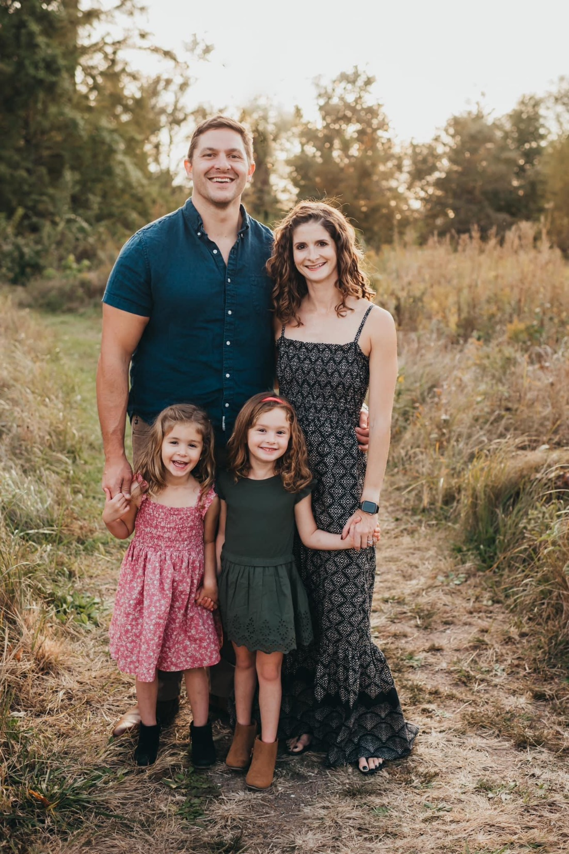
Thank You!
Michael Reiter, MD
mreiter@stlbrainandspine.com
www.stlbrainandspine.com

