Slide 1
Workers’ Compensation 101
Administrative Law Judge Karla Boresi
Honorable Lee Schaefer
Notes:
KOB: Play by play -
CWR: Color commentator

Slide 2
Workers’ Compensation 101: Outline
History of Compensation for Injuries
Elements of a Compensable Claim
It’s All In The Timing
Benefits
Adjudication
Notes:
History – to help you understand

Slide 3
Missouri Workers’* Compensation Law: 1926
The Missouri General Assembly passed a workers’ compensation law in 1919 and finally received enough votes from citizens in a referendum to become law in 1926.
* Was “Workmen’s Compensation Law” until retitled in 1980.
Notes:
Workers’ Comp as we know it began 100 years ago. How far back would we have to go if we were to look at when the ideas first started?

Slide 4
Compensation in Antiquity

Slide 5
2050 B.C. - Ur-Nammu
“If a man knocks out the eye of another man, he shall weigh out ½ of mina in silver” or 30 silver shekels. Applied to all aspects of daily life.
1750 B.C. - Code of Hammurabi
penalties for careless and neglectful behavior, i.e., if an unskilled surgeon caused loss of life or limb, the surgeon’s hands were cut off.
Ancient Greek, Roman, Arab, and Chinese Laws
provided sets of compensation schedules, with precise payments for the loss of a body part.
loss of a joint of the thumb was worth ½ the value of a finger
value of an ear was based on its surface area
loss of a certain appendage was compensated by the amount of length lost
Notes:
Ur-Nammu - The founder of a Sumerian dynasty - Goal wan to establish “Equity in the land”
The overarching goal of the code was to establish “equity in the land.” In doing so, King Ur dictated laws such as “if a man knocks out the eye of another man, he shall weigh out ½ of mina in silver” or 30 silver shekels. The code itself implies that the payment of compensatory awards applied to all aspects of daily life. The code also reflects the ubiquitous use of labor slaves, as it only provided for and only awarded monetary compensation awards to the slave owner, rather than the laborer, if the slave in the case sustained the injury.
The Nippur Tablet No. 3191

Slide 6
Compensation in Antiquity
Compensation only applied to free citizens.
What happened when a slave was injured?
Notes:
Who was doing all the dangerous work?

Slide 7
Middle Ages in Europe: Birth of Common Law

Slide 8
Middle Ages in Europe: Birth of Common Law
Work force evolving away from enslaved/indentured workers and protections were needed.
Schedules were replaced by noblesse oblige: an honorable lord would care for his injured serf
Common Law developed - England was very legalistic.
Employees could sue, but Employers were protected - Unholy Trinity of Defenses
Contributory Negligence
Fellow Servant
Assumption of Risk
Notes:
English Common law established three principles known as the “unholy trinity of defenses” to determine whether work place injury was compensable. First, the contributory negligent principle held that if a worker was in “anyway” responsible for an injury, the employer was not liable. Second, the “fellow servant” rule exempted an employer from liability when the workers’ injury arose out of the negligent conduct of a co-worker. Third, the “assumption of risk” rule permitted employers to enter into contracts with workers whereby the worker would waive the right to sue the employer for damages. Since employers would often enter into these agreements with workers when a job required exceptionally dangerous work, the waiver agreements became known as “death contracts.”

Slide 9
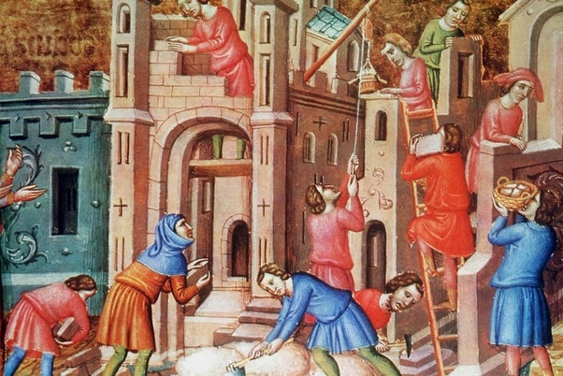
Contributory Negligence:
A common law tort rule which bars plaintiffs from recovering for the negligence of others if they too were negligent in causing the harm.
Notes:
Story about Mason the mason who was crushed by a pile of 1000 bricks that had been negligently stacked on the back of his wagon. The employer established Mason had put one extra brick on the load. Mason was barred from recovery.

Slide 10
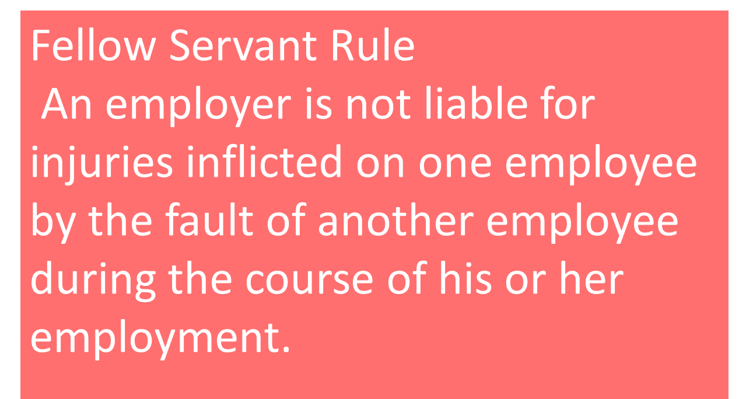
Notes:
The Lord has two knights sparing in the yard. The white knight, being egged on by the Lord to act recklessly, delivers much more than just a flesh wound. The black night sues. Because his co-worker caused the injury, he cannot recover from the Lord.

Slide 11
Assumption of Risk: A common law doctrine that refers to a plaintiff's inability to recover for the tortious actions of a negligent party in scenarios where the plaintiff voluntarily accepted the risk of those actions.
Notes:
Eric develops PTSD after serving as Lord Vengeance’s executioner for five years. Everyone thinks he is cursed, they will not let him enter the church, his only prospects for a wife are the daughters of his fellow executioners, and he recently had to behead his cousin Bob. He wants to sue, but he is laughed out of court because he knew what he was getting into when he took the job.

Slide 12
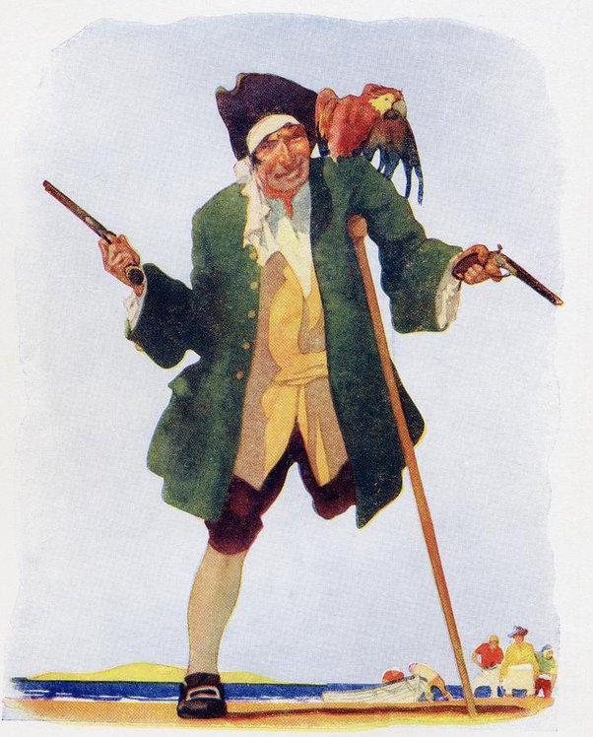
What Industry was an early adapter of Workers’ Compensation as we know it?
Very Dangerous
Workers needed incentives
Notes:
So we are now in the 1600-1800, chugging along to modern times.
. Why is pirating so addictive?
Answer: They say once ye lose yer first hand, ye get hooked!

Slide 13
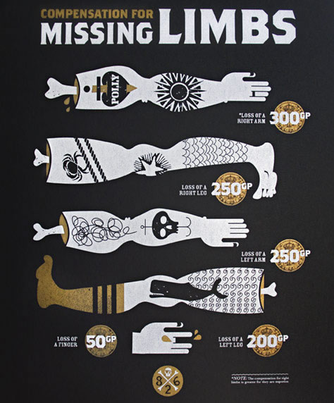
The Pirate Code
Employment contract
Listed the “recompense and reward each one ought to have that is either wounded or maimed in his body, suffering the loss of any limb, by that voyage.”
Incentive to sign up
Kept crew loyal
Return to work options
Notes:
One of the most interesting clauses in the pirate code addressed pirate compensation for injuries: “recompense and reward each one ought to have that is either wounded or maimed in his body, suffering the loss of any limb, by that voyage.”
The compensation for lost limbs corresponded to weekly pay. If the average pay was 2 gold pieces a week, the loss of an arm on this ship was 150 weeks. The finger was 25 weeks. Note arms were more valuable than legs, and the right side was more valuable than the left.

Slide 14
DWC : 1758
Notes:
This is the earliest known picture of a hearing at the DWC

Slide 15
The Industrial Revolution and Modern Workers’ Compensation 1877-1917
Notes:
The next big shift occurred between the end of the Civil war and the start of WWI
Factories and Urbanization

Slide 16
The workplace was dangerous
Injuries were cheap
Workers were plentiful/replacable
Court access was limited
Triangle Waist Company Fire 1911
Notes:
In 1900, only 50% of all workplace fatalities recovered anything, at an average of ½ a years pay.
Triangle Waist Co. Fire – 10 story building filled with fabric, exits didn’t exist or were blocked, filled with flammable material. 146 women and girls dead. No Workers comp (the court of appeals had declared the recently pass comp act unconstitutional the day before the fire) families turned to the courts. The owners were acquitted of manslaughter, and A civil suit against the owners netted each of 23 families $75 in damages

Slide 17
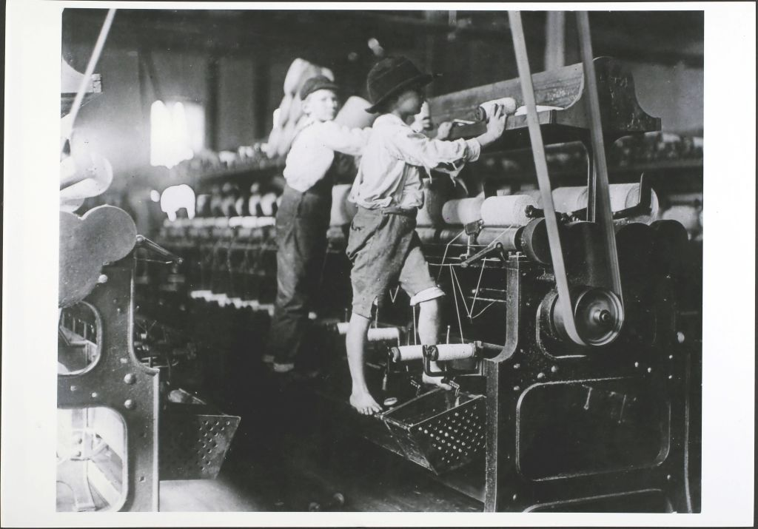
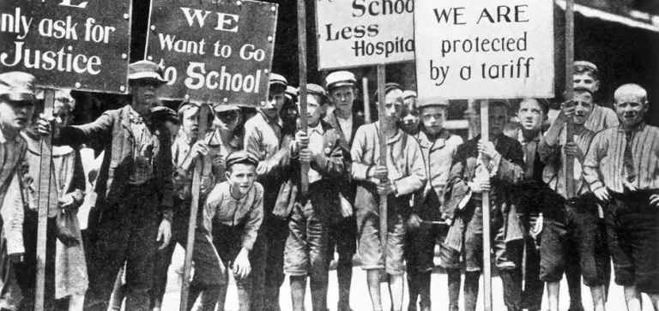
We Have Got To Do Something About This…
Labor Unions
State Factory Acts
Social Reforms
Mandatory public education
Child labor laws
8-hour workdays
Improved infrastructure/sanitation
Workers’ Compensation
Notes:
The fire led to legislation requiring improved factory safety standards. This period saw the growth of unions that fought for better working conditions for factory workers.
Author Upton Sinclair hoped to show the American public the horrible effects of capitalism on workers in the Chicago meatpacking industry. His book, "The Jungle," described how workers lost their limbs, were exposed to dangerous chemicals, and caught infectious diseases while working long hours in cold, cramped conditions. He hoped that this would lead to labor reforms. However, Sinclair's vivid descriptions of the industry did not immediately lead to labor legislation. But public outcry did lead to the passage of the Pure Food and Drug Act and the Meat Inspection Act in 1906.

Slide 18
Workers’ Compensation: The Great Tradeoff
Employees
Risks were increasing
Physical harm
Loss of income
In court
Better outcomes
But still unpredictable
Not accessible to all
REDUCE RISKS
Employers
Injuries were more serious than ever
Juries were becoming more sympathetic to injured workers
States passed laws that made it easier to sue employers
Size and frequency of jury awards to workers increased
Employers’ liability insurance was EXPENSIVE
CONTROL COSTS
Notes:
Injuries were more serious than ever
Juries were becoming more sympathetic to injured workers
States passed laws that made it easier to sue employers
Size and frequency of jury awards to workers increased
Employers’ liability insurance was EXPENSIVE
Employees wanted safe working conditions

Slide 19
Key Elements of Workers’ Compensation
No Fault System
Mandatory Coverage
Defined Benefits
Exclusive Remedy
Employer Protections
Dispute Resolution
Dynamic – Periodic Reviews
The Workers’ Compensation System is a framework that seeks to protect the interests of both workers and employers. Its key features ensure that injured workers receive the care and support they need while also providing employers with predictability and protection from potential litigation.
Notes:
NO-FAULT SYSTEM
employees can receive benefits proving negligence or at fault . Conversely, employers are protected from most lawsuits by injured employees seeking damages for pain and suffering.
MANDATORY COVERAGE
This ensures that funds are available to cover potential claims.
DEFINED BENEFITS
Medical :
Disability
Death :
EXCLUSIVE REMEDY
workers cannot sue employers for work-related injuries outside of this system, with some exceptions based on gross negligence or intentional harm.
EMPLOYER PROTECTIONS
Besides being shielded from most lawsuits, employers can also participate in the claim process, ensuring that claims are legitimate and that they are not being defrauded.
DISPUTE RESOLUTION
, the system has mechanisms in place for dispute resolution.
PERIODIC REVIEWS
The Workers’ Compensation System is not static. Periodic reviews and updates ensure that it remains relevant and effective in addressing the changing dynamics of the workplace. Adjustments can be made to benefit amounts, coverage criteria, and other aspects to reflect current economic conditions and medical advancements.
The Workers’ Compensation System is a framework that seeks to protect the interests of both workers and employers. Its key features ensure that injured workers receive the care and support they need while also providing employers with predictability and protection from potential litigation.

Slide 20
Elements of a Compensable Case
Notes:
(

Slide 21
Employer § 287.030
Using services of another for pay;
2) Must have 5 or more employees;
3) Construction industry must have 1 or more employees;
4) Employers with less than 5 employees may elect to become subject to the Workers’ Compensation Act by purchasing workers’ compensation insurance.
Notes:
(1) Every person, partnership, association, corporation, limited liability partnership or company, trustee, receiver, the legal representatives of a deceased employer, and every other person, including any person or corporation operating a railroad and any public service corporation, using the service of another for pay;
(2) The state, county, municipal corporation, township, school or road, drainage, swamp and levee districts, or school boards, board of education, regents, curators, managers or control commission, board or any other political subdivision, corporation, or quasi-corporation, or cities under special charter, or under the commission form of government;
(3) Any of the above-defined employers must have five or more employees to be deemed an employer for the purposes of this chapter unless election is made to become subject to the provisions of this chapter as provided in subsection 2 of section 287.090, except that construction industry employers who erect, demolish, alter or repair improvements shall be deemed an employer for the purposes of this chapter if they have one or more employees. An employee who is a member of the employer's family within the third degree of affinity or consanguinity shall be counted in determining the total number of employees of such employer.

Slide 22
Statutory Employer § 287.040
Statutory ER is liable for injuries to a subcontractor and sub’s EEs
Immediate ER is primarily liable and statutory ER is secondarily liable
Often arises on construction jobs when a subcontractor is uninsured
Work under contract
on the premises
in the ordinary course of business
Notes:
the usual business which he there carries on shall be deemed an employer and shall be liable under this chapter to such contractor, his subcontractors, and their employees, when injured or killed on or about the premises of the employer while doing work which is in the usual course of his business.
2. The provisions of this section shall not apply to the owner of premises upon which improvements are being erected, demolished, altered or repaired by an independent contractor but such independent contractor shall be deemed to be the employer of the employees of his subcontractors and their subcontractors when employed on or about the premises where the principal contractor is doing work.
3. In all cases mentioned in the preceding subsections, the immediate contractor or subcontractor shall be liable as an employer of the employees of his subcontractors. All persons so liable may be made parties to the proceedings on the application of any party. The liability of the immediate employer shall be primary, and that of the others secondary in their order, and any compensation paid by those secondarily liable may be recovered from those primarily liable, with attorney's fees and expenses of the suit. Such recovery may be had on motion in the original proceedings. No such employer shall be liable as in this section provided, if the employee was insured by his immediate or any intermediate employer.

Slide 23
Employee §287.020
Person in service of any employer
Under ANY contract of hire (express, implied, oral or written) or under appointment or election
Includes: Execs of corporations, Minors, Sole proprietors/partners that elect coverage
Excludes: Farm labor, domestic servants in home, qualified real estate agents/direct sellers, inmates, unpaid charitable volunteers, certain sports officials for non-profits, and for hire motor carriers §287.041
Independent Contractor???
Notes:
The word "employee" as used in this chapter shall be construed to mean every person in the service of any employer, as defined in this chapter, under any contract of hire, express or implied, oral or written, or under any appointment or election, including executive officers of corporations.
Contrast: Independent Contractor –factor test boils down to “Who controls the details?” Online worksheets Fed and state
Independent contractors are hired to accomplish a particular job. The relationship between the hiring party and the independent contractor is contractual.
There is a written, verbal or implied contract between the two parties about what will be done and how much that service is worth. The contractor does the job, is paid and moves on to the next job under the next contract.
giving a worker direction on when, how and where to complete work; paying by the hour, week or month; reimbursing for business and travel expenses; performing work on the business's premises or having a continuing relationship between the worker and the employee all may point to a worker being an employee under the law.

Slide 24
Accident §287.020
[A]ccident…shall mean an unexpected traumatic event or unusual strain identifiable by time and place of occurrence and producing at the time objective symptoms of an injury caused by a specific event during a single work shift.
An injury is not compensable because work was a triggering or precipitating factor.

Slide 25
Occupational Disease
An identifiable disease arising with or without human fault out of and in the course of the employment. §287.067.1
Exposure must be the prevailing factor in causing both the resulting medical condition and disability. Ordinary, gradual deterioration, or progressive degeneration of the body caused by aging or by the normal activities of day-to-day living shall not be compensable.
Ordinary diseases of life to which the general public is exposed outside of the employment shall not be compensable, except where the diseases follow as an incident of an occupational disease as defined in this section
Includes: repetitive motion injuries, heart, lung, communicable disease
Last Exposure Rule
Notes:
In this chapter the term "occupational disease" is hereby defined to mean, unless a different meaning is clearly indicated by the context, an identifiable disease arising with or without human fault out of and in the course of the employment. Ordinary diseases of life to which the general public is exposed outside of the employment shall not be compensable, except where the diseases follow as an incident of an occupational disease as defined in this section. The disease need not to have been foreseen or expected but after its contraction it must appear to have had its origin in a risk connected with the employment and to have flowed from that source as a rational consequence.
An employee shall be conclusively deemed to have been exposed to the hazards of an occupational disease when for any length of time, however short, he is employed in an occupation or process in which the hazard of the disease exists, subject to the provisions relating to occupational disease due to repetitive motion, as is set forth in subsection 8 of section 287.067.

Slide 26
Injury
In this chapter the term "injury" is hereby defined to be an injury which has arisen out of and in the course of employment. An injury by accident is compensable only if the accident was the prevailing factor in causing both the resulting medical condition and disability.
An injury or death by occupational disease is compensable only if the occupational exposure was the prevailing factor in causing both the resulting medical condition and disability

Slide 27
Causation/Prevailing Factor
An injury shall be deemed to arise out of and in the course of the employment only if:
(a) It is reasonably apparent, upon consideration of all the circumstances, that the accident is the prevailing factor in causing the injury; and
(b) It does not come from a hazard or risk unrelated to the employment to which workers would have been equally exposed outside of and unrelated to the employment in normal nonemployment life.
"The prevailing factor" is defined to be the primary factor, in relation to any other factor, causing both the resulting medical condition and disability.
Notes:
Accident § 287.020 - The word "accident" as used in this chapter shall mean an unexpected traumatic event or unusual strain identifiable by time and place of occurrence and producing at the time objective symptoms of an injury caused by a specific event during a single work shift. An injury is not compensable because work was a triggering or precipitating factor.
3. (1) In this chapter the term "injury" is hereby defined to be an injury which has arisen out of and in the course of employment. An injury by accident is compensable only if the accident was the prevailing factor in causing both the resulting medical condition and disability. "The prevailing factor“ is defined to be the primary factor, in relation to any other factor, causing both the resulting medical condition and disability.
(2) An injury shall be deemed to arise out of and in the course of the employment only if:
(a) It is reasonably apparent, upon consideration of all the circumstances, that the accident is the prevailing factor in causing the injury; and
(b) It does not come from a hazard or risk unrelated to the employment to which workers would have been equally exposed outside of and unrelated to the employment in normal nonemployment life.
(3) An injury resulting directly or indirectly from idiopathic causes is not compensable.
(4) A cardiovascular, pulmonary, respiratory, or other disease, or cerebrovascular accident or myocardial infarction suffered by a worker is an injury only if the accident is the prevailing factor in causing the resulting medical condition.
(5) The terms "injury" and "personal injuries" shall mean violence to the physical structure of the body and to the personal property which is used to make up the physical structure of the body, such as artificial dentures, artificial limbs, glass eyes, eyeglasses, and other prostheses which are placed in or on the body to replace the physical structure and such disease or infection as naturally results therefrom. These terms shall in no case except as specifically provided in this chapter be construed to include occupational disease in any form, nor shall they be construed to include any contagious or infectious disease contracted during the course of the employment, nor shall they include death due to natural causes occurring while the worker is at work.

Slide 28
It’s All In The Timing
Notes:
Give the employer an opportunity to provide medical attention to the employee to mitigate damages;
Expedite the resolution of any workers’ comp claims by prompting the employer to file an injury report with the Division of Workers’ Compensation;
Gives the employer notice so that it can investigate the matte
Notice § 287.420 RSMo.
No proceedings for compensation for any accident under this chapter shall be maintained unless written notice of the time, place and nature of the injury, and the name and address of the person injured, has been given to the employer no later than thirty days after the accident, unless the employer was not prejudiced by failure to receive the notice. No proceedings for compensation for any occupational disease or repetitive trauma under this chapter shall be maintained unless written notice of the time, place, and nature of the injury, and the name and address of the person injured, has been given to the employer no later than thirty days after the diagnosis of the condition unless the employee can prove the employer was not prejudiced by failure to receive the notice.

Slide 29
Employee Notice §287.420
EE must provide written notice of injury no later than 30 days after the accident unless the ER is not prejudiced
EE must provide written notice within 30 days after diagnosis of an OD unless the EE can prove the ER was not prejudiced by failure to receive notice
Actual notice is enough
ER can assert a lack of notice defense. If that happens, the EE has the burden of proving that the lack of notice or delayed notice did not prejudice the employer (or insurance company)
Notes:
Give the employer an opportunity to provide medical attention to the employee to mitigate damages;
Expedite the resolution of any workers’ comp claims by prompting the employer to file an injury report with the Division of Workers’ Compensation;
Gives the employer notice so that it can investigate the matte
Notice § 287.420 RSMo.
No proceedings for compensation for any accident under this chapter shall be maintained unless written notice of the time, place and nature of the injury, and the name and address of the person injured, has been given to the employer no later than thirty days after the accident, unless the employer was not prejudiced by failure to receive the notice. No proceedings for compensation for any occupational disease or repetitive trauma under this chapter shall be maintained unless written notice of the time, place, and nature of the injury, and the name and address of the person injured, has been given to the employer no later than thirty days after the diagnosis of the condition unless the employee can prove the employer was not prejudiced by failure to receive the notice.

Slide 30
Report of Injury § 287.380
Every employer … shall within thirty days after knowledge of the injury, file with the division …a full and complete report of every injury …
ER shall report all injuries to their insurance carrier, or third-party administrators, if applicable, within five days of the date of the injury or within five days of the date on which the injury was reported to the ER by the employee, whichever is later.
If the claim is timely made to the insurer, then the insurer is responsible for preparing the Injury Report to the Division of Workers’ Compensation.
Notes:
On behalf of all the adjusters, thank you to all the employers who report injuries to the insurance carrier in a timely manner. Trust me, it makes things much easier.

Slide 31
Statute of Limitations
§ 287.430 - “within two years after the date of injury or death, or the last payment made under this chapter on account of the injury or death”
If Employer fails to file Report of Injury – “within three years….”
Notes:
So, if you fail to file a report of injury, you are giving the employee an extra year to file their case. That could be a very costly mistake.
Statute of Limitations § 287.430 RSMo.
Except for a claim for recovery filed against the second injury fund, no proceedings for compensation under this chapter shall be maintained unless a claim therefor is filed with the division within two years after the date of injury or death, or the last payment made under this chapter on account of the injury or death, except that if the report of the injury or the death is not filed by the employer as required by section 287.380, the claim for compensation may be filed within three years after the date of injury, death, or last payment made under this chapter on account of the injury or death. The filing of any form, report, receipt, or agreement, other than a claim for compensation, shall not toll the running of the periods of limitation provided in this section. The filing of the report of injury or death three years or more after the date of injury, death, or last payment made under this chapter on account of the injury or death, shall not toll the running of the periods of limitation provided in this section, nor shall such filing reactivate or revive the period of time in which a claim may be filed. A claim against the second injury fund shall be filed within two years after the date of the injury or within one year after a claim is filed against an employer or insurer pursuant to this chapter, whichever is later. In all other respects the limitations shall be governed by the law of civil actions other than for the recovery of real property, but the appointment of a conservator shall be deemed the termination of the legal disability from minority or disability as defined in chapter 475. The statute of limitations contained in this section is one of extinction and not of repose.

Slide 32
Answer to Claim
File within 30 days of notice of claim
Fail to file timely Answer
Facts alleged in the claim are deemed admitted
Legal conclusions must still be proven (Percentage of disability, Arising out of and in the course and scope of employment, Medical Causation
Notes:
Attorney Dewey Cheatum fills in “max rate” on every claim he files, including for fast food workers. In T.H. v. Sonic Drive In of High Ridge, 388 S.W.3d 585 (Mo. App. E.D. 2012) found that if the employer did not file the answer on a timely basis that “max rate” meant that the employee was entitled to the maximum compensation rate in effect as of the date of injury. For example the maximum compensation rate in effect on August 16, 2017 was $923.01 per week for temporary total disability benefits. The rate for full time employee earning $7.00 per hour would be $186.67 per week. The maximum compensation rate for permanent partial disability effective with August 16, 2017 was $483.48. So the employee’s rate increased by almost $300 per week because of the Max Rate allegation AND Employer’s failure to file a timely answer

Slide 33
Benefits

Slide 34
Medical Treatment §287.140
In addition to all other compensation paid to the employee under this section, the employee shall receive and the employer shall provide such medical, surgical, chiropractic, and hospital treatment, including nursing, custodial, ambulance and medicines, as may reasonably be required after the injury or disability, to cure and relieve from the effects of the injury.
EMPLOYER SHALL PROVIDE TREATMENT THAT IS “REASONABLY REQUIRED” TO “CURE AND RELIEVE THE EFFECTS OF THE INJURY.”
EMPLOYER HAS THE RIGHT TO “SELECT” THE PROVIDER
EE HAS RIGHT TO SELECT OWN PROVIDER AT OWN EXPENSE
EMPLOYER MUST PAY MILEAGE/ REASONABLE EXPENSES IF EXAM/TREATMENT IS “AT A PLACE OUTSIDE THE LOCAL OR METROPOLITAN AREA FROM THE EMPLOYEE’S PRINCIPAL PLACE OF EMPLOYMENT.”
Notes:
Prevailing factor is a CAUSATION standard NOT a TREATMENT standard
What does that mean?
CAUSATION STANDARD: Is the work accident the prevailing factor (primary factor in relation to any other factor) in causing the medical condition?
TREATMENT STANDARD: Is the treatment reasonably required to cure and relieve EE from the effects of the work injury? Does the need for treatment flow from the injury? If yes, treatment should be authorized.

Slide 35
Temporary Disability §287.170
TTD benefits are intended to cover the healing period and are payable until EE is able to return to work or has reached the point where no further progress is expected (MMI).
Test: Is EE able to compete in the open labor market under his physical condition?
Notes:
Temporary Partial Disability compensation rate – 287.250 – 2/3rd AWW up to a max that is adjusted annually
Max for TTD/PTD= 105% of SAWW; PPD Max is 55% SAWW
Not communicating available work to EE/lack of documentation
-create CLEAR EXPECTATIONS/COMMUNICATION
-ER not communicating EE’s work status to claim adjuster
-Not staying w/i doctor restrictions
-Untimely payment of benefits
-if ttd is uncontested and payments are 30+ days late, ttd is increased by ten percent simple interest per annum.
-If EE feels his/her best interests were not considered, they are less likely to settle and more likely to seek an attorney
-ER paying benefits outside of workers’ compensation may not be in accordance with the statute (i.e. requiring EE to use personal leave in lieu of paying TTD). See 287.160.5 RSMo

Slide 36
Temporary Disability §287.170
Waiting Period of 3 days
14 + days off, first 3 days are now owed
Late payments ☹ - possible interest penalty!
No Unemployment and TTD at the same time.
Terminated due to post-injury misconduct?
As a general rule, it is not post-injury misconduct if the employee is absent from work due to the injury. Exception would be if the employee is capable of work with restrictions but refuses to come to work.
Notes:
Staying on top on TTD/ RTW issues pay off overall
Communications regarding restrictions, accommodations, etc,,
Avoid penalties
If EE feels their best interests were not considered, they are less likely to settle and more likely to seek an attorney
-ER paying benefits outside of workers’ compensation may not be in accordance with the statute (i.e. requiring EE to use personal leave in lieu of paying TTD). See 287.160.5
2/3rds of EE’S AWW up to the State Maximum. Minimum is $40 per week.
No benefits for first 3 days of disability during which ER is open for business;
If EE misses 14 or more days, EE is entitled to benefits for the first 3 days;
If ER does not contest liability and benefits are made more than 30 days after becoming due, EE is entitled to 10% simple interest for the late payments;
Dollar-for-dollar credit if EE receives unemployment during the period of TTD;
EE is not entitled to TTD benefits if terminated due to post-injury misconduct;
As a general rule, it is not post-injury misconduct if the employee is absent from work due to the injury. Exception would be if the employee is capable of work with restrictions but refuses to come to work.

Slide 37
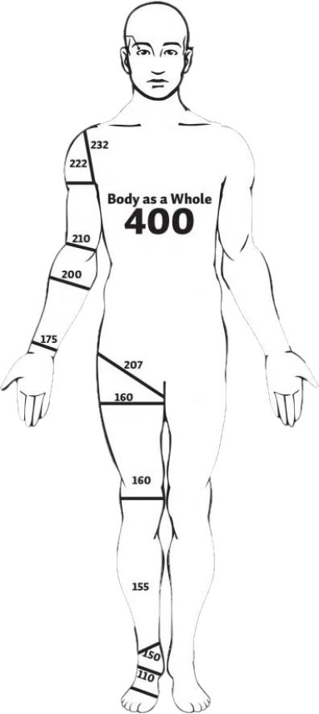
Permanent Partial Disability §287.190
PPD is “permanent in nature and partial in degree”
Demonstrated and certified by a physician
RATING not necessary if injury subject to lay understanding
“Where inconsistent or conflicting medical opinions exist, objective medical findings shall prevail over subjective medical findings.” §287.190.6 (2)
Schedule of Losses

Slide 38
How to Calculate Permanent Partial Disability
Leg at knee = 160
AWW = 600 doubloons
Rate = 400 doubloons
PPD = 100%
(plus 10% for severance)
160
x 110% = 176 weeks
176 weeks
x 400 =
74,400
Notes:
Look to the scheduled value
Determine % disability

Slide 39
Permanent Total Disability §287.020
Inability to return to any employment and not merely inability to return to the employment in which the employee was engaged at the time of the accident.
Interpreted as the inability of the employee to perform the usual duties of the employment under consideration, in the manner that such duties are customarily performed by the average person engaged in such employment.
Notes:
Two workers with the same back injury: Expectations for a 72-year-old housekeeper with an eighth grade education are different than those for a 28 year-old physicist and former college rowing champion.
Any Work (considering age, education, prior work experience and transferable work skills).
Nature of the injury must be considered;
4) Ability to compete for work in the open labor market must be considered;
5) Not all jobs are considered work in the open labor market;
6) Benefits are 2/3 of the employee’s average weekly wages up to the State Maximum;
7) Benefits terminate upon employee’s death or when he or she becomes able to return to the work force.

Slide 40
Permanent Total Disability §287.020
The test for permanent total disability is whether, given the employee’s situation and condition, he or she is competent to compete in the open labor market.
LIFETIME BENEFIT
Notes:
Two workers with the same back injury: Expectations for a 72-year-old housekeeper with an eighth grade education are different than those for a 28 year-old physicist and former college rowing champion.
Any Work (considering age, education, prior work experience and transferable work skills).
Nature of the injury must be considered;
4) Ability to compete for work in the open labor market must be considered;
5) Not all jobs are considered work in the open labor market;
6) Benefits are 2/3 of the employee’s average weekly wages up to the State Maximum;
7) Benefits terminate upon employee’s death or when he or she becomes able to return to the work force.

Slide 41
Penalties
Penalty Against Employer
Injury caused by ER’s failure to comply with any statute in this state or lawful order of DWC/LIRC
Benefit increased by 15%
Penalty Against EE
Failure to use safety device OR safety rule
EE had actual knowledge of rule
ER made a reasonable effort to cause EE to use device/follow rule
Benefit decreased 25-50%
Drug/Alcohol Policy Violation
Notes:
287.120. 4. Where the injury is caused by the failure of the employer to comply with any statute in this state or any lawful order of the division or the commission, the compensation and death benefit provided for under this chapter shall be increased fifteen percent.
287.120.5. Where the injury is caused by the failure of the employee to use safety devices where provided by the employer, or from the employee's failure to obey any reasonable rule adopted by the employer for the safety of employees, the compensation and death benefit provided for herein shall be reduced at least twenty-five but not more than fifty percent; provided, that it is shown that the employee had actual knowledge of the rule so adopted by the employer; and provided, further, that the employer had, prior to the injury, made a reasonable effort to cause his or her employees to use the safety device or devices and to obey or follow the rule so adopted for the safety of the employees.
287.120.6. (1) Where the employee fails to obey any rule or policy adopted by the employer relating to a drug-free workplace or the use of alcohol or nonprescribed controlled drugs in the workplace, the compensation and death benefit provided for herein shall be reduced fifty percent if the injury was sustained in conjunction with the use of alcohol or nonprescribed controlled drugs.
(2) If, however, the use of alcohol or nonprescribed controlled drugs in violation of the employer's rule or policy is the proximate cause of the injury, then the benefits or compensation otherwise payable under this chapter for death or disability shall be forfeited.
…
(4) Any positive test result for a nonprescribed controlled drug or the metabolites of such drug from an employee shall give rise to a rebuttable presumption, which may be rebutted by a preponderance of evidence, that the tested nonprescribed controlled drug was in the employee's system at the time of the accident or injury and that the injury was sustained in conjunction with the use of the tested nonprescribed controlled drug if:
(a) The initial testing was administered within twenty-four hours of the accident or injury;
(b) Notice was given to the employee of the test results within fourteen calendar days of the insurer or group self-insurer receiving actual notice of the confirmatory test results;
(c) The employee was given an opportunity to perform a second test upon the original sample; and
(d) The initial or any subsequent testing that forms the basis of the presumption was confirmed by mass spectrometry using generally accepted medical or forensic testing procedures.

Slide 42
Adjudication

Slide 43
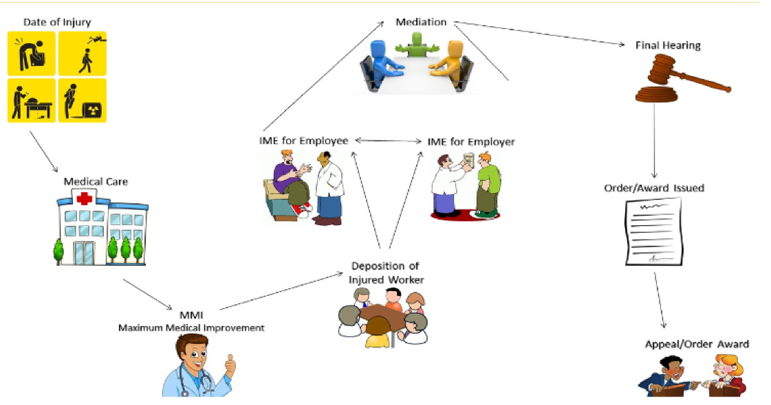
Settlement
Discovery/
Notes:
This is a typical pathway of a comp case

Slide 44
Settlement
Discovery/
Notes:
This is my favorite way for a case to move – the adjusters/employees/attorneys do all the work outside the DWC

Slide 45
Temp
Settlement
Discovery/

Slide 46
Settings at the DWC
Pre-Hearing
Status Call – email
Hardship PH – to resolve issues short of permanency (treatment, TTD, evidentiary issues)
ProSe (Conference or ProSe PH)
Mediation - Informal meetings held in person with an ALJ in order to facilitate a compromise settlement
Settlement of case only in some offices
Any issue that needs to be addressed by an ALJ to move the case along short of final compromise (Hardship Mediation) (See Hardship PH)
Notes:
Make sure you have the case assigned to an attorney, esp. with Pro Se cases
Make sure you have made a previous offer before starting a mediation
If you are the one with authority, be available if you have a case in mediation

Slide 47
Settings at the DWC
Extended Mediations – by request; special attention/additional time needed
Dismissal Docket – insufficient progress shown – ALJ’s discretion
Telephone Conferences - used in limited exigent circumstances to resolve issues
Settlement Days – multiple cases set with same ER/adjusters

Slide 48
Hearings at the DWC
Hearing - an evidentiary hearing on the record (a verbatim record is made for the reviewing tribunal)
Prerequisites
Attendance at a meaningful Mediation, all issues discussed
Completion of all discovery
Hardship Hearing - evidentiary hearing held before an ALJ when the EE alleges that he or she is not at MMI, is in need of medical treatment or entitled to TTD benefits, and the ER is not providing such treatment or benefits. Also, .203 Hearing for TTD ONLY.
Final Hearing -when the EE has reached MMI or the case is otherwise ready for final resolution.

Slide 49
Appeals
Labor and Industrial Relations Commission
3-person panel
Considers briefs and arguments, but does not take additional evidence
Affirms, reverses, and/or modifies the ALJ’s award
Can make different factual findings – “second bite at the apple”
Missouri Court of Appeals (rarely, the Missouri Supreme Court)
Considers Legal Issues Only
Transcript, brief, no new evidence
BEWARE OF DEADLINES! (20/30)

Slide 50
Settlement § 287.390
Compromise settlements are encouraged
Must be signed by an ALJ to be valid
Is the settlement the result of undue influence or fraud?
Does the EE fully understand his or her rights and benefits?
Does the EE voluntarily agree to accept the terms of the settlement agreement?

