Slide 1
The Perfect IME
Jennifer Y. Weller
Attorney/Partner
Vessell Bridges Murphy Law Offices
Lyndon Gross MD Phd
OrthoMissouri

Slide 2
Learning Objectives/Key Takeaways
Learn the behind the scenes of IMEs
What cases end up getting IMEs and why
What office prep and medical records are essential to “The Perfect IME”
What documentation an IME should include
What questions to ask in a cover letter

Slide 3
What is an IME?
“the evaluation of an injured party that utilizes a third party, independent medical professional to issue an unbiased opinion on the injury”
Often used in workers’ compensation and liability claims
No Physician/Patient relationship is formed
https://imecarecenter.com/a-comprehensive-independent-medical-exam-guide/

Slide 4
IME vs. DIRECTING MEDICAL TREATMENT:
What’s the difference?
§287.140 – . . . the employer shall provide such medical, surgical, chiropractic, and hospital treatment, including nursing, custodial, ambulance and medicines, as may be reasonably required after the injury or disability, to cure and relieve from the effects of the injury.
Take and maintain control of medical treatment.
Consult counsel for recommendations, even if not litigated.
Do NOT let employee seek treatment on their own i.e. do not “direct” them to go to their own doctor/primary care physician.
Be cautious with requesting medical causation opinions.

Slide 5
WHAT CASES END UP GETTING AN IME AND WHY?
Because the employer directs medical care, it can be more difficult to get an IME – why?
  Once a physician is chosen by the employer and “authorized”, then the employer is bound by the opinions and recommendations of that physician.
  Getting an IME because the employer is dissatisfied with the treating physician’s diagnosis or treatment recommendations, can be viewed as “doctor shopping”.
When is it appropriate to get an IME?
  Before treatment is authorized to address diagnosis and medical causation.
  If/when an employee “adds” injury to a new body part.
  If a second opinion is warranted (diagnosis, treatment, work status).
  If the treating physician refers to a specialist.

Slide 6

WHAT OFFICE PREP AND MEDICAL RECORDS ARE ESSENTIAL TO “THE PERFECT IME”
BEFORE IME
Office is contacted by third party companies or law firms.
Appointment is scheduled in a designated IME time slot by office staff
Records are requested to be in office 2 weeks in advance to appointment
Records are organized and sorted
Any missing records or imaging studies are requested
A predication of all the records in chronologic order is performed

Slide 7
WHAT OFFICE PREP AND MEDICAL RECORDS ARE ESSENTIAL TO “THE PERFECT IME”
Legal Perspective:
  All medical records and films to date
  Any prior, relevant medical records and films
  Investigation results:
    Details from employer on accident – factual information that may call into question the validity of the claim, information on outside activities/injuries
    Witness statements
    Employee recorded statement
    Video of accident/injury
    Employee deposition transcript
    Surveillance video
  Job description

Slide 8
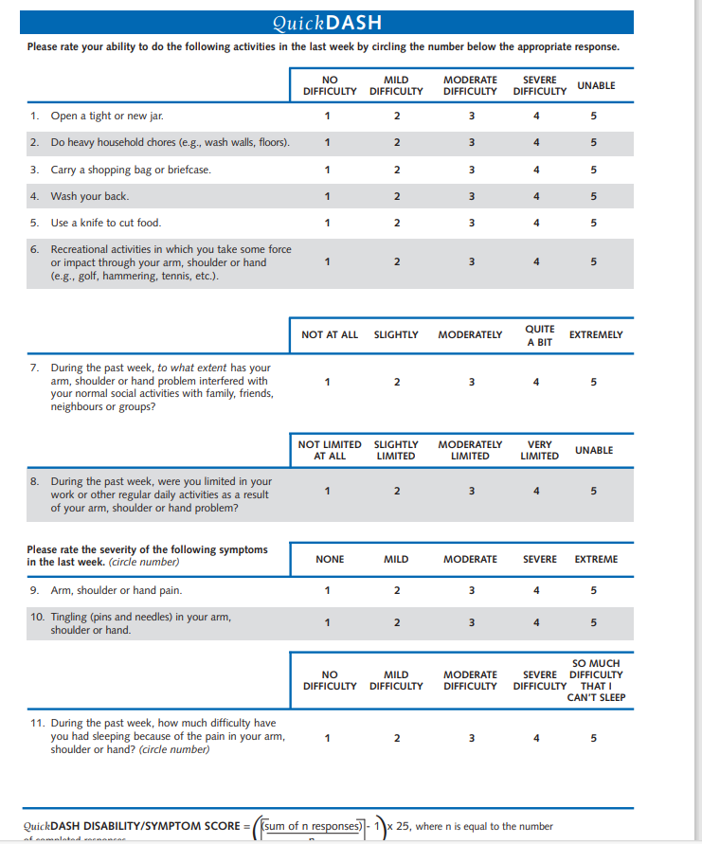
WHAT PHYSICAL EXAM AND DOCUMENTATION IS ESSENTIAL TO “THE PERFECT IME
DAY OF IME
A complete physical exam is performed
It is important to document the injured extremity and the contralateral if possible for comparison
Claimant's imaging studies are reviewed by provider only

Slide 9

WHAT DOCUMENTATION AN IME SHOULD INCLUDE
AFTER THE IME
Reports often include restrictions if needed as well as PPD ratings
Both Missouri and Illinois impairment ratings can be provided

Slide 10
WHAT DOCUMENTATION AN IME SHOULD INCLUDE
Legal Perspective:
  History of accident/injury provided by employee
  Reference to relevant, investigative information provided by employer/insurer/defense counsel
  Summary of any prior medical records with reference to any relevant past medical history, injury, treatment, surgery, and/or co-morbidities.
  Diagnosis of medical condition, if any
  Clear and concise opinion on medical causation with supporting explanation, if appropriate
  Treatment recommendations, if any
  Opinion on work status
  Disability rating, if appropriate

Slide 11
WHAT QUESTIONS TO ASK IN A COVER LETTER
Diagnosis
Medical causation
Treatment recommendations
MMI
PPD
Work status

Slide 12
WHAT QUESTIONS TO ASK IN A COVER LETTER
Example Questions
In your opinion, what is the diagnosis, if any, to (insert employee’s name) (insert injured body part)?
In your opinion, was the (insert injury date) injury the prevailing factor in the cause of any condition to his/her (insert injured body part)?
In your opinion, does (insert employee’s name) require any further evaluation and/or treatment to his/her (insert injury body part)? If so, what is the nature and anticipate length of said evaluation and/or treatment?
Does any recommended evaluation and/or treatment flow from the work injury on (insert injury date)?
If (insert employee’s name) does not require any further evaluation and/or treatment, has he/she reached maximum medical improvement for his/her (insert injured body part)?
If (insert employee’s name) is at MMI, has he/she sustained any permanent partial disability to his/her (insert body part)? If so, what is the percentage of that disability?
Does (insert employee’s name) require any restrictions on his/her activities as a result of the work injury on (insert injury date) ? If so, what is the nature and anticipated length of any restriction(s)?

Slide 13
QUESTIONS?
CONTACT US
JENNIFER WELLER
Vessell Bridges Murphy Law Offices
1715 Deer Tracks Trail, Suite 250
St. Louis, MO 63131
(573) 777-4488
jennifer.weller@vbmlaw.com
LYNDON GROSS
OrthoMissouri
11330 Olive Blvd, Unit 150
Creve Coeur, MO 63141
(314) 336-2566
teamgross@orthomo.com

